Slide 1
Warm Up #1
Review: Why can gasses like sulfur dioxide (SO₂), a gas found in both volcanic ash and industrial factories, be harmful to soil?
Review: What are the four layers of atmosphere and their functions?
Review: How does the temperature of an inner city compare to its surrounding suburbs? Why do you think there is such a temperature disparity?

Slide 2
Air Pollution

Slide 3
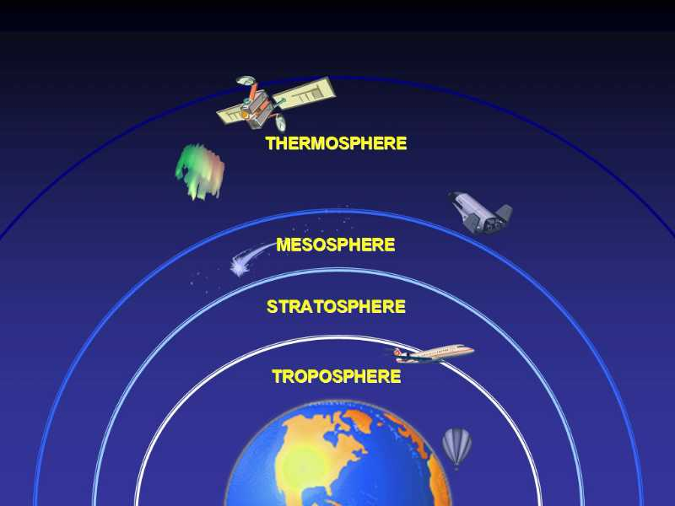
ATMOSPHERIC LAYERS
REALLY HOT
COLD, DESTROYS METEORS
CONTAINS O-ZONE LAYER
CONTAINS GREENHOUSE GASSES

Slide 4
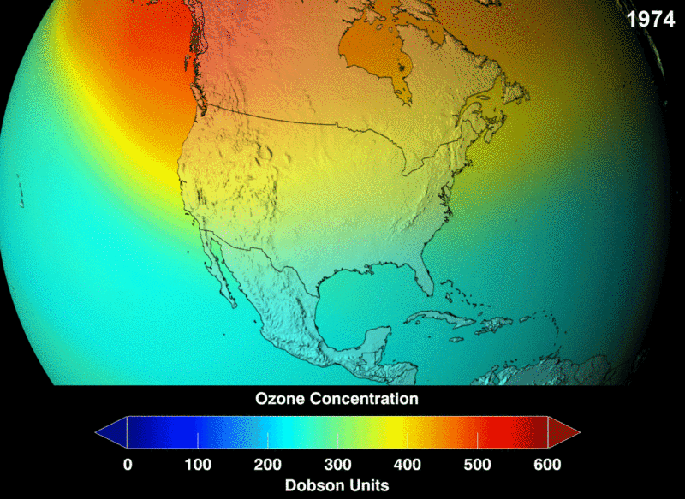
Stratosphere: Ozone Shield
Ozone Shield – filters UV radiation (sun)
Gasses Involved: Oxygen (O2) and Ozone (O3)
Humans Contribute: CFC’s, other carbon-based gasses
Effect: Ozone Depletion (polar regions)

Slide 5
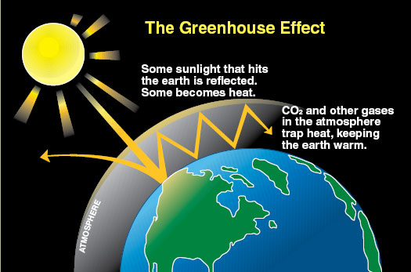
Troposphere: Greenhouse Effect
Troposphere – traps heat near Earth’s surface
Gasses: Water vapor (H₂O), CO₂, Methane (CH₄)
Humans Contribute: CO₂, Methane, CFC’s, N₂O (nitrous oxide)
Effect: Global Warming

Slide 6
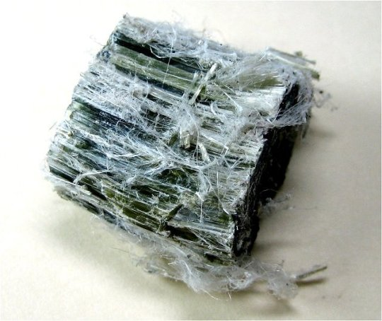
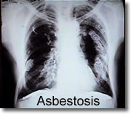
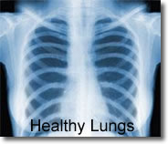
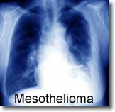
Asbestos
Form of PM_{2.5/10} – particulate matter (smoke, lead, soot, etc)
Problem in developing countries
Btwn 2.5 and 10 micrometers in size
Break down – microscopic (enter deep
in lungs)
Asymptomatic
10-40 year build-up
Asbestosis (lung scarring) and Mesothelioma (lung cancer)

Slide 7
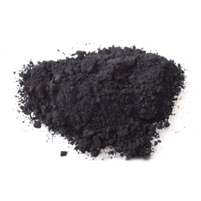
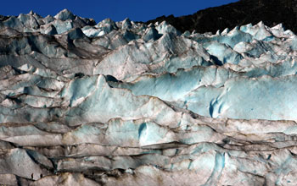
Black Carbon and Global Distillation
Black Carbon – tiny particles released from auto exhaust
Global Distillation – wind currents blowing carbon toward poles
Accumulation of black carbon over glaciers (more melting)

Slide 8
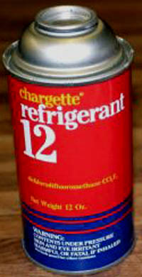
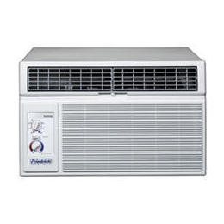
What are CFC’s?
CFC – Chlorofluorocarbons (chlorine, fluorine and carbon) – aka FREON.
Uses: air conditioning (car, buildings), Teflon (cookware)
+’s: Low flammability/reactivity with other substances
-’s: Long lifespan (damages Ozone layer bond w/sun exposure) – Antarctica
Montreal Protocol – no more CFCs

Slide 9
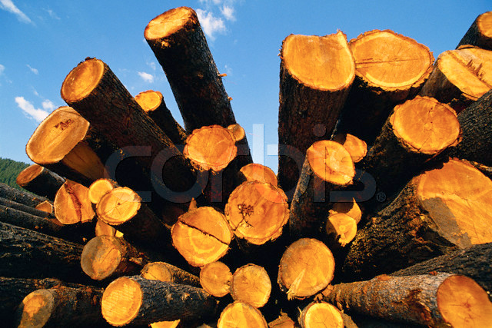
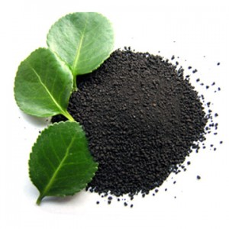
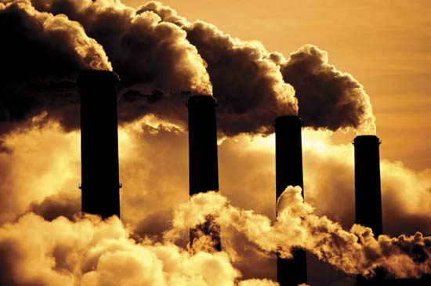
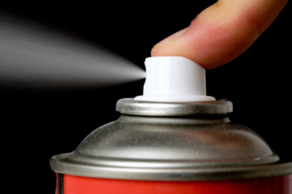
Other Contributors
CO_{x} (carbon dioxide) – fossil fuels, logging
NO_{x} (nitrogen dioxide) – fertilizers, fossil fuels
SO_{x} (Sulfur Dioxide) – coal/oil burning
VOC (volatile organic compounds ) – aerosol, paints, etc.

Slide 10
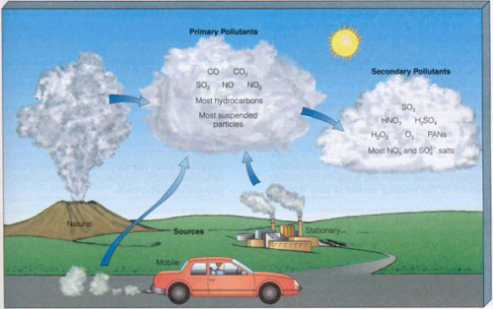
Types of Pollutants
Primary Pollutants – pollutants that INITIALLY rise into atmos.
Ex. SO₂
Secondary Pollutants – pollutants that form AFTER chemical reactions in atmos.
Ex. SO₃ (combines with O in atmos.)

Slide 11
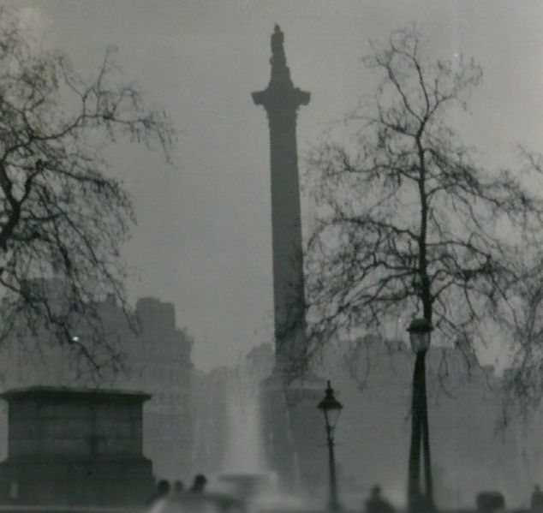
Auto Pollution: Smog
Smog – “smoky fog”
Two Types:
Industrial (factories) – sulfur or carbon-based
Photochemical (cars) – nitrogen-based
Influenced By:
Sunlight, population size, transportation, location

Slide 12
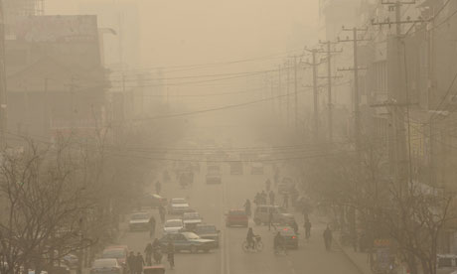
Smog Progress: Los Angeles
Morning Rush Hour – NO₂ builds
2NO + O₂ → 2NO₂
Afternoon Sun – NO₂ breaks down to form Ozone (O₃)
NO₂ + O₂ → NO + O₃
NO₂/NO = brown color

Slide 13
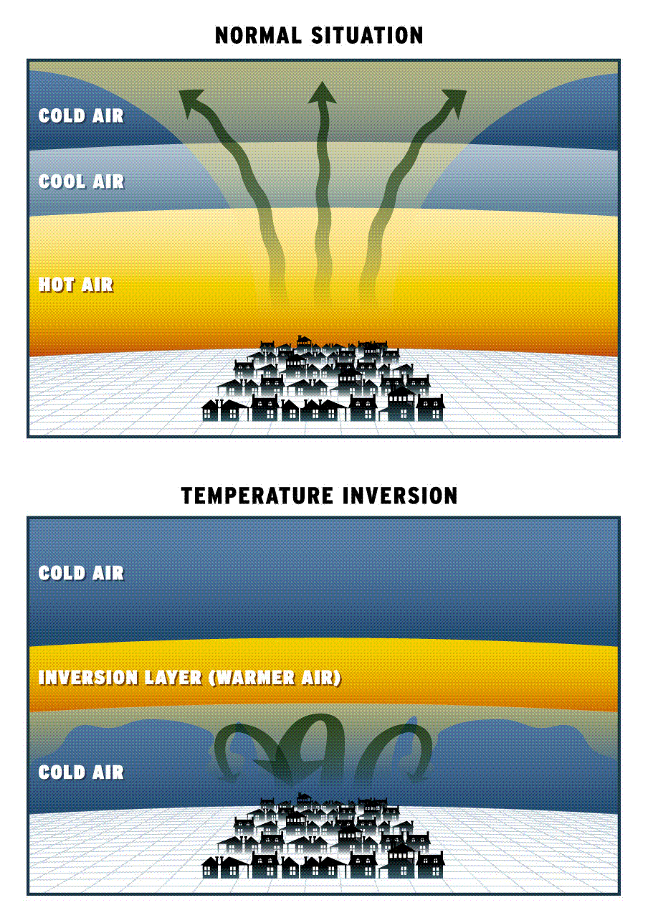
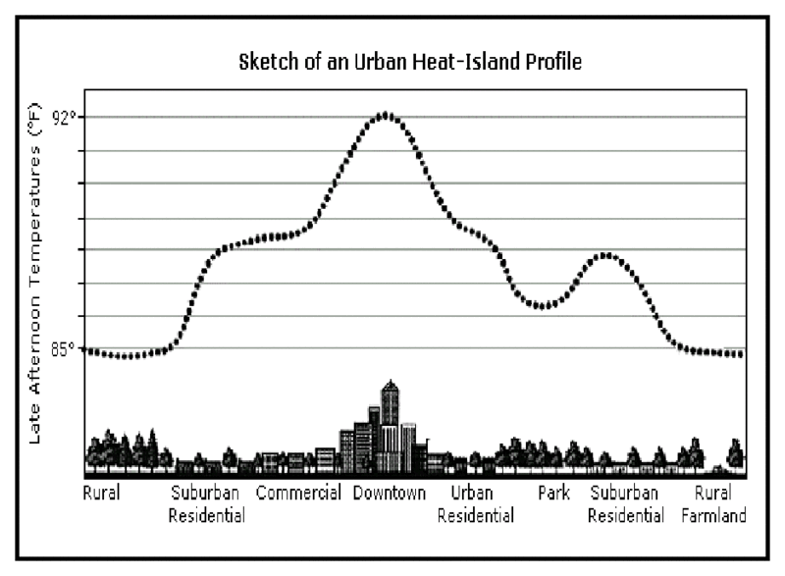
Effects of Smog
Normal: Hot air rises
With Smog:
Temp. Inversion – cool air trapped under warm air (no circulation) → valleys
Asthma, lung cancer,
Heat Islands (cities) – hotter temps than surrounding area
Weather changes, deaths

Slide 14
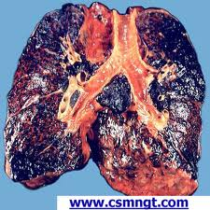
Contents of a Cigarette
Arsenic – rat poison
Carbon Monoxide (CO) – colorless, odorless
Harder for blood to carry oxygen
Nicotine – addictive
Radioactive substances
Cute
Not Cute

Slide 15
Marijuana (Cannabis)
Contains THC – chemical that induces the “high” (resembles dopamine → neurotransmitter)
Positives: Used for medicinal purposes (pain-relief for cancer/AIDS patients), helps cancer patients eat (induces the “munchies”)
Negatives: Illegal (recreationally), can lead to heart and psychological problems (including addiction, anxiety), and can lead to harder drugs (cocaine)

Slide 16
Warm Up # 2
Show one chemical reaction leading to the release of smog. Label Primary and Secondary pollutant, the chemical names of each compound (as well as their source), and what TYPE of smog you are creating.
Why does the sky appear brown in urban areas that contain smog? When is it most abundant and why?
Why do you think temperature inversions usually occur in valleys (describe the conditions of a valley that make it ideal)?

Slide 17
Common Household Pollution Sources
Car/fireplace – Carbon Monoxide
Bathroom – mold/bacteria
Cleaning supplies - ammonia
Walls – paint fumes (VOCs – formaldehyde), asbestos
Septic Pump- Radon (radioactive gas)

Slide 18
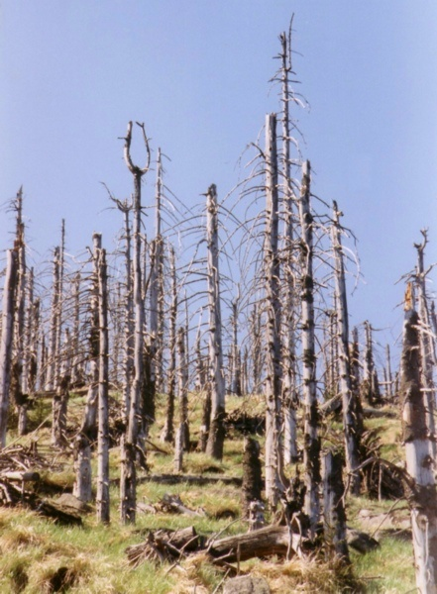
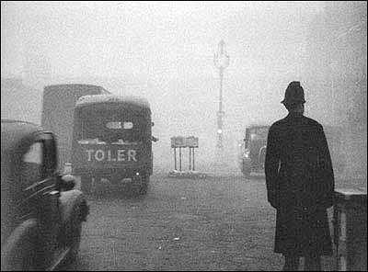
Air in London Sucks
Acid Rain – sulfuric and nitric acids
Normal Rain pH = 5.6
Acid Rain pH = approx. 4.5
Cause: Burning of fossil fuels (coal, oil, gas, etc)
Seeps into soil, contaminate water
London Fog (1952) – 4,000 dead, 100,000 hospitalized

Slide 19
Legislation
Clean Air Act – established standards for air pollution
Topics:
Motor vehicle emissions
Toxic pollutants
Acid rain
Ozone depletion
Problems:
PM₁₀ increase, clean up (not prevention), not strict enough

Slide 20
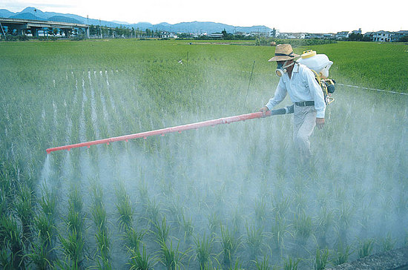
Pesticides Revisited
Pesticides – kills pests to preserve crops
Types:
Insecticide (kills insects)
Fungicide (kills fungi)
Rodenticide (kills rodents)
Herbicide (kills weeds/plants)
+ = preserves crops, food safety preserved
= water/air contamination → birth defects, expensive
Note: Nitrogen-based fertilizers NOT same pollutants as smog

Slide 21
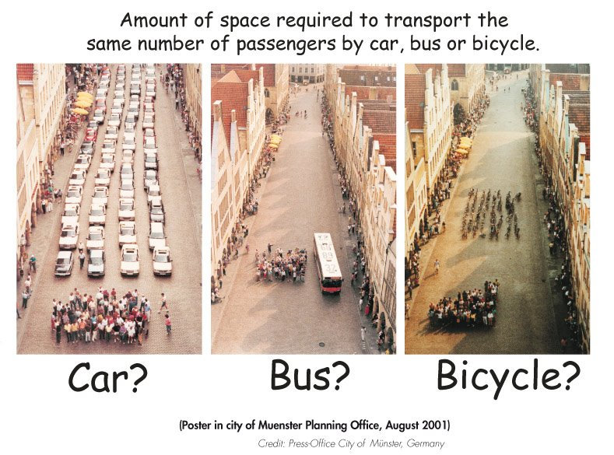
Possible Solutions
Mass Transit
Less fossil fuel emissions, less smog
Renewable Energy Funding
Less fossil fuels = less smog
Tax Incentives, not Penalties
Positive reinforcement
Less Pollutant substitutes
Less NO2

Slide 22
Not-so-Quick Quiz (2009 AP Exam)
(a) Support Councilwoman Smith’s statement that nitrogen-based fertilizers cause other environmental problems by describing one such problem.
(b) Identify a nitrogen-containing primary pollutant that contributes to the formation of photochemical smog. Describe how that primary pollutant forms and explain why Councilman Budd was wrong.
(c) Identify one secondary pollutant that is a component of photochemical smog and describe the following.
(i) How the secondary pollutant forms
(ii) ONE human health effect of the pollutant
(iii) ONE environmental effect of the pollutant
(d) Earth’s natural nitrogen cycle occurs in several steps. Describe one chemical transformation that occurs in the natural nitrogen cycle and discuss the importance of that transformation to an ecosystem.

Slide 23
Warm Up #
It has been observed that the emission of photochemical smog is approx. 50 kg of NO2 per year, per 100 humans.
Given a density of 500,000 humans per hectare in a city, calculate the amount of photochemical smog emitted, in kilograms, by humans inhabiting a 15,000 square meter city. (10,000 square meters = 1 hectare)
Show the chemical formula of NO2 in the atmosphere, including ALL appropriate labels for compounds.
If gasification costs $2 per kilogram, determine the cost in dollars, to clean up the exhaust of cars in this city? Additionally, describe what gasification does.

