Slide 1
Warm Up #1
How do you think tornadoes form?
Why is it better, on a hot day, to be on the first floor of a house rather than the second floor?
How are weather and climate the same? How are they different?

Slide 2
Warm Up #2
In “An Inconvenient Truth,” Al Gore briefly discussed the Greenhouse Effect. Explain in your own words what happens. (option: draw a picture of it)
How does CO₂ relate to temperatures? How are scientists able to know global temperatures hundreds of thousands of years ago?
How do the polar ice caps help regulate global temperatures? What is this called? (hint: ____ effect)

Slide 3
Warm Up #3
How does global warming affect the Alaskan oil industry?
Why do atmospheric CO₂ levels oscillate throughout the year? (why are they high in winter, and low in summer?)
Say you have a cup of water with an ice cube in it. When that ice cube melts, how do you think it will effect the water level in the cup? Why do you think so?

Slide 4
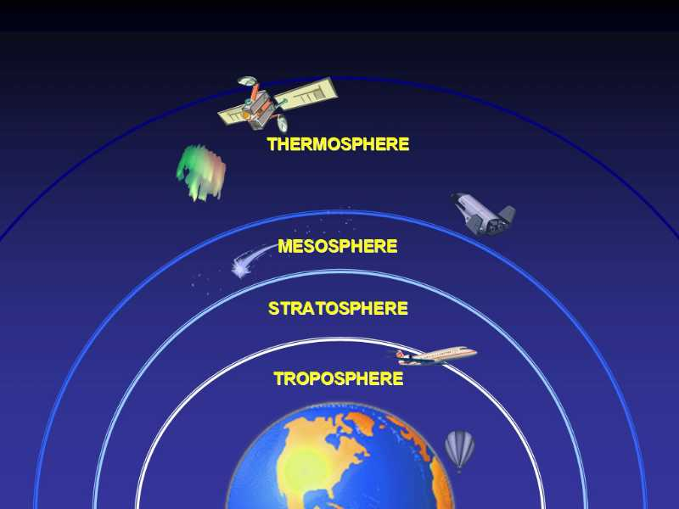
ATMOSPHERIC LAYERS
REALLY HOT
COLD, DESTROYS METEORS
CONTAINS O-ZONE LAYER
CONTAINS GREENHOUSE GASSES

Slide 5
Warm Up #3
Do you believe Global Warming is real, or do you think it is only a theory? Explain.
Why do we experience seasonal changes on Earth?
What is the difference between sea ice and land ice in how it affects the sea level?

Slide 6
Warm Up #4
What is the albedo effect (think wearing white in summer)? How is it an example of a positive feedback loop?
How do seasonal changes relate to CO2 levels?
Why could Europe ironically go into an ice age if global warming continues?

Slide 7
Global Warming
Chapter 19

Slide 8
Global Warming FAQ
What are greenhouse gasses?
Gasses keeping heat in (CO₂, CH₄, N₂0, CFCs)
Are greenhouse gasses bad?
No, they’re very important.
Why is global warming bad?
Weather, biodiversity, glaciers, disease, refugees

Slide 9
Greenhouse Effect
With Global Warming…
Layer of Gas = too thick
Too much heat kept in = too hot

Slide 10
Seasonal Changes: Correcting a Misconception
NO: how close Earth is to sun
YES: amount of direct sunlight
Earth on 23º Tilt
Summer = tilt TO the sun (more direct light)
Winter = tilt AWAY from sun (less direct light)

Slide 11
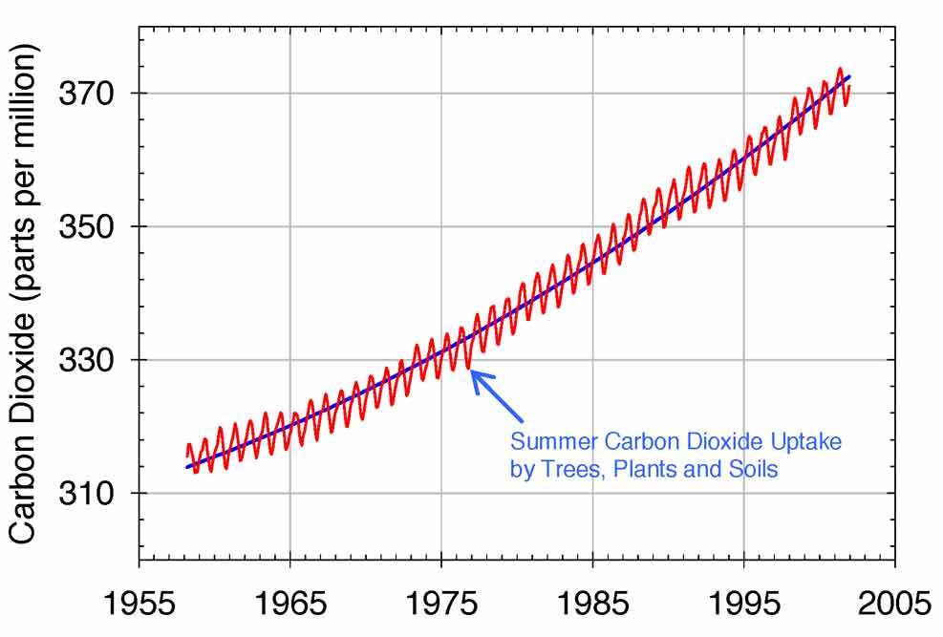
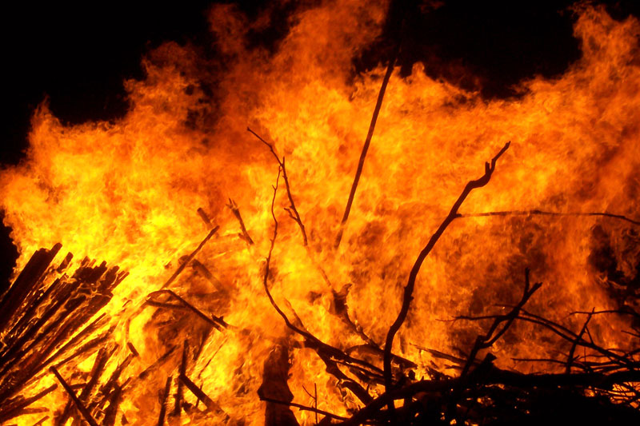
CO2 and Global Warming
CO2 = fossil fuels, fires
Goes up and down, but levels steadily increasing
Up and Down = plant growing season
Spring/Summer = low
Fall/Winter = high
Steady increase = human activity, fires, more humans

Slide 12
It’s Not Just CO2!
CH₄ (Methane) – landfills
N₂0 (Nitrous Oxide) – cars, aerosol
CFC (chlorofluorocarbons) – old A/Cs, aerosol
Can be in atmos. for a LONG time
Recovery = 100+ years!

Slide 13
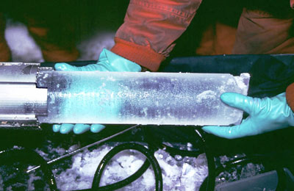
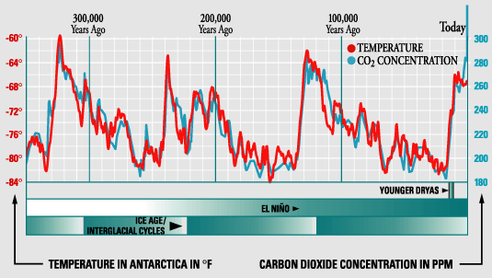
Measuring the Destruction
Ice Core Samples – measure CO2 levels and temp.
650,000 years of data
Number of small temp. changes
Past 50 years = RAPID increase in CO2

Slide 14
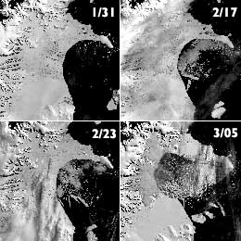
Ice Regulates Temperature, Too!
Ice (white)
Reflects light (albedo)
As ice melts, less albedo, temps rise
Liquid water – breaks up ice sheets
Larsen B Shelf (2002)

Slide 15
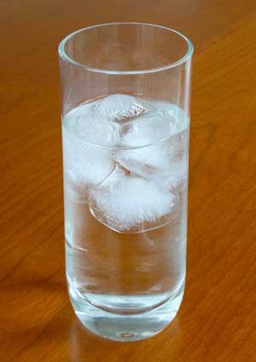
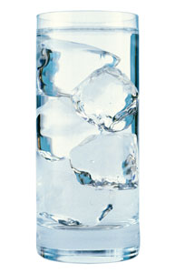
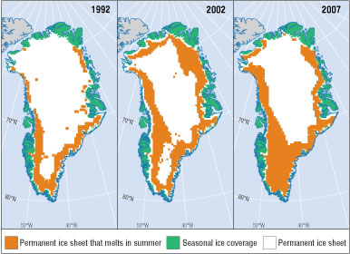
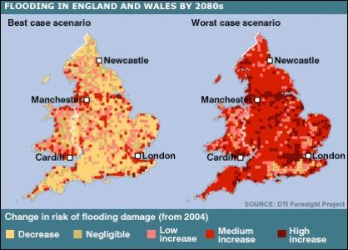
Sea Ice and Land Ice
Sea Ice = ice floating in sea
ice cube floating in water
Does NOT raise sea level
Less sunlight reflected
Land Ice = ice attached to land (Greenland, Antarctica)
Stack of ice cubes
DOES raise sea level

Slide 16
The Ocean Conveyor Belt
Thermohaline Circulation
Warm, less salty water up to Europe
Cold, salty water down to S.A., Africa, Asia
Oceans absorb CO₂ from atmos via mixing (good)
Warming = less mixing = no conveyor belt
Europe = Ice Age

Slide 17
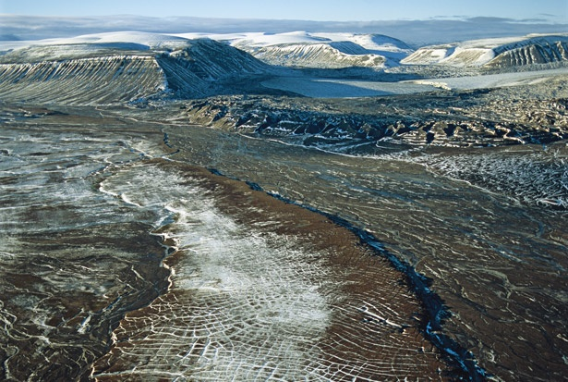
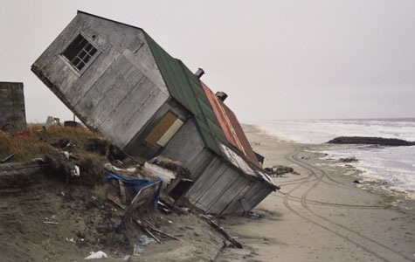
Permafrost
Permafrost – layer of soil permanently frozen (tundra)
Traps methane (greenhouse gas)
Global warming = p.frost thaws
release of methane
residential destruction
oil access = limited

Slide 18
Quick Quiz #2
Give two examples of how carbon is taken out of the atmosphere.
What is permafrost, and why is it a danger to global warming?
How can ice core samples be a helpful resource to people who study climate change?

Slide 19
Warm Up # 6
Year | 1970 | 1975 | 1980 | 1985 | 1990 | 1995 | 2000 | 2005
CO_{2 (ppm)} | 317 | 326 | 334 | 360 | 375 | 387 | 399 | 405
Temp. Change (ºC) | .15 | .05 | .32 | .08 | .33 | .47 | .24 | .45
Draw a graph using the information given above (you will need 2 Y-axes)
Draw a best fit line for temperature. What seems to be the trend as CO2 levels rise?
Do you think these levels will continue to rise forever? If not, what do you think will eventually have to happen?

Slide 20
Global Warming Continued

Slide 21
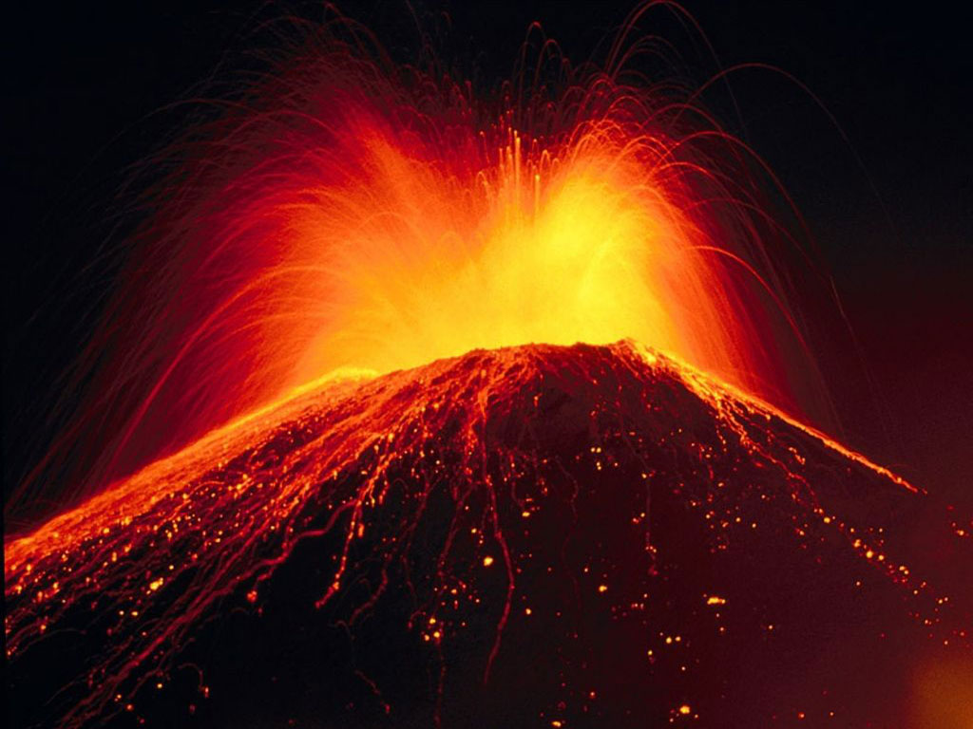
Carbon Cycle
CO₂ OUT of atmosphere:
Dissolved in oceans (diffusion)
Photosynthesis
Dead matter – fossil fuels
CO₂ INTO atmosphere:
Combustion (industry) / volcanoes / fires
Consumers exhaling
Oceans release CO₂

Slide 22
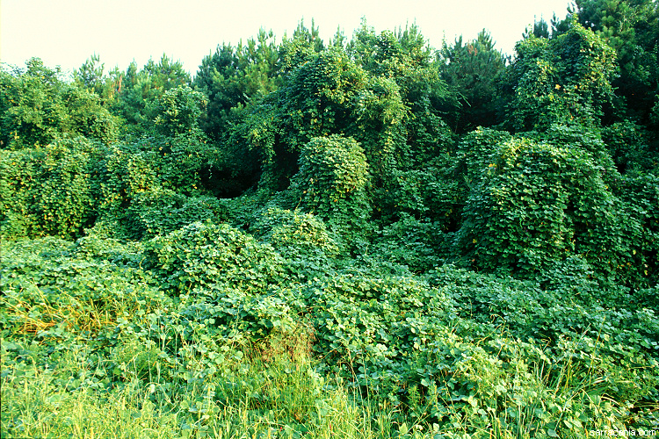
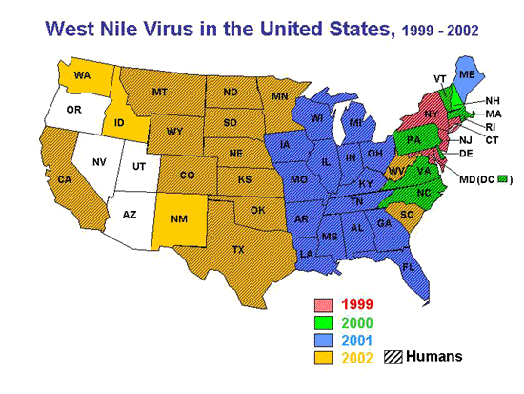
Global Warming Hurts Wildlife
Ocean = more acidic
More CO₂ = lower pH
Invasive species / parasites / disease
30 “new” diseases
65% world at risk for these diseases
Extinction rates = 1000x higher

Slide 23
Example
Warm temps = caterpillars come earlier (food)
More living caterpillars = more invasive species to eat them

