Slide 1
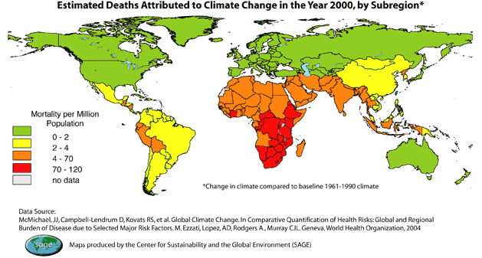
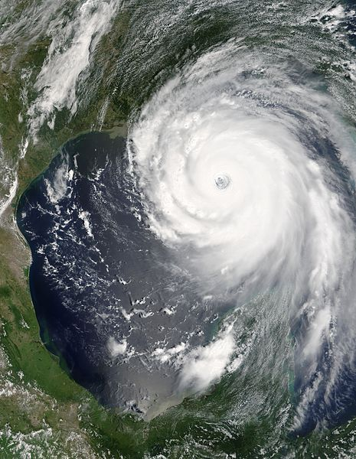
Global Warming Hurts Humans
Warm temps and disease
Warm temps and flooding/extreme weather
Warm temps and refugees
Warm temps and water dependency (glaciers)

Slide 2
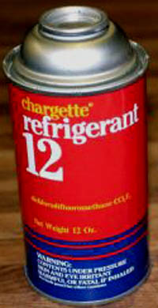
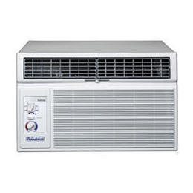
What are CFC’s?
CFC – Chlorofluorocarbons (chlorine, fluorine and carbon) – aka FREON.
Uses: fire extinguishers (WWII), air conditioning (car, buildings), Teflon (cookware)
+’s: Low flammability/reactivity with other substances
-’s: Long lifespan (damages Ozone layer bond w/sun exposure) – Antarctica

Slide 3
THE CFC PROBLEM: PICTURED

Slide 4
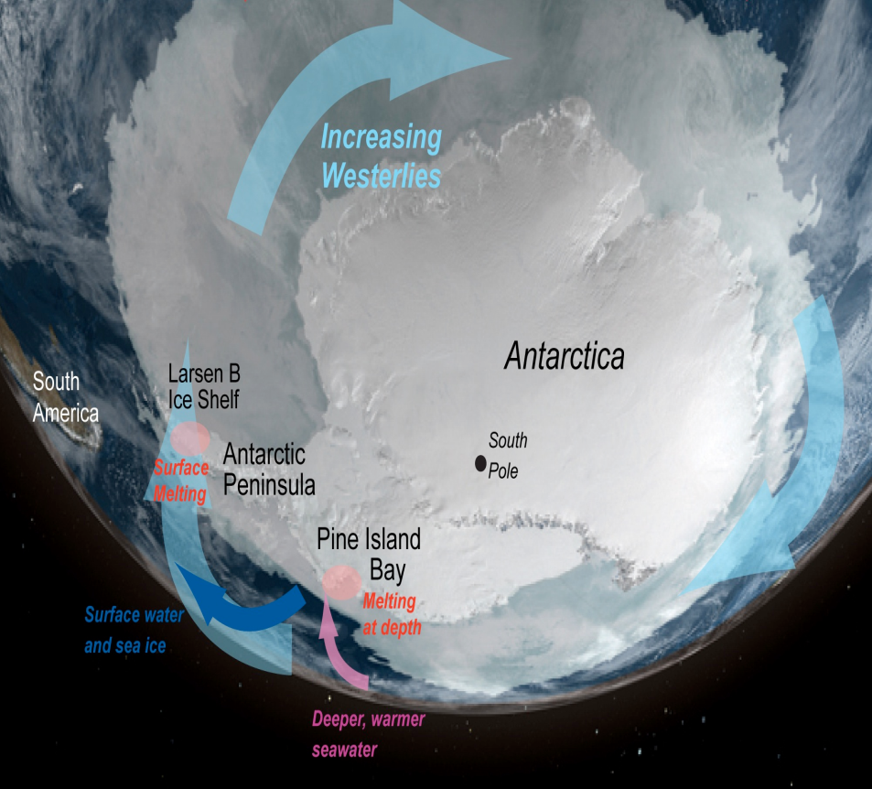
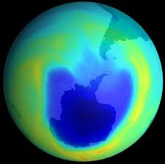
Why an Ozone Hole in Antarctica?
Answer: Freezing, windy conditions + sunlight
Polar Vortex Winds - capture CFCs / G.H. gases in winter
Clouds form, trapping gas (slow moving)
Sunlight = ozone death
A normal process, but now too much ozone loss

Slide 5
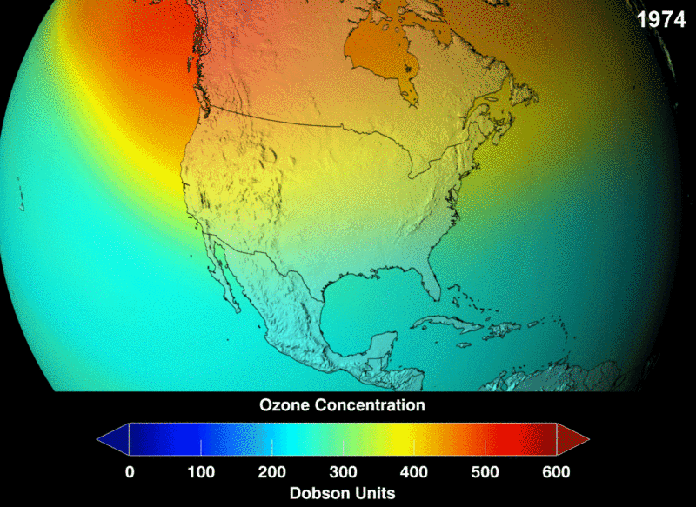
Ozone and CFCs
Ozone (O3) – in stratosphere
Keeps UV rays out
CFC problem – chlorine breaks down O3
More UV rays = more skin cancer
Montreal Protocol – no more CFCs (1970s)
Vortex Winds – hole over Antarctica

Slide 6
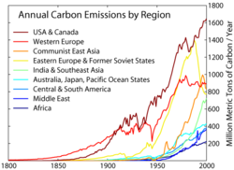
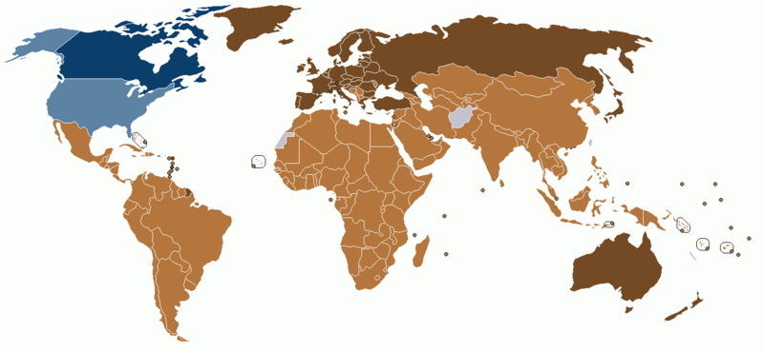
Kyoto Protocol (1997)
Conference to reduce carbon emissions GLOBALLY
Montreal Protocol – CFCs
Pre-1990 levels by 2012
US & Canada– NOT on board (only countries)

Slide 7
Warm Up #7
Year | 1970 | 1975 | 1980 | 1985 | 1990 | 1995 | 2000 | 2005 | 2010
Summer | 317 | 326 | 334 | 360 | 375 | 387 | 399 | 405 | 416
Winter | 330 | 341 | 365 | 382 | 394 | 401 | 414 | 422 | 436
Construct a line graph using the following info.:
Why are CO₂ levels lower in the summer than they are in the winter?
Draw a line of best fit. What seems to be the general trend of CO₂? How does this affect temperature?

Slide 8
Ecological Footprint
How Many Earths Does Your Lifestyle Need?

Slide 9
What is an Ecological Footprint?
Human demand for Earth’s resources compared to Earth’s regeneration capacity
Measured in global hectares/human capita (approx 2.1 global hectares/capita = 1 earth)
Humanity Average: 1.3 Earths
On avg. humans use Earth’s resources 1.3x faster than Earth can renew them
US Average: 5-6 EARTHS!!

Slide 10
Ecological Footprint by Country

Slide 11
Places like United States (500 million people) = HUGE ecological footprint
BUT India and China (1 billion people each) = SMALL ecological footprint
Why is there such a big difference??

Slide 12
Take Out a Sheet of Paper…
Places like United States (500 million people) = HUGE ecological footprint
BUT India and China (1 billion people each) = SMALL ecological footprint
Why is there such a big difference??

Slide 13
MyFootprint.org
www.myfootprint.org
“Green” non-profit non-governmental organization (NGO)
Quiz designed to measure individual ecological footprint based on where you live and the lifestyle you lead
How often you use water, drive, use electricity, etc.

Slide 14
What Can We Do to Reduce Ours?
In your tables, come up with strategies to reduce your own ecological footprints.
What methods of transportation? How often?
Recycle habits?
Spending habits?
Water use habits?
Use of power - gas, electricity, light sources?

Slide 15
Global Warming Review Slides

Slide 16
Global Warming and Gases
Greenhouse Effect – too thick (troposphere)
Too much heat trapped
CO2 (fires, exhaling, fossil fuels) , CH4 (landfills) , N20 (cars), CFCs (aerosol, A/Cs)
Carbon Cycle (oceans, plants/animals, volcanoes, dead matter)

Slide 17
Global Warming and Ice
Albedo Effect – ice reflects sunlight
Positive Feedback Loop
Sea Ice vs. Land Ice
Greenland (land) = 20 ft. increase in sea level
Glaciers melting (water supply)
Permafrost – frozen soil layer
Release methane, damage houses, access to oil

Slide 18
Global Warming and Life (Death)
Extreme Weather (hurricanes, tornadoes)
Disease (mosquitos)
Extinctions (generalist species)
Refugees (sea level rising)
Thermohaline Circulation (ocean conveyor belt)
Warm, shallow, less salty water
Cold, deep, salty water

Slide 19
Measurements and Solutions?
CO₂ levels
High in winter, low in summer…but rising on avg.
Ice Core Samples
Some warming and cooling periods
Kyoto Protocol (1997) – reduce G.H. gas emissions
US not involved (economic reasons)

Slide 20
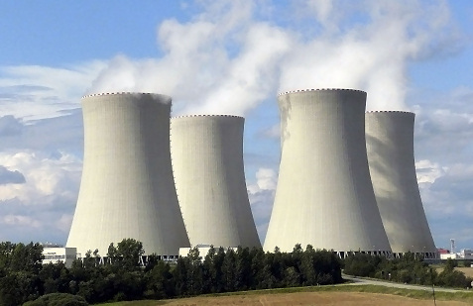
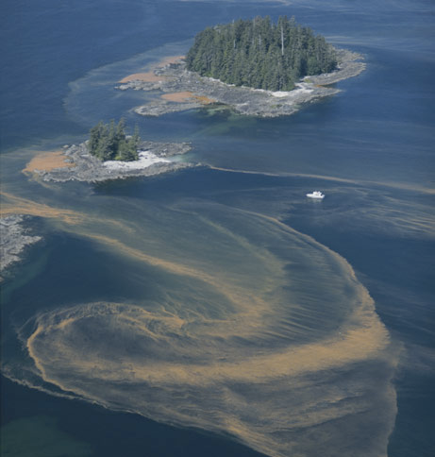
Other Solutions?
Natural Gas?
Nuclear Power?
Iron to Oceans?
Carbon Tax?

