Slide 1
Warm Up #2
Wetlands were once considered to be wastelands. Over 50 percent of the United States original wetlands have been destroyed.
(a) Describe TWO characteristics that are used by scientists to define an area as a wetland.
(b) Wetlands are highly productive ecosystems with complex food webs.
(i) Complete the diagram of the wetland food web below by drawing arrows that show the direction of energy flow.
FISH SNAIL ALGAE EAGLE
(ii) Explain why it takes many hectares of wetland to support a pair of eagles.
(c) Describe TWO economic benefits (other than those related to water quality) that wetlands provide.
(d) Describe one specific human activity that degrades wetlands.
(e) There isn’t really much of a seating chart anymore…so why do you sit in the same seat you always do (except you, Kyle. You go, Kyle).

Slide 2
Competition

Slide 3
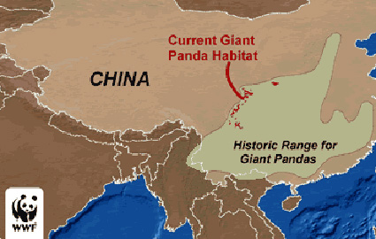
Laying the Land
Niche – conditions a species needs in order to survive and reproduce in an ecosystem
Conditions = physical (temperature) and chemical (salinity, acidity)
IMPORTANT to study:
Human impact effects
Species interaction
Extinction rates

Slide 4
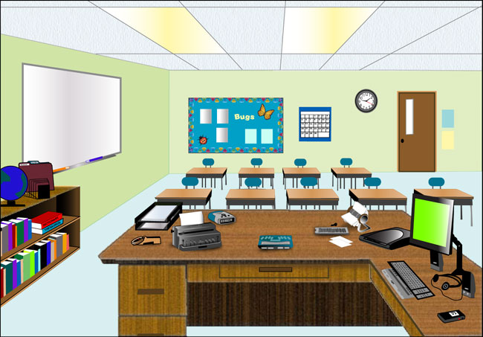
The Lockett Niche
In our class, 36 desks
Fundamental Niche – full range of resources and conditions a species can use
You can sit at ANY desk
Realized Niche – the resources of the fundamental niche a species TENDS to use
The desk you normally sit at
Why? Competition for resources

Slide 5
Habitat vs. Niche
Niche – how organism interacts with limited resources available to them
It’s role in the ecosystem
Ex. DESKS
Habitat – actual location of where the organism lives
Where it lives in the ecosystem
Ex. CLASSROOM

Slide 6
Question to Ponder…
The Giant Panda, which lives in China and eats only bamboo, is on the verge of extinction due to a variety of factors.
How are humans contributing to the Panda’s extinction?
How are other animals contributing to the Panda’s extinction?
How is the Panda contributing to its own extinction?

Slide 7
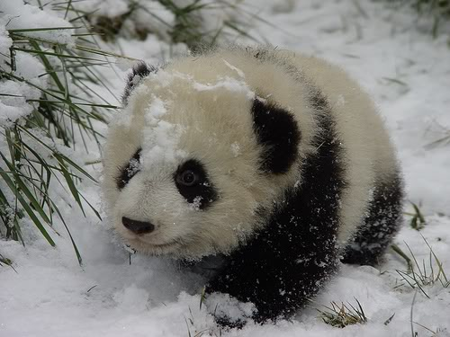
Other threats to the Cuteness
Non-Native Species – species introduced to a niche by humans
Competition for resources (food, light, shelter, etc)
Non-Native species usually more Generalist (can tolerate more)
WHAT’S A PANDA TO DO??

Slide 8
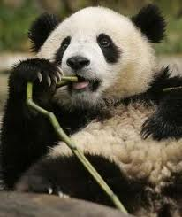
Why the Panda is killing itself
Generalist species – can survive in a large variety of niches (flies, cockroaches, mice, etc)
Specialist species – can only survive in a very particular niche/environment (Panda)
Less tolerant = less likely you are to survive

Slide 9
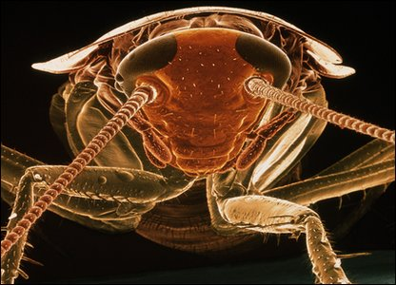
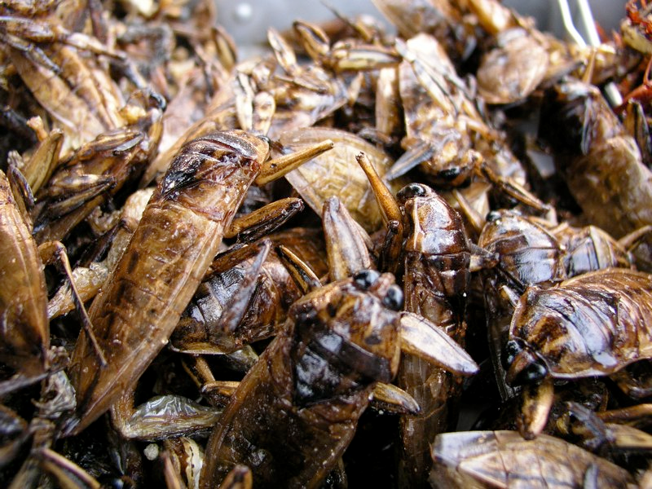
The Grossness of the Cockroach
Literally eats anything (including electrical cords and glue)
Can breed anywhere (except polar regions)
1 cockroach → 10 million babies in one year.
One species can survive frozen for 48 hours
Can survive nuclear bomb

Slide 10
Adaptation Strategy Plan A
Scenario: Non-native species thrive in cold and moderate temperatures
Directional Selection – reproductive rates better on one side of curve than other
Solution: You learn to love the heat

Slide 11
Adaptation Strategy Plan B
Scenario: Non-native species loves either really hot or really cold climates
Stabilizing Selection – highest reproduction = center of curve
Solution: You, as a cute panda, adapt to living in moderate climates

Slide 12
Adaptation Plan C
Scenario: Non-native species thrives in moderate temperatures
Disruptive Selection – high reproduction at BOTH extremes
Solution: You either get a jacket or embrace sweating

Slide 13
Adaptation to a Competitor

