Slide 1
Warm Up #4
Ultimately, what is any organism’s goal? What is the biggest threat to this goal they have?
How would mainland species compare to those of island locations? How would this be an example of geographic isolation?
Nemo is a cute saltwater clownfish. A competitive (and not as cute) fish species thrives in moderate levels of salinity. Show, using a bell curve, show how Nemo would respond to this invasive species. What type of selection is this?
I personally believe that humans are neither innately good nor evil, but instead innately selfish. Where do you stand on this issue? Provide any personal testimony/opinion you have to support your argument.

Slide 2
Warm Up #5
In a hypothetical world, a coral species thrives in moderate levels of salinity. There are two competing coral species, one that thrives in low salinity levels, and another thriving in high salinity levels. How will the original coral species adapt in order to survive?
What types of organisms do you think existed when life on Earth began? Why do you think so (what traits would these organisms need to have?)
Why would humans not have made the cut of organisms to BEGIN life?
How can a specific niche influence the traits you possess? Use Darwin’s finches as an example.
How can the size of a population influence the traits you possess?

Slide 3
Ecological Succession

Slide 4
Ecological Succession
Ecological Succession – gradual, predictable changes in species composition
Primary – establishing life where life NEVER existed
Secondary – RE-establishing life after a disaster

Slide 5
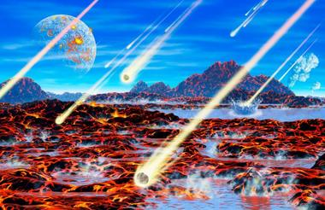
When the World was Young
Atmosphere:
Hydrogen CYANIDE
Carbon MONOXIDE
Hydrogen SULFIDE
Earth Cools (water)
Miller-Urey Experiment – organic matter from gasses of Earth
Asteroids → Archaebacteria

Slide 6
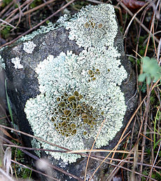
Primary Succession Steps
Pioneer Species – first species to inhabit area (ballers)
Lichens (fungi + algae)
FORMS SOIL
Early Successional – small life forms, generalists
Mid Successional – larger, more specific life
Late Successional – larger, diverse species
Wilderness – most diverse, large species

Slide 7
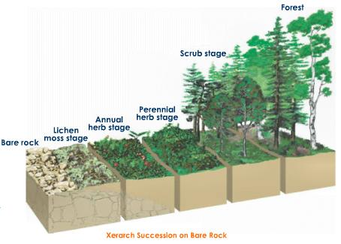
Plant Evolution During Succession
Early – reproduce quickly, close to ground, survive harsh conditions (facilitation)
Lichens
Mid – less hardy plants, larger, reproduce slowly, need more soil (inhibition)
Shrubs, grasses
Late – larger, slow reproducing, very stable (tolerance)
Trees

Slide 8
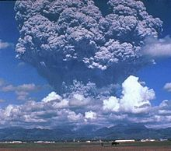
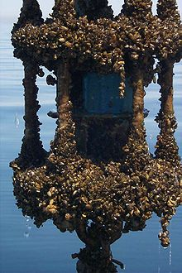
Secondary Succession – Starting Over
Catastrophic – sudden change in ecosystem
Natural – disease, flood, volcanic eruption
Human Caused – toxic waste, overgrazing, urbanization
Gradual – slow, steady change in ecosystem
Natural – climate change, evolution
Human Caused – soil/air pollution, “pest” elimination, non-native species

Slide 9
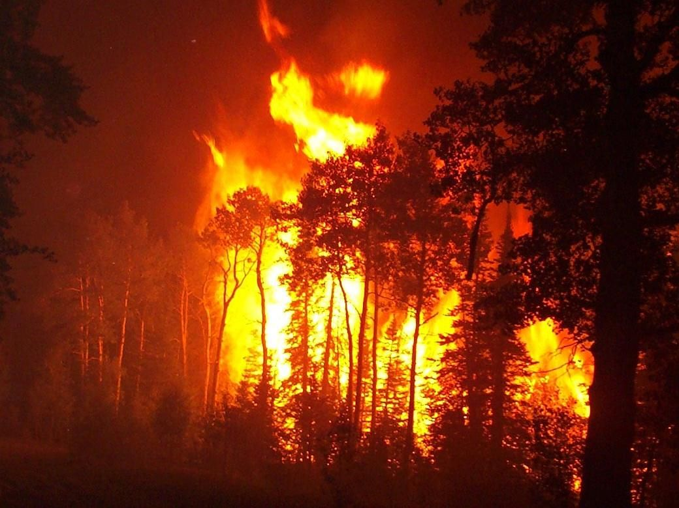
Fire…It’s Complicated, Okay.
Fire = thought of as bad
Wipes out entire ecosystems if uncontrolled
CONTROLLED fires = a good thing (Yosemite)
Prevents build up of flammable shrubs, allows trees to germinate
Grassland vs. Temperate Forest

Slide 10
Aftermath: Population Zero Succession After Humans
Trailer: https://www.youtube.com/watch?v=69-ARLAhpIQ
Clip: https://www.youtube.com/watch?v=Rh-lqtxZisA
Full Movie: https://www.youtube.com/watch?v=XHoOG4eKzbM

