Slide 1
Warm Up #1
How do producers in the euphotic zones of aquatic biomes obtain energy? How does that affect the amount of dissolved oxygen in this particular zone? Why?
For those producers living in the ________ zone, where it is completely dark, how do these species obtain energy? What specific compounds do they use, and where do they come from?
Review: what are the two major laws of Thermodynamics? How do you think that applies to the food we eat?

Slide 2
Energy Flow Within an Ecosystem

Slide 3
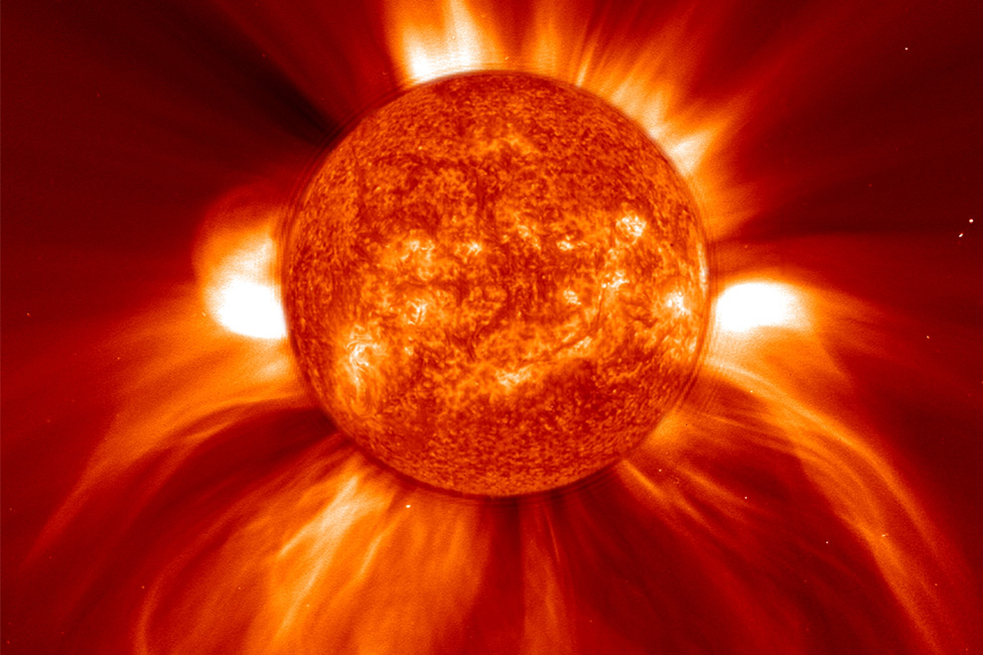
Here Comes the Sun…
THE SUN
Main energy source for life on Earth
Makes energy → Nuclear Fusion
4 hydrogen atoms → 1 helium atom + ENERGY
Other Energy Source: Chemical Compounds
Found underground/in VERY deep water

Slide 4
Review: Photosynthesis
Producers – make their own energy (Autotrophs)
Photosynthesis Equation:
H₂0 + CO₂ + Light Energy → Glucose and Oxygen
Light MUST BE present
What about when NO light is present?

Slide 5
Chemosynthesis: Extreme Circumstances
Typically used by remotely-located bacteria (volcanoes, hot springs)
No light present
CO₂ + H₂0 + Sulfide Compounds + Chem Energy → Carbs

Slide 6
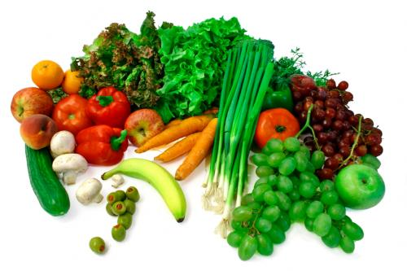
CONSUMERS
Also known as Heterotrophs – obtain energy from other organisms
Types:
Herbivores – Eat only plants (cows)
Carnivores – Eat only animals (dogs)
Omnivores – Eat both plants and animals (humans)
Detritivores/Decomposers - Eat dead organic matter (earthworms, fungi)

Slide 7
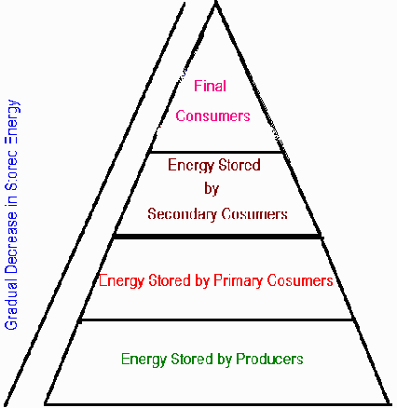
Feeding Relationships
Energy Flow = ONE DIRECTION!
Different levels = Trophic Levels
Sun/Inorganic Compounds → Autotrophs → Heterotrophs
OR
Sun → Producers → Consumers

Slide 8
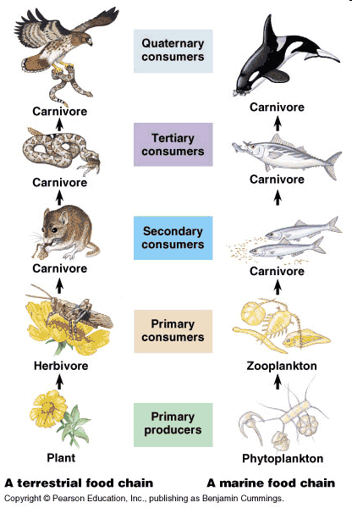
Two Types
Food Chain – A series of steps in which organisms transfer energy by eating and being eaten
Food Web – A feeding network of complex interactions among various organisms
More Realistic!

Slide 9
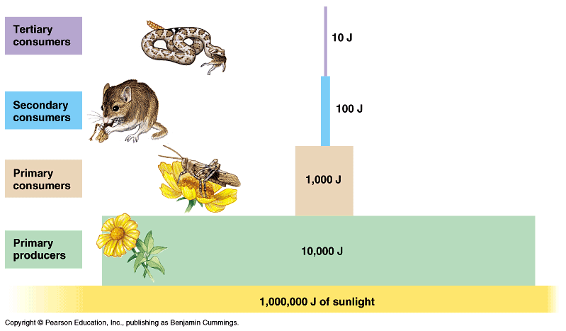
Energy Pyramid
Ecological Efficiency - % of energy available at each trophic level
90% of energy lost going up trophic level!!
Biomass – Amount of living tissue within trophic level
98.8% of energy from sun is NOT used

Slide 10
Should We Be Vegetarians?
Herbivores = Vegetarians
Vegetarians eat 90% more biomass than meat eaters
Grasshoppers, Humans and Frogs (Oh my!)
1 %
10 %
Vegetarian
100% available energy

Slide 11
Quick Quiz #1
As you go up each trophic level, 90% of the energy in the previous trophic level is lost. Where is this energy going? Is this an ecologically efficient process?
Under what circumstances would an autotrophic organism use chemosynthesis rather than photosynthesis? Give an example of a location that requires chemosynthesis.
You are in a forest, in which there are four major organisms: SEQUOIA TREE, SQUIRREL, RABBIT, and OWL. Construct a food web showing the relationships you see. Labeling the producers, primary consumers and secondary consumers (along with what percentage of energy they are getting)

