Slide 1
Warm Up #4
Environmental conditions in coastal estuaries vary greatly.
Discuss TWO important causes for the variation in temperature and/or salinity of an estuary. Explain how your cause is related.
Discuss TWO roles that coastal wetlands play that are ecologically important, and TWO that are economically important.
Identify and describe THREE ways human have negatively impacted wetlands.
Oysters are very temperature sensitive. Between 20-30ºC, the organisms are able to live, but oysters can no longer live outside of this range. Show this information in a graph.
What environmental law could be implemented to protect these ecotones? Explain why.

Slide 2
Aquatic Biomes
Part 2: Freshwater Biomes

Slide 3
Freshwater?
Salinity = less than 1% water by volume
Major Biomes:
Lakes
Formed via earthquakes, volcanoes, glaciation
Streams
Rivers
Wetlands

Slide 4
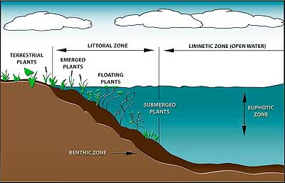
Lake Zones – Part 1
Littoral – shallow area near shore
Most productive zone (plants, sunlight)
Limnetic – topmost layer of water
Sunlight, small fish/plankton

Slide 5
Lake Zones – Part 2
Profundal – deep, cold water
No photosynthesis, larger fish
Benthic – lake floor
Mostly decomposers

Slide 6
Warm Up # 9
A species of coral functions optimally between the temperatures of 20ºC and 25ºC. Express this in a limiting factor bell curve, and describe this curve, using important vocabulary.
Draw a lake, and represent the four major zones, providing brief descriptions of each zone.
What is the difference between a scavenger and a decomposer? What do they have in common?
Sometimes lake are crystal clear, and other times really murky and brown…why do you think certain lakes look clear while others look brown?

Slide 7
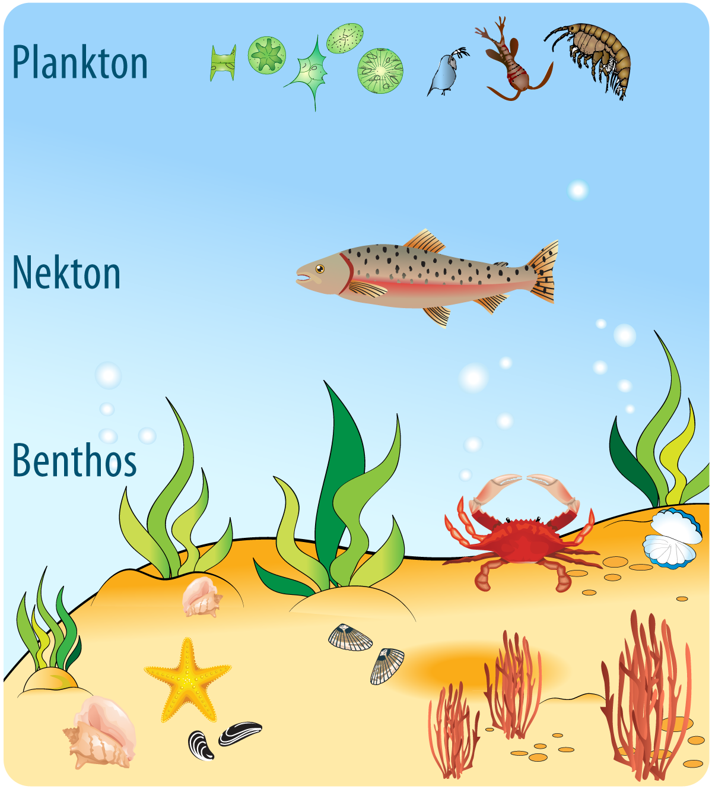
Organisms in Marine Biomes
Plankton – producers (algae, plankton)
Nekton – free-swimming fish (consumers)
Benthos – bottom-dwellers (scavengers and decomposers)

Slide 8
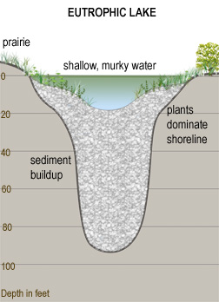
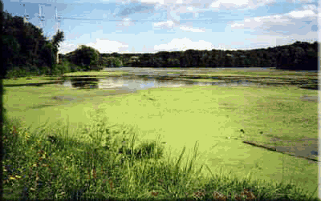
Eutrophic Lake
Eutrophic – nutrient rich
Shallow
Gentle sloped shores
Wide littoral zone
Dense fish populations
Murky brown (nutrients)

Slide 9
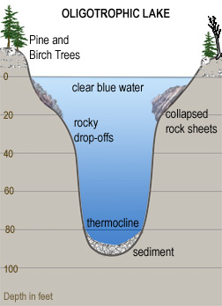
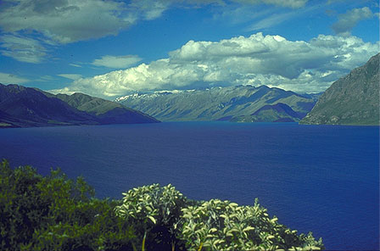
Oligotrophic Lake
Oligotrophic – nutrient-poor
Deep
Steep sloped shore
Clear blue (nutrient poor indicator)
Narrow littoral zone
Low fish/plankton concentrations

Slide 10
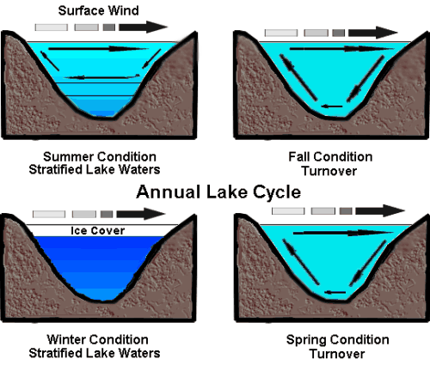
How Lakes Circulate
Nutrients up, oxygen down
Winter/Summer – no circulation, lake at various temps
Thermocline present – uneven temperature distribution in lake
Fall/Spring – lake nutrients circulate, lake at same temp.

Slide 11
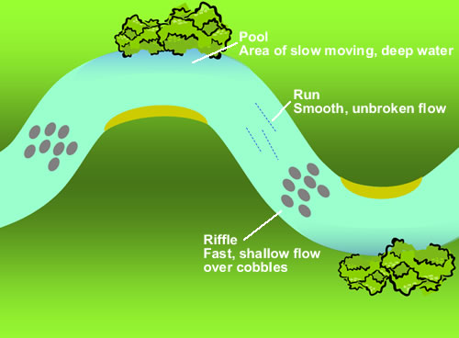
Rivers
Flow into a drainage basin – area in which water pools together at single point before entering another body of water
River Delta – formed at mouth of river (before entering estuary, wetland, lake, ocean, etc)
VERY fertile soil (Nile River Delta - Egypt, Ganges River Delta - India
Rapids – rocky, steep incline. Turbulent water

