Slide 1
Biodiversity

Slide 2
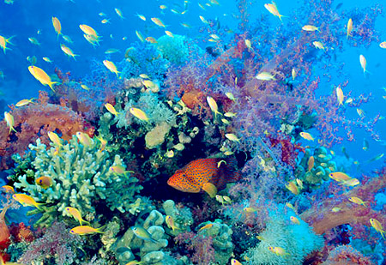
Biodiversity
Three types:
Genetic – various types of genes for a species
Species – various types of species in an ecosystem
Ecological – various types of niches, trophic levels, productivity of community

Slide 3
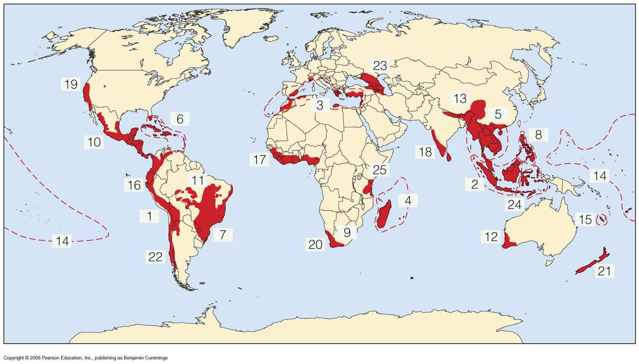
Biodiversity Cont’d
Biodiversity NOT evenly distributed
Biodiversity Hot Spots – places teeming with life
Tropical regions, near bodies of water
Estuaries, tropical forests, coral reefs, etc.
3-100 million species exist!
30 million = insects!

Slide 4
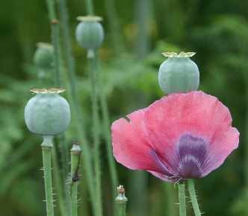
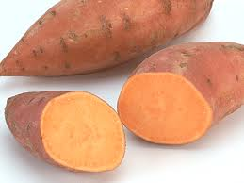
Why Is this Good?
Food sources
Fruits, vegetables, etc.
Drugs/medicines
Penicillin, morphine, cortisone
Ecological services
Soil formation, waste disposal, nutrient cycling, water purification
Tourism
Beauty

Slide 5
Warm Up #2
A human being is an example of being genetically biodiverse. What does this mean?
Why is biodiversity a good thing (list and explain 3 different reasons, giving examples)
Using the invasive species you researched yesterday as an example, how did this species come to inhabit its current location? Why is your species currently a problem in the area it’s living in?

Slide 6
Endangered Species

Slide 7
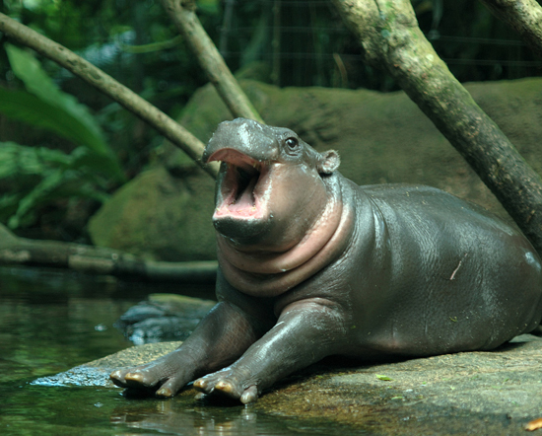
HIPPOs kill biodiversity
Human threats to biodiversity…
H abitat destruction
I nvasive species
P ollution
P opulation (human)
O verharvesting

Slide 8
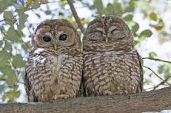
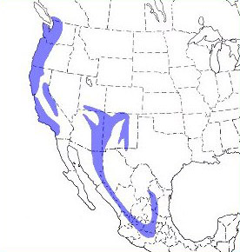
Habitat Destruction: Spotted Owls
Spotted Owls – need large areas of land
Umbrella Species/Keystone Species
Habitat Fragmentation– patches of land where owls live
Goal – to get rid of animal
More prone to disasters
Replace with: mining, damming, fishing, etc.
Toll Roads in OC

Slide 9
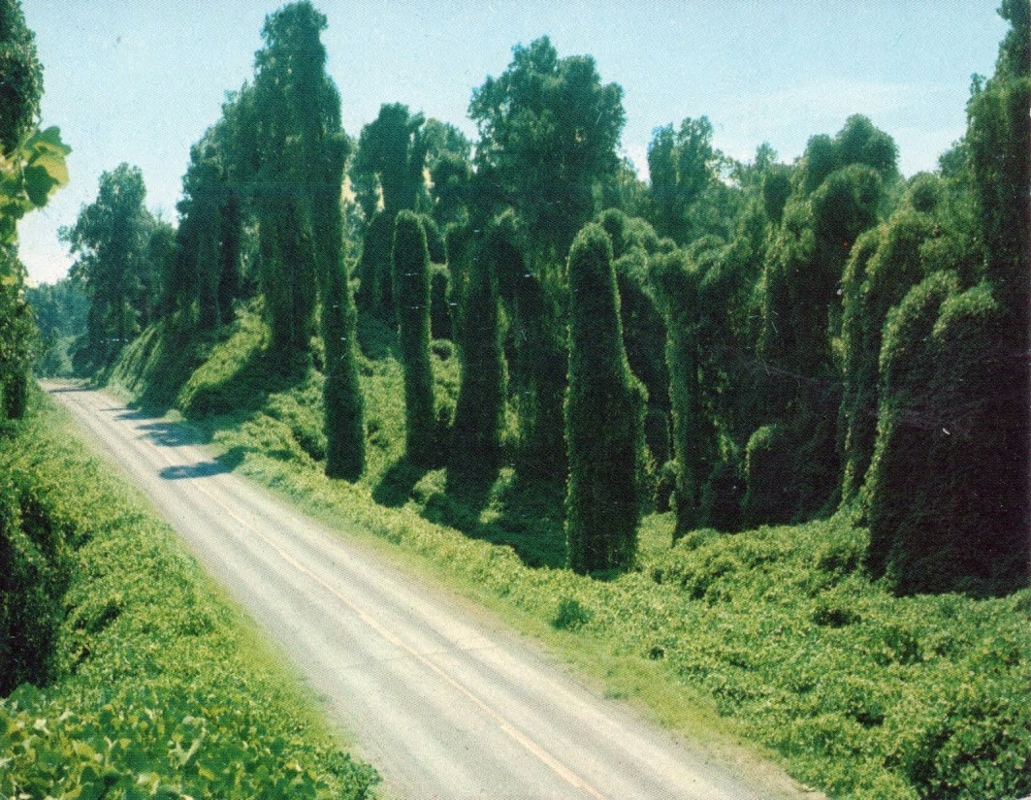
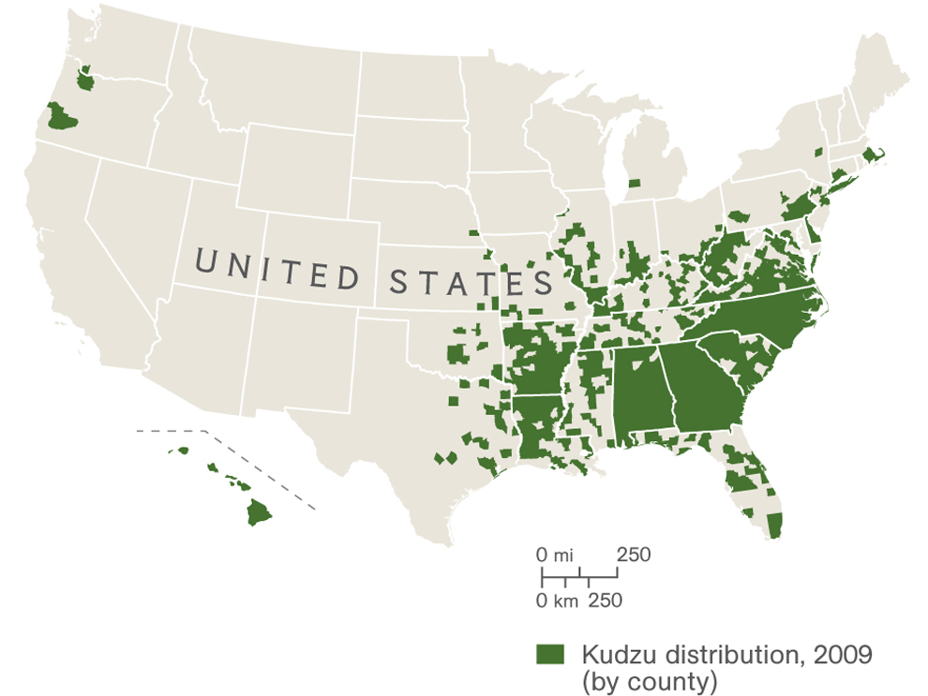
Invasive Species - Kudzu
Invasive Species –
introduced by humans
will outcompete native species for resources
Kudzu – vine that coils/wraps around trees
Kills them due to lack of light
Introduced as a form of erosion control / a legume
150,000 acres annually (Southern States)

Slide 10
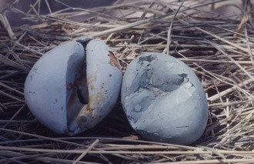
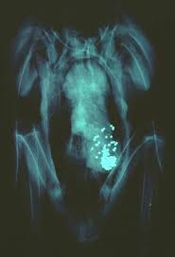
Pollution: DDT, Lead, Mercury
DDT – pesticide (chlorine-based)
Seals, condors
Lead – released from shotguns, on bottom of lakes
Ducks, swans, etc.
Mercury – Minimata
Chemical Company – dumping Mercury (chemical sludge) into Minimata Bay

Slide 11
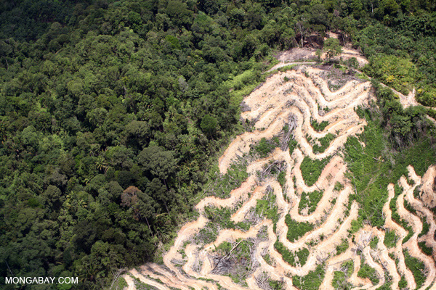
Population: Trees
Human population = exponential
Need for timber products
Overlogging = deforestation (desertification)
Trees = niche for various species

Slide 12
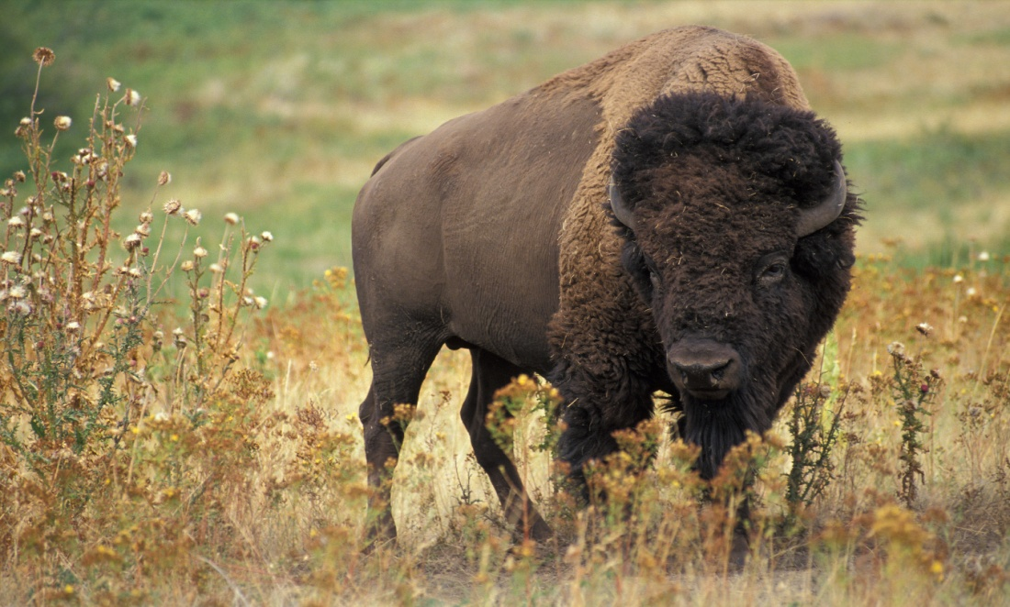
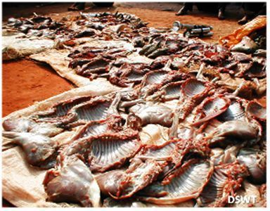
Overharvesting: Bison and Bushmeat
Overharvesting – overhunting, overfishing, overfarming
Bison – great plains (US)
60 million → 150
Bushmeat – meat from chimps, elephants, antelope, etc.
Delicacies

Slide 13
Major Laws Protecting Species
CITES – convention regarding trading of endangered species
Requires paperwork, warning of trading animals (zoos, private, etc)
Sea World? Elephant Sanctuaries? Circuses?
Lacey Act (1900) – no plants/animals bought illegally can be sold/traded

Slide 14
Warm Up #1
Of the 5 major human-related threats to biodiversity in the HIPPO acronym, which one do you think is the most preventable and why?
In your answer, re-state the five major threats to biodiversity.
Legislation like CITES is designed to protect animals when being transferred from zoo to zoo, or from the wild to captivity. Where do you stand on this legislation, knowing that places like Sea World, circuses and small underfunded zoos also benefit from this legislation in place? Is this no better than selling an animal on the black market? Explain your reasoning.
What do you think is the purpose of a hunting/fishing license? Do you think they are counterproductive toward conservation? Explain.

Slide 15
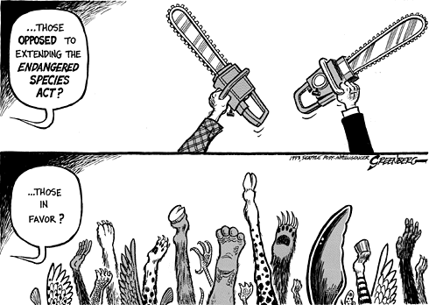
Endangered Species Act (1973)
IUCN - Identifies all species in danger of extinction
US Fish and Wildlife Service – takes funding from ESA
Critically Endangered – on the verge of extinction
Endangered Species –in danger of extinction
Vulnerable Species – threatened

Slide 16
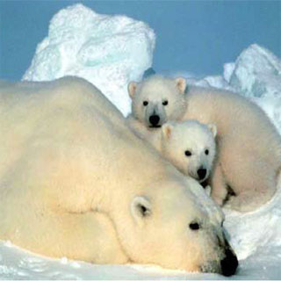
Plans for Recovery
Republicans vs. Democrats
Bush – weakened ESA
Obama – strengthened ESA
In US…$150 million/year on recovery/protection
½ that amount = 12 charismatic species (Flagship Species)
Emotional connection with species
Conservation = a popularity contest?

Slide 17
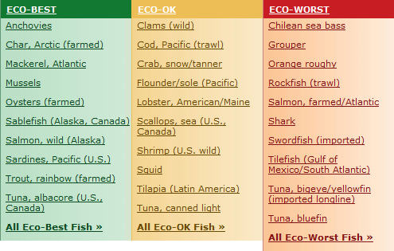
Things YOU can do
Join an animal rights org
World Wildlife Foundation (WWF)
Don’t support overharvesting
Tropical Fish
Certain types of seafood
Salmon good, tuna bad
Rescue pets from Humane Society/animal shelter, not pet stores
Buy organic, sustainable, in-season and wild-caught

Slide 18
Quick Quiz #1
If you were in charge of the funds associated with the ESA, would you change where the money goes? Why or why not?
If you are in favor of saving certain endangered species, what will YOU personally do to participate in their protection? Why? Even if you say “nothing,” say why. If you are not in favor of saving them, state why you are not.
Which of the HIPPO human threats do you think is the worst/most problematic? Why have you chosen this?

Slide 19
Warm Up #2
Why has the human species grown exponentially for the past 100 years? Give three reasons.
Will the human species continue to grow exponentially? Why or why not? Give three reasons.
There are FOUR things that can alter the human population of a country (positive and negative). What are they? Name as many as you can.

Slide 20
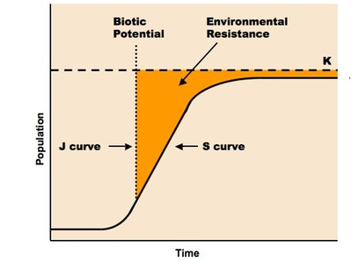
Population Factors Biotic Potential
Favorable environment/space
High birth rate
Few competitors/defense mechanisms
Generalist/genetic diversity
Food supply
Disease/parasite resistant

Slide 21
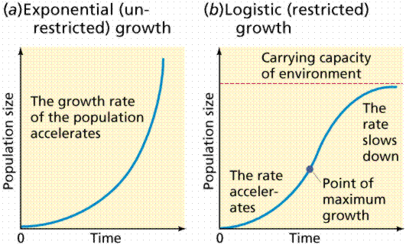
Types of Growth
Exponential (J-Shaped) – unregulated pop. growth
Biotic Potential – amt of offspring possible in perfect conditions
r-strategists
Logistic (S-shaped) – growth over a long period of time
Carrying capacity (K) – largest pop. An environment can handle
K-strategists
K = carrying capacity

Slide 22
Comparing…
r-strategists (bacteria)
K-strategists (humans)
Mature rapidly, short-lived, small in size
Many offspring/quick reproduction
Population fluctuations, type III
Insects, algae, bacteria, annual plants
Mature slowly, long-lived, large in size
Few offspring/slow reproduction
Population stable near carrying capacity (K)
Humans, sharks, trees, elephants

Slide 23
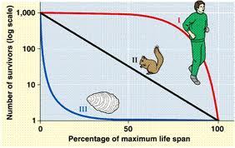
Survivorship Curves
Type I – most deaths in later years
K-strategists
Type II – even distribution of deaths throughout
K-strategists
Type III – most deaths in early years
r-strategists

Slide 24
Population Factors
Density-Independent – population factors NOT related to pop. size
Natural disaster, climate or weather, etc.
Density-Dependent – population factors related to pop. size
Intraspecific competition, disease, predation, parasitism

Slide 25
Population Increase = Exponential
(# Births + # Immigrants) – (#Deaths + # Emigrants)
r =
Total Population
Population Growth Formula:
When population doubles: RULE OF 70 – divide 70 by the growth rate given [why? Because ln(2) = .693]

Slide 26
Practice Problem
If the growth rate of a developing country is 14%, how long will it take for the population size to double?

Slide 27
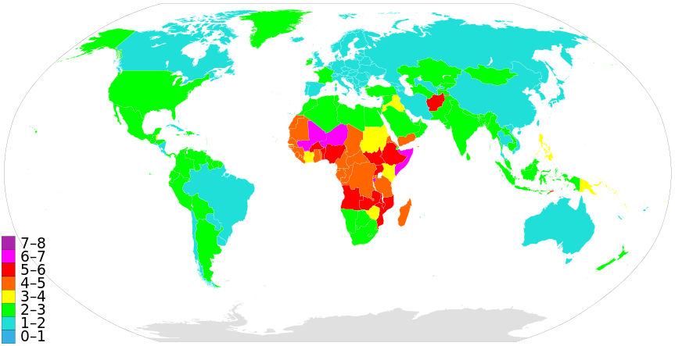
Fertility vs. Birth Rate
Total Fertility Rate (TFR) – avg. number of babies mothers will have in their lifetime (see map above)
Crude Birth Rate – number of babies born (per 1,000 people) in a given year.

Slide 28
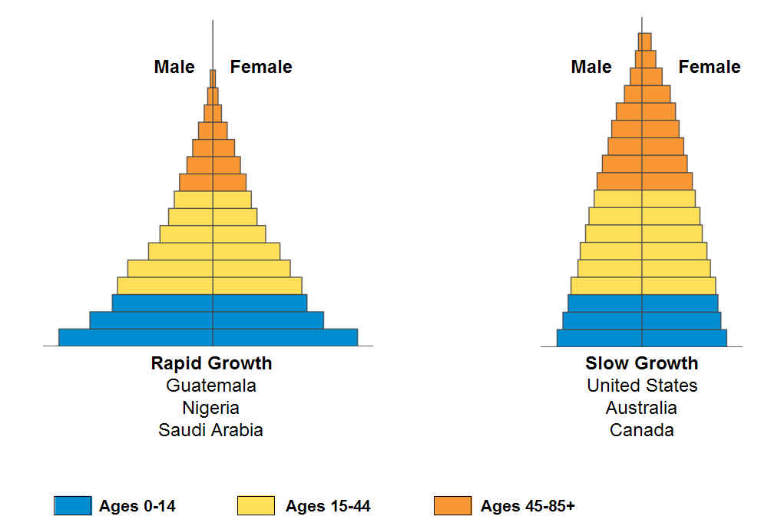
Age-Structure Diagrams

Slide 29
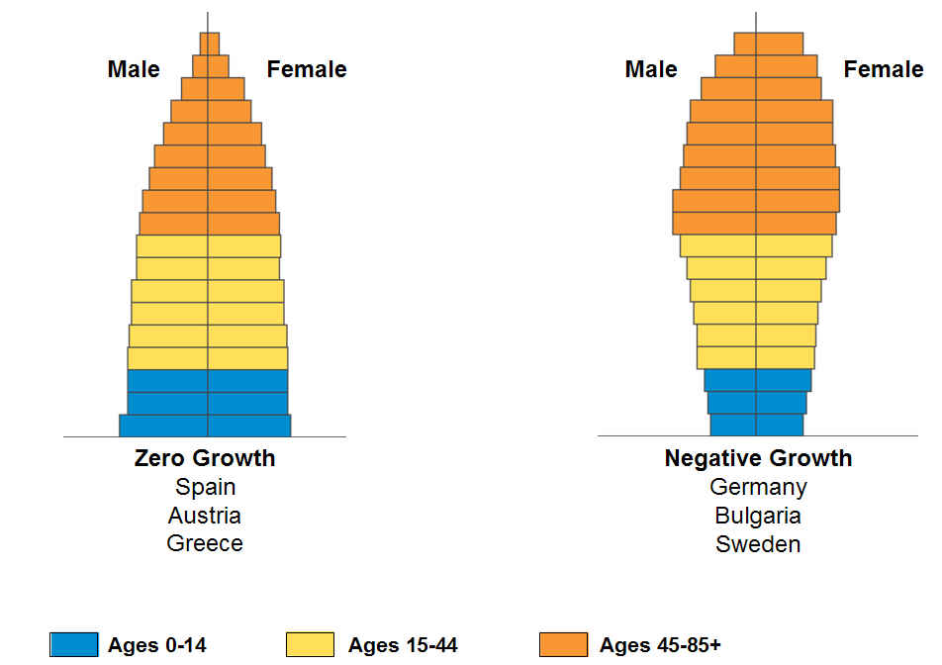
Age-Structure Diagrams

Slide 30
Warm Up #4
Age Range | 0-9 | 10-19 | 20-29 | 30-39 | 40-49 | 50-59 | 60-69 | 70-79 | 80+
% Male | 5 | 7 | 8 | 11 | 12 | 15 | 15 | 14 | 13
% Female | 6 | 9 | 9 | 11 | 11 | 13 | 15 | 16 | 10
Draw an Age-Structure diagram given the information above.
Describe the demographic of this particular country in terms of age.
Do you think this is an example of a DEVELOPED, DEVELOPING, or DECLINING country? Why do you think so?
Why do you think there is such a large percentage of the population in the later age ranges (how are they being kept alive?)
What implications does this age-structure diagram have on the future of the population of this country (will it go up/down? Why?)

Slide 31
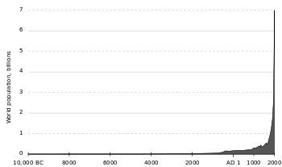
Human Population Growth

Slide 32
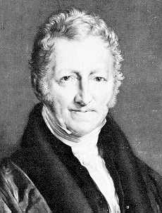
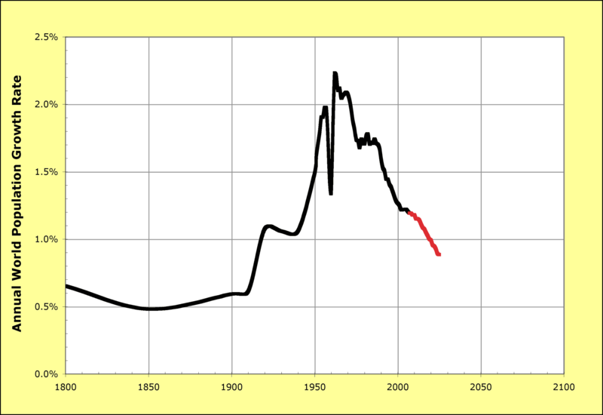
Thomas Malthus
Thomas Malthus – 19th century philosopher
Population will rise FASTER than agricultural production
Cost of living will increase
War, disease, famine all INEVITABLE
Our greed, vices and selfishness will be our demise

Slide 33
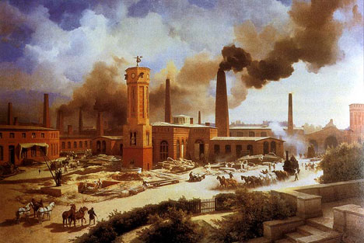
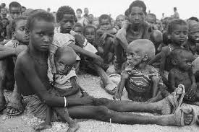
Our Changing World
Population increase shifts:
1900 – increase in currently DEVELOPED countries (US)
Industrial revolution
2000 – increase in currently DEVELOPING countries (Kenya)
What’s causing this change?

Slide 34
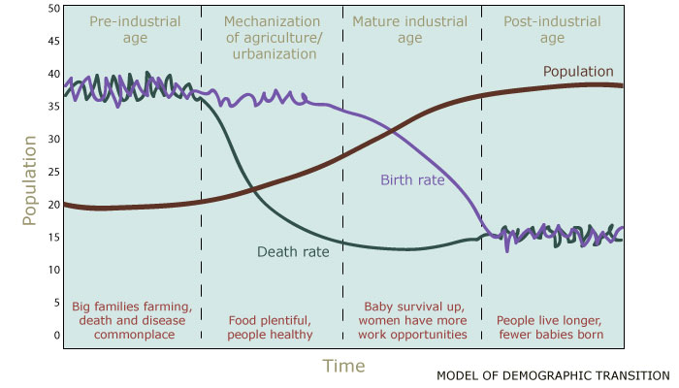
Japan: A Developed Country’s Journey
Result: Demographic Transition – dramatic change in population
death rates decrease first, population increases
then birth rates decline, causing population to level off, then decrease
Japan – a nation of old people

Slide 35
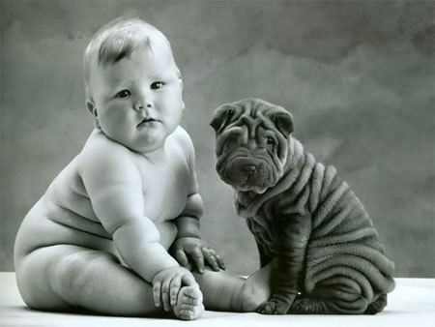
Factors Influence Birth Rates
Education Level
Child Labor Importance
Urbanization
Cost, Medical Advancements
Employment
Marriage Age
CULTURAL NORMS

Slide 36
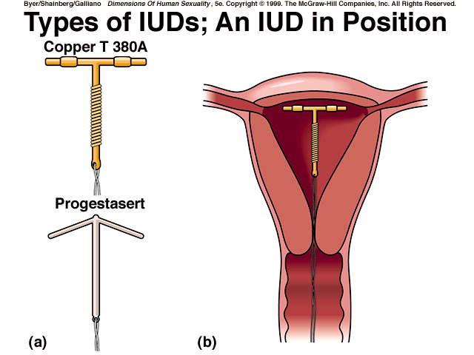
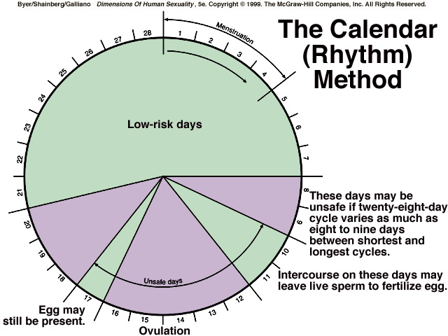
Contraception and Effectiveness
Abstinence
100% effective
IUD, Diaphragm, “The Pill,” Spermicide
94-98% effective
Condom
86% effective
Rhythm Method (don’t try this)
84% effective

Slide 37
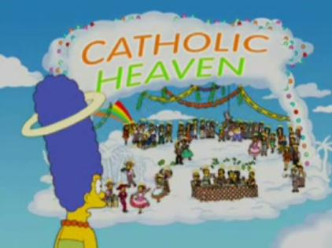
Cultural Norms In African Countries…and Catholicism
Man = breadwinner
Woman = kitchen and bedroom
Implications of this?
Women MUST be monogamous, men do not
Implications of this?
Contraception = NOT an option
Implications of this?
Goal for Catholic mothers = PROCREATE
Implications of this?

Slide 38
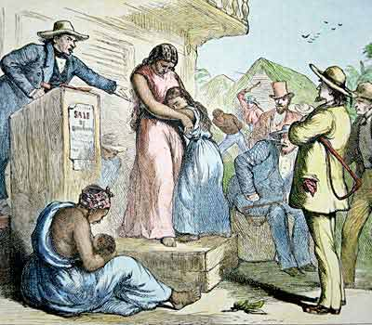
The Power of Empowerment
Developing countries → women subservient to men
Women
1/10th of world income
0.01% property
70% of the poor
2/3 of the illiterate
No right to vote/own things
What if this changed?

Slide 39
Quick Quiz #
What do you think is the biggest cultural reason population sizes are growing so much? What do you think should be done to change this problem?
Say you are living in a country, like Japan, with a high elderly population. What are some pros and cons to having this type of demographic (think economically)?
What do you think will eventually happen to the populations of DEVELOPING countries?

Slide 40
Warm Up #5
You are living in a country of 20 million people. In one year if you had 45,000 births, 12,000 deaths, 5,000 immigrants and 2,000 emigrants…what is the growth rate of your country? How large will the country be in 10 years?
Why do you think the views of Thomas Malthus agree with those of Natural Selection? What would they both have to say in regards to the human population?
What do you think makes a “powerful” nation powerful?

Slide 41
Warm Up # Use 2003 AP Exam Info to help Answer ?’s
Graph your work, making two lines (1 for births, 1 for deaths)
What is the annual growth rate of Industria in 1950? What was the birth rate in 1977?
Indicate TWO factors that might have accounted for the rapid decline in death rates between 1855 and 1895. Indicate one specific reason why the birth rate might have been so high in 1855, and was so slow to decrease between 1855 and 1950.
Determine what the population size of Industria would have been in 1951 if the population had continued to grow at the annual rate of growth recording in 1895.

Slide 42
Warm Up #
Country | Total Fertility Rate (TFR) | Crude Birth Rate (per 1000) | Crude Death Rate (per 1000) | Infant Mortality Rate (per 1000) | Per Capita Income
China | 1.6 | 12 | 7 | 27 | 6,500
Kenya | 5.9 | 43 | 18 | 100 | 1,000
U.S. | 2.0 | 14 | 8 | 6.7 | 42,000
Consider the data in the above table. Identify and discuss TWO economic or societal factors that account for the difference between the TFR of Kenya and that of the United States
Describe TWO human activities related to the rapidly growing world population that are having an impact on Earth’s biodiversity?
At China’s current population growth rate, and their current population being approximately 1.5 billion people, what will the population be 280 years from now?

Slide 43
Population Growth Continued

Slide 44
India’s Missing Girls: PBS Video
http://www.pbs.org/frontlineworld/rough/2007/04/the_missing_gir.html

Slide 45
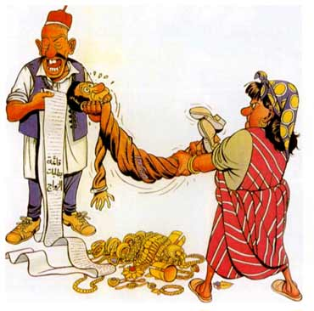
Economical Incentives for Birth Control
China – One Child Policy
Higher taxes, loss of health benefits if 2+ kids
India – dowry (gift to husband for marrying daughter)
VERY expensive, especially in poor areas
US – babies (i.e. “welfare checks”) – abusing the system

Slide 46
India’s Economic and Cultural Problems
Having a girl = paying a dowry, not passing on family name, not a working member of society
Having a boy = receiving a dowry, passing on family name, and working member of society
WHY HAVE A GIRL?!

Slide 47
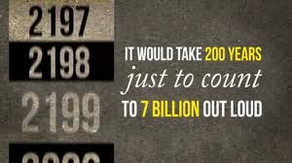
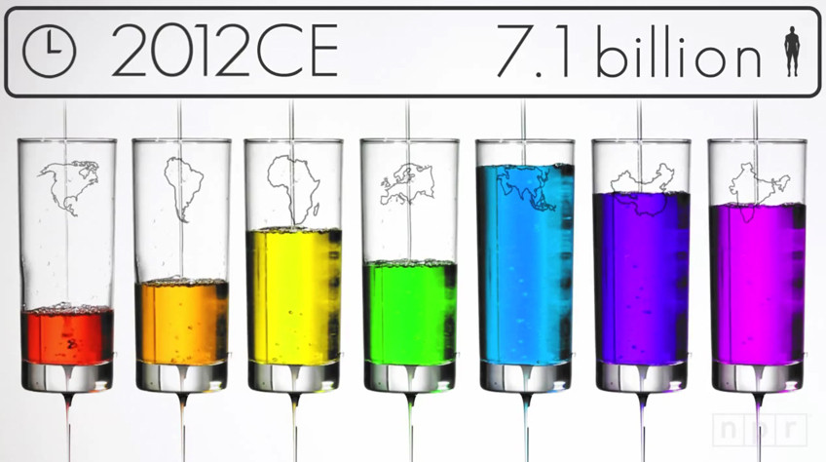
How is this 7 Billion Counted?
Approximate – births and deaths make knowing exact # impossible
China/India = vaccination records
Gov’t lies about data

Slide 48
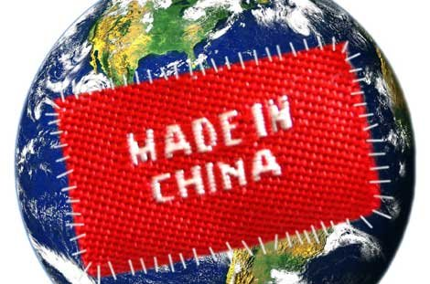
Power in Numbers?
China and India → 2.4 billion people (35% of population)
Take over the world?
Power and technology – more power = more advanced technology
Power and education

Slide 49
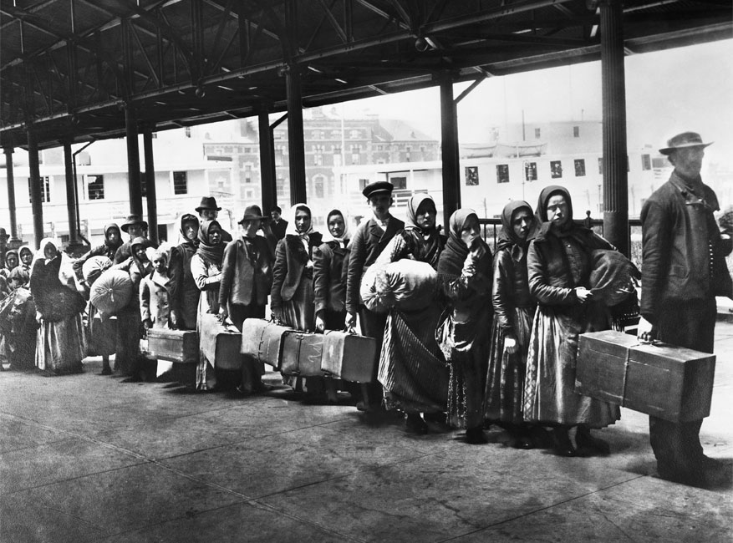
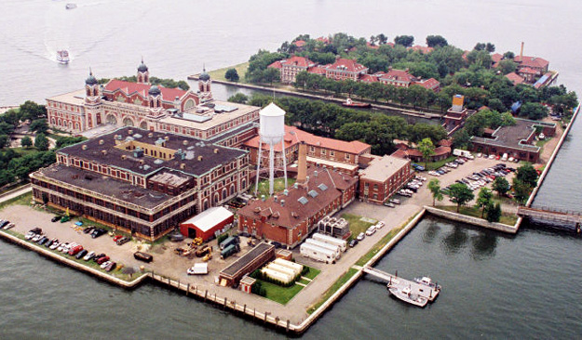
Immigration
Immigration –relocation to another country
US – large illegal immigration problem (Mexico)
US = land of opportunity
Cost of immigration: jobs, poverty, standard of living, taxes, etc.

Slide 50
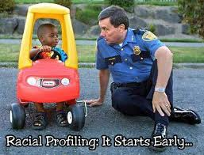
Border Patrol and Morality
Racial profiling – segregating and treating somebody differently based on race
SB1070 (Arizona)
Access to education?
Better life, or job stealers?
Is this right?

Slide 51
Quality of Life
Population increase = quality of life decrease
Population will spike, and then start to decrease
So will: pollution, food and industrial output
HOWEVER: resources will fall consistently

Slide 52
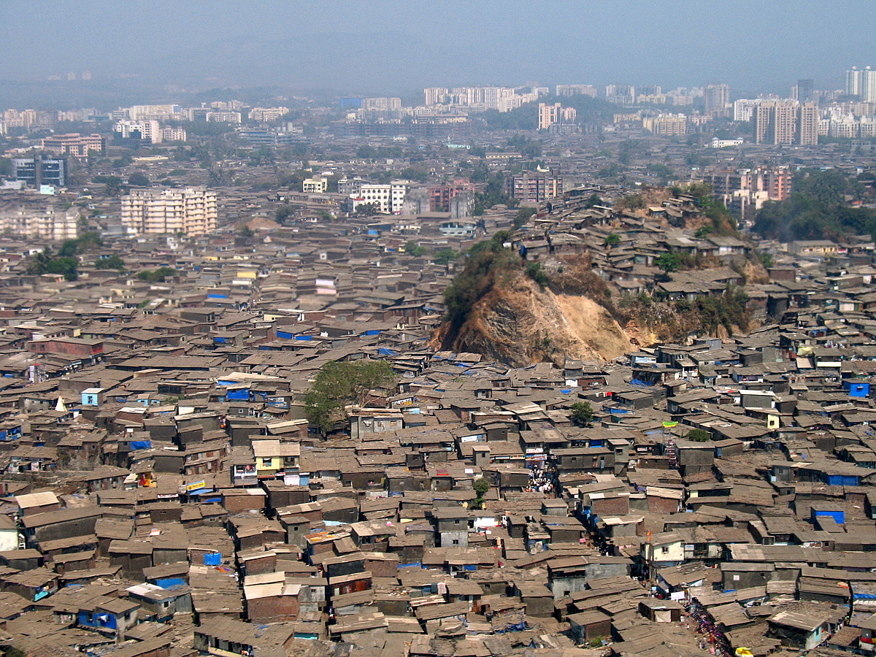
Sudden Population Rises on a Country http://www.youtube.com/watch?feature=player_embedded&v=VcSX4ytEfcE#!
Increased poverty
Increased unemployment
Increased pollution
Increased mortality rates (even with medical advances)
Lower survival rates

Slide 53
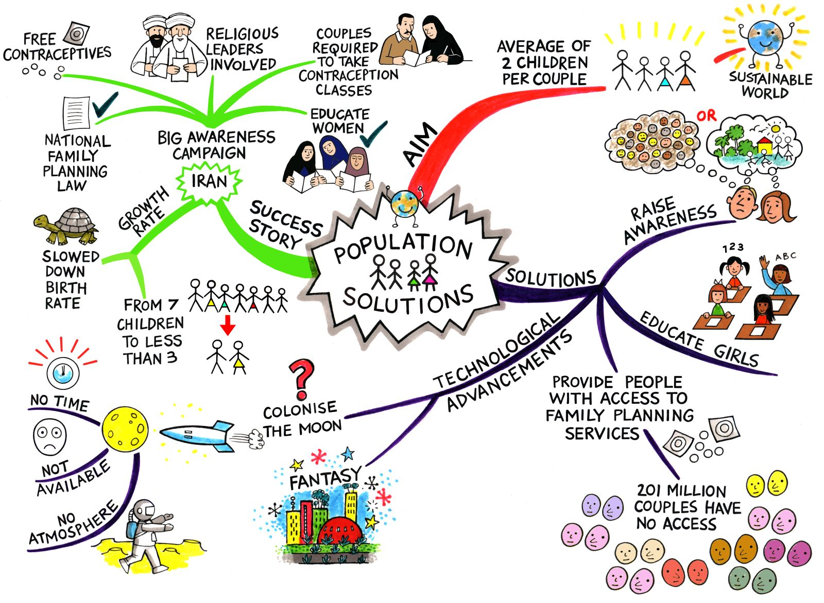
Possible Solutions
Family planning/healthcare
Educating women
Economic incentives
Increase man’s responsibility in child-rearing
Get rid of poverty (more jobs)
Equality

Slide 54
Warm Up #7
The United States currents has approximately 330 million people. The third largest of any country. China and India surpass the US in terms of sheer population, each country holding over 1 billion people.
If the current growth rate of the US was that of a developed country, 0.4%, how large will the population be in 10 years?
If this growth rate continues, how long would it take the US to reach 1 billion people? Does this seem plausible? Why or why not? Use demographic transition trends in your answer.
How does being a K-strategist/Type I survivor influence how the human population increases?
What are some density-dependent factors that can influence the US population? What about density-independent factors? (2 each)

