Slide 1
Warm Up #6
What do pioneer species do in primary succession?
Describe the plants living in the later stages of ecological succession. What do they look like? How efficiently do they reproduce? Give some examples.
Give an example of a catastrophic human-caused environmental disaster we have discussed in class. How did this disaster negatively damage the ecosystem and how the environment recovered (if at all).
Finally, choose an “ecosystem” and briefly describe how it evolves from a basic, to a more complex ecosystem. This should NOT be a real place – choose something that involves your day-to-day life (for example – a favorite TV show, a clothing store, favorite sport, etc).

Slide 2
Productivity and Biodiversity

Slide 3
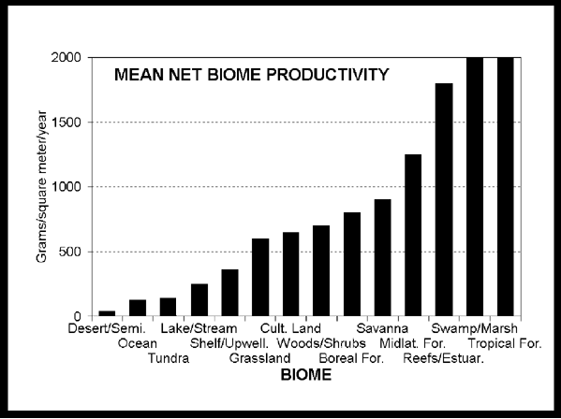
Productivity
Primary Productivity – how much solar energy → chemical energy
Photo/chemosynthesis
More photosynthesis, more productive
Rainforests, coral reefs, estuaries, etc.

Slide 4
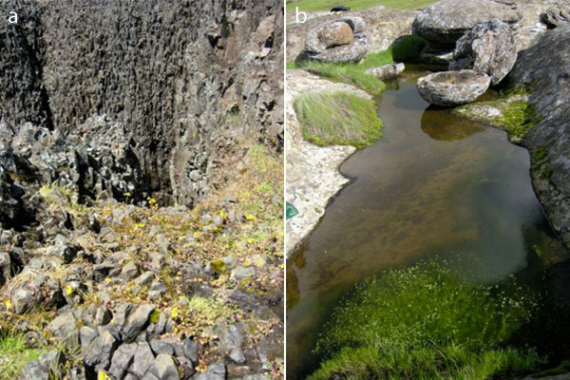
Primary Ecological Succession: Revisited
Primary Succession – starting life where no life previously existed
Pioneer Community – first life forms and their niches
Lichens
Complex Community – more diverse, abundant life

Slide 5
Abundance vs. Diversity
Abundance – how many total organisms exist
Diversity – how many DIFFERENT organisms exist
Niches, genetic variation, etc.
Higher abundance/diversity…more productivity

Slide 6
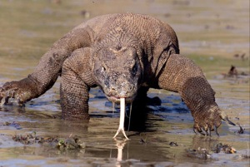
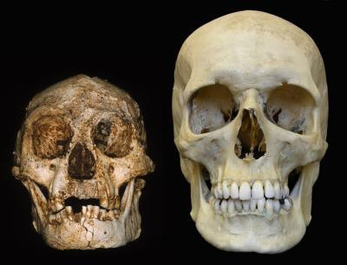
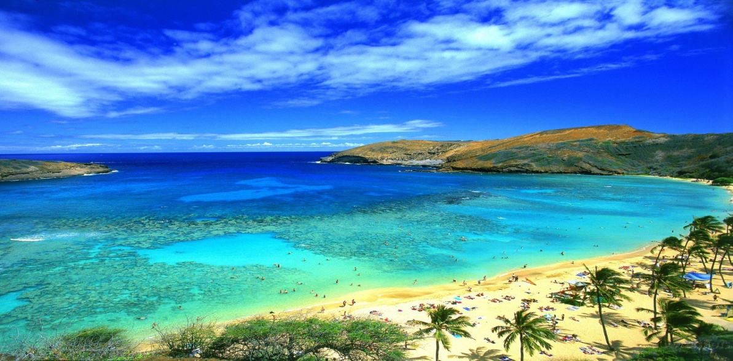
Islands vs. Mainland
Island Gigantism – small species growing larger
Komodo Dragon
Island Dwarfism – larger species growing smaller
Islands = more susceptible to drama (more specialists) - isolated
Human activity
Invasive species
Habitat disruption
Large, close islands =
more diversity

Slide 7
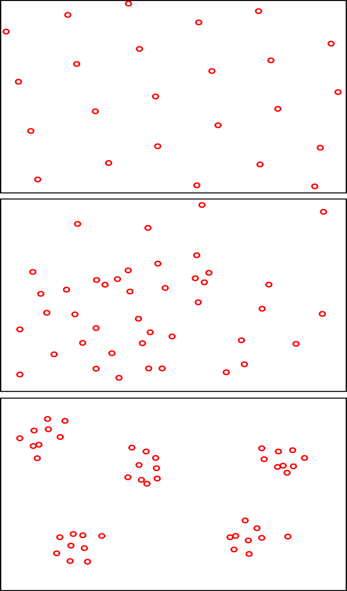
Organism Distribution
Uniform – equal spacing between organisms
Trees, Bird nests (avoid competition)
Random – irregular spacing between organisms
Flowers (resource availability)
Clustered – species packed together, separate from others
Trees/Fish/wolves (protection, better hunting)

Slide 8
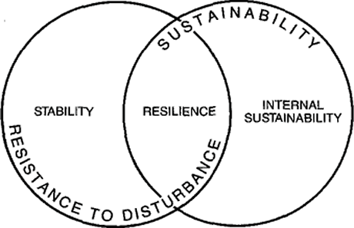
Ecological Stability Indicators
Constancy (no change)
Ideal, but rare
Persistence (resistance to change)
Disturbance-adapted species
Resilience (repairing damage after change)
Ecological succession (secondary)

Slide 9
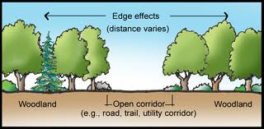
Transition Zones
Edge Effect – the relationships between species of different boundaries
Ecotone – transition zone
Susceptible to disturbances – any force that can inhibit patterns of community
Human activity - gradual
Natural disaster - catastrophic
Invasive species- gradual

Slide 10
Quick Quiz #3
How can ecological disturbances actually benefit certain species?
Give two reasons why some species would distribute themselves in a clustered pattern? What about a uniform distribution?
Give one example of an ecotone we have discussed in class. Why would disturbing this particular ecotone be problematic?
Comparing a pioneer community to a complex community, how do they differ in terms of diversity, resilience and productivity?

Slide 11
Warm Up #7
How do pioneer communities differ from complex communities in terms of: efficiency, resilience, and productivity.
How do you define productivity? Provide two very productive biomes, and one reason why it is more productive than a desert.
What are three major signs of stability? Why do species living in ecotones face stability issues?

Slide 12
Warm Up #8
According to the video, why do skyscrapers and dams begin to crumble after years of human absence?
Draw three pictures representing how organisms distribute themselves in a place. Give one reason each why they distribute themselves in this way.
A species of bacteria thrives in moderate pH levels. Due to acid rain, how will this bacteria species respond if it is to survive? Show this in a bell curve.
Why does acid rain occur? Give two sources of it.

Slide 13
Warm Up #7
Biological diversity, or biodiversity, has become a topic of great concern among conservationists. Biodiversity is often used by scientists and policy makers to help determine the health of ecosystems.
Describe TWO characteristics shared by ecosystems that have high biodiversity.
(b) Identify TWO specific human activities that result in a loss of biodiversity, and explain how each activity lowers biodiversity.
(c) For each human activity you discussed in (b), propose a practical strategy (other than simply banning the activity) to reduce the loss of biodiversity.
(d) Describe ONE naturally occurring factor that could lead to a loss of biodiversity.
(e) Describe TWO ecological benefits that greater biodiversity provides.

