Slide 1
Warm Up #6
How does mutualism differ from interspecific competition? How are they similar?
What do you think a keystone species is? In terms of the ocean, give one example of a keystone species discussed in the video.
Where is all the light found in the ocean (top or bottom)? What about nutrients?

Slide 2
Water Biomes
Part 1: Saltwater Biomes

Slide 3
Limiting Factors – Coastal Zones
Limiting Factor – a non-living factor that can prevent the survival of a species
Temperature
Access to sunlight
Dissolved oxygen content
Higher oxygen levels close to surface
Depends on #producers, #decomposers, temp
Nutrient availability
Higher nutrients on ocean floor

Slide 4
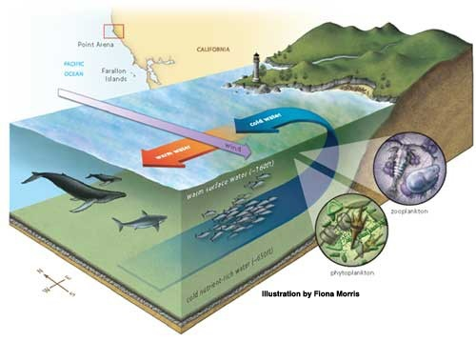
Importance of Ocean Currents
Upwelling – cycling of warm surface water with cool deep water
Nutrient cycling
Aquatic – Phytoplankton and whales

Slide 5
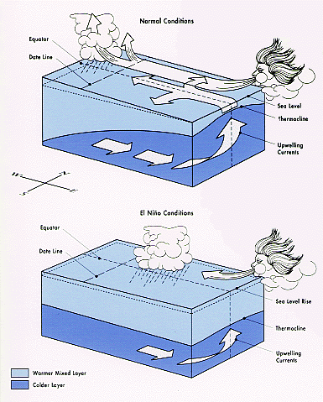
El Nino
El Nino Southern Oscillation (ENSO) – in Pacific Ocean
Western winds weaken
Occurs every 3-4 years
Lasts several months
Result: no nutrient upwelling, dramatic affects aquatic ecosystems

Slide 6
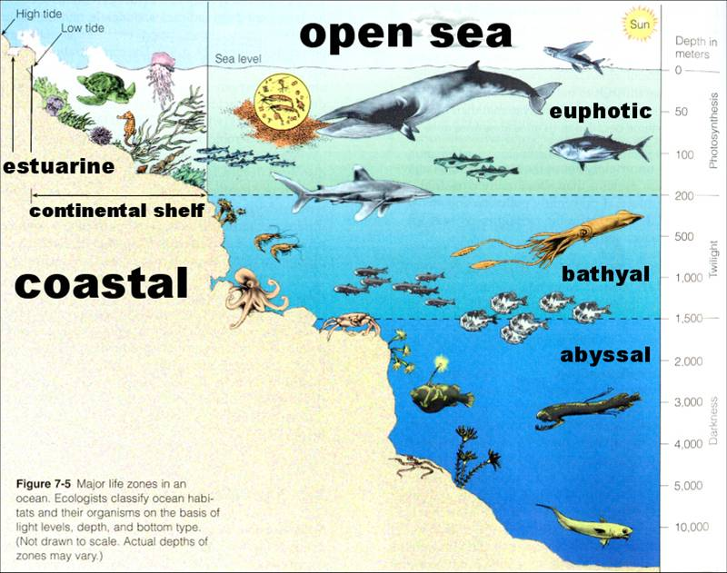
Type 1: Coastal Zone
Shallow salt water
Close to shore
Light-rich, nutrient poor
Biodiversity
Threatened by human activity

Slide 7
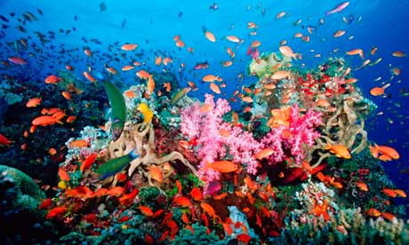
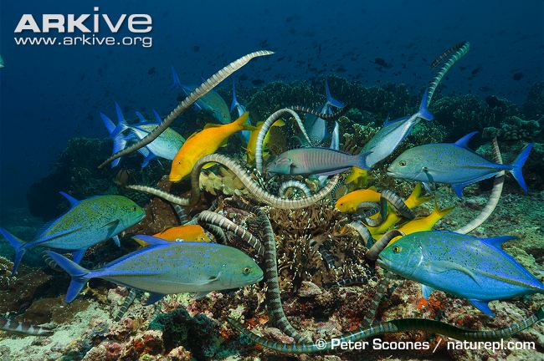
Coral Reefs
Tropical forests of the sea
Near equator, biodiversity, nutrient poor water
Coral = keystone species – affect many other organisms of ecosystem
Coral and algae = mutualism relationship
Another: sea kraits and crevally

Slide 8
Coral and Algae: A Case Study
Algae live inside coral
mutualism
+ = algae make food (photosynthesis)
+ = coral protect and provide nutrient-rich enviro.
Nutrients make coral skeleton (calcium carbonate)
Regulates CO2 levels

Slide 9
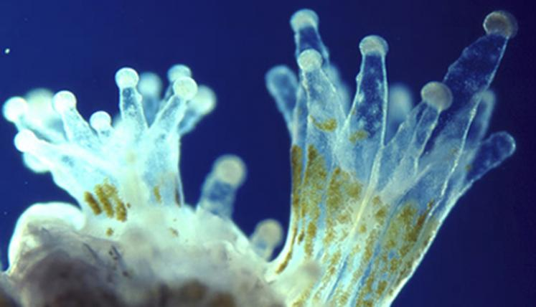
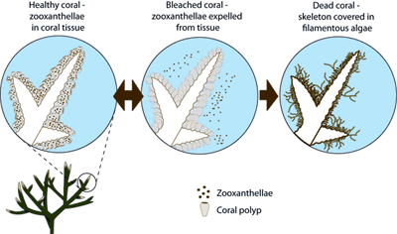
Coral and Algae: Healthy and Bleached

Slide 10
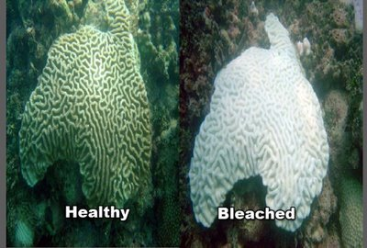
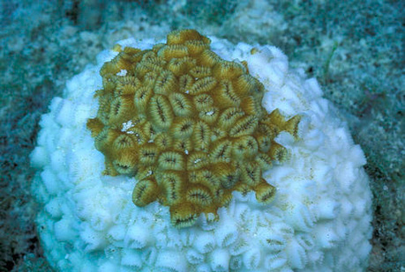
Coral and Algae cont’d
Algae = temperature and salinity sensitive (limiting factor)
Human activity = high temps
10% reefs destroyed already
Result: algae die → Coral Bleaching – coral turns white, releases CO2

Slide 11
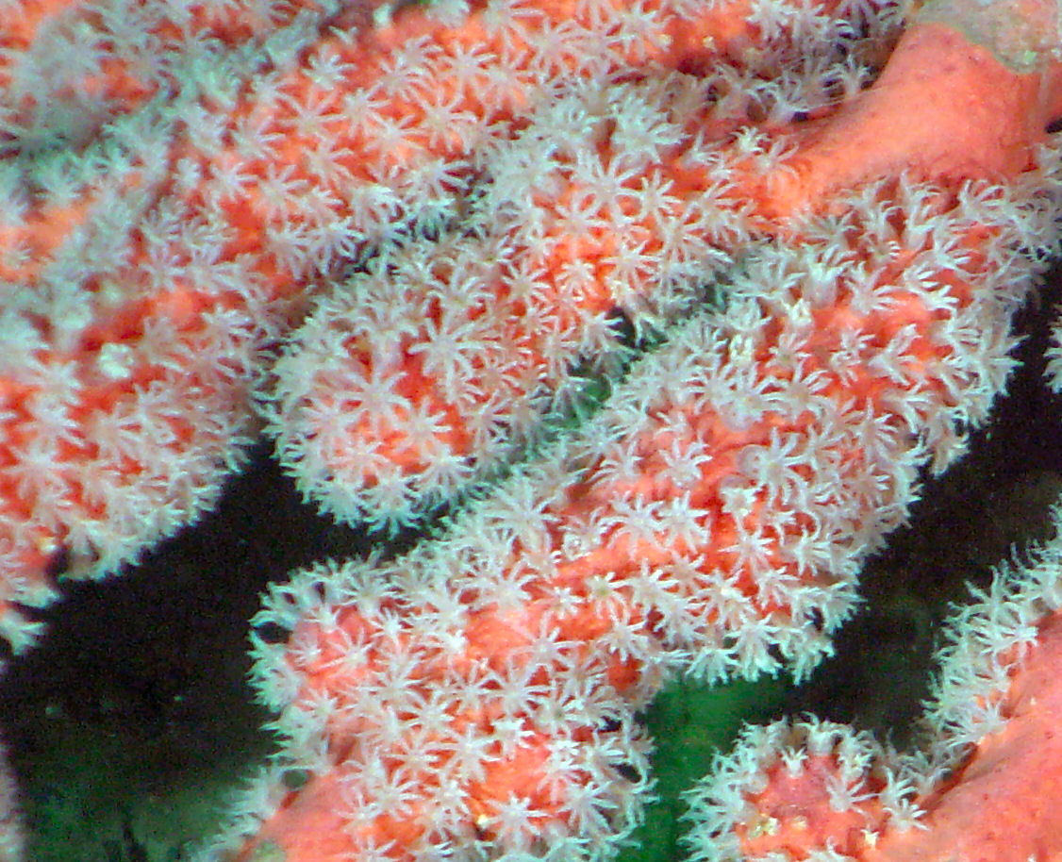
Effects of Coral Bleaching
Loss of biodiversity
Loss of tourism (Great Barrier Reef) – less $$
Raised ocean temps (CO2) – positive feedback
More invasive, harmful species

Slide 12
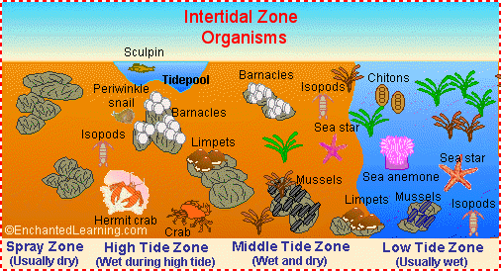
Intertidal Zones
Area of shoreline between low and high tide
Extremely variable environment (salinity, waves)
Organisms: protective shells or cling to something

Slide 13
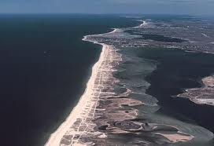
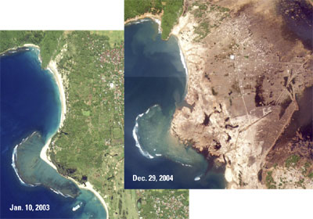
Barrier Islands and Beach Erosion
Barrier Islands – thin strips of sediment running parallel to shore
Protect mainland from floods
Human development
Seaside Heights (Jersey Shore)
Beach Erosion – ADD MORE HERE

Slide 14
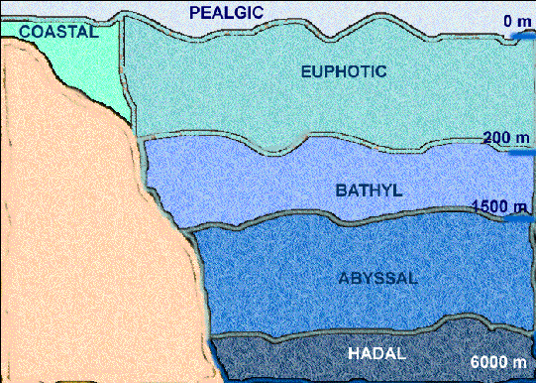
Open Sea
Very little activity (90% surface area, 10% life)
Euphotic Zone – photosynthesis, light, nutrient poor
Bathayal Zone – twilight zone (dimly lit)
Abyssal Zone – very dark, nutrient rich
Site of chemosynthesis – use of chemicals (ex. Sulfur) to obtain energy where light is not present

Slide 15
Quick Quiz # 3
Why are coral considered to be a keystone species?
Use two specific examples to explain why coral and algae have a mutualism relationship?
Why is coral bleaching an example of a positive feedback event?

Slide 16
(a) Explain how an increase in the amount of dissolved CO₂ in ocean water results in a decrease in the pH of ocean water.
(b) Explain why the movement of carbon into the ocean has been increasing since 1850.
(c) Identify and describe one likely negative environmental impact of the loss of coral reefs.
(d) Identify one environmental problem (other than ocean acidification or loss of coral reefs) that affects marine ecosystems on a global scale.
Use the assumptions in the table below to perform the calculations that follow.
Assume that the total global area of corals growing in reefs is 2.5 × 10¹¹ m²
Assume that corals grow only vertically and that the average vertical growth rate of corals is 3 mm/year.
Assume that the average density of CaCO₃ in corals is 2 × 10³ kg/m³
(i) Calculate the current annual global increase in volume, in m³, of CaCO₃ in coral reefs. Show all steps in your calculation.
(ii) Calculate the current annual global increase in mass, in kg, of CaCO₃ in coral reefs. Show all steps in your calculation.

Slide 17
Warm Up #3
Describe what an El Nino is and clearly indicate where it occurs.
Describe the connection between the ENSO-related climate change and the transmission of disease. Explain whether the article is correct in reporting of various disease epidemics.
People in what part of the world would most likely be affected by this link between El Nino and disease?
Describe TWO other important environmental problems associated with ENSOs

Slide 18
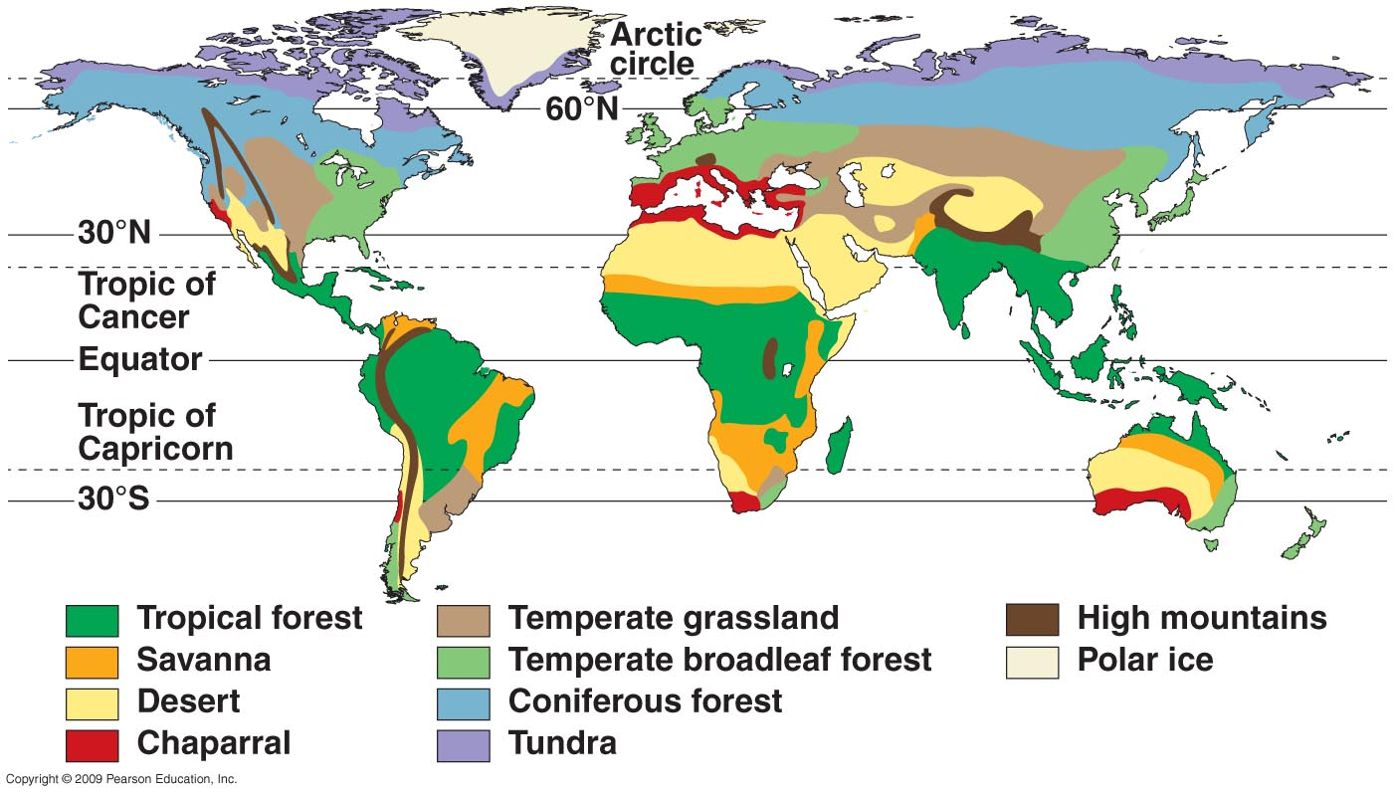

Slide 19
Warm Up # 7
How does coral bleaching happen, and give one environmental and one economical reason why this would be bad?
How do the conditions and organisms change at various levels in the open ocean?
Why are barrier islands important?
How do species learn to adapt in intertidal zones? Why are these adaptations necessary?

Slide 20
Ecosystems

Slide 21
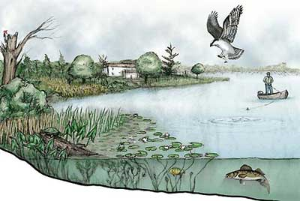
What is an Ecosystem?
Ecosystem – community of different species interacting with one another and with nonliving environment of matter and energy.
Shares same climate – long-term weather
A lake ecosystem, what is that hawk diving for?

Slide 22
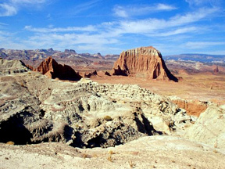
Ecosystem: Non-Living Factors
Abiotic Factors – non-living components of an ecosystem
Rocks, water, soil
“A-” = not; “Bio-” = living
Abiotic factors affecting environment:
Temperature
Salinity of water
pH of soil/water
Precipitation

Slide 23
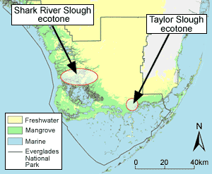
Setting Ecosystem Boundaries
Ecotone – a transitional zone from one ecosystem to another
Contains mixture of species from both ecosystems
Revisiting: Riparian Zones, why are they important?
Mangrove Forests –
Florida’s dying ecotone

Slide 24
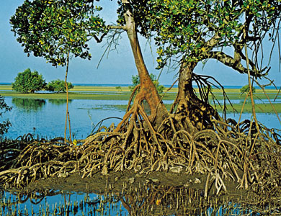
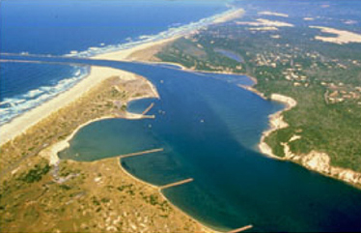
Real Life Drama: Mangroves in Florida
Mangrove – a tree found on coastal regions of Florida
Obtains freshwater from saltwater
Estuary - partly enclosed coastal body of water with one or more rivers or streams flowing into it, and with a free connection to the open sea
Salinity levels = variable
Human activity = less mangroves
More erosion, hurricane damage

Slide 25
Effects on Loss of Mangroves
Zone of Tolerance – Amount of physical and chemical change to an environment an organism can handle (Stress Zone)
Limiting Factor Principle – abiotic factor that can limit/prevent growth of species
Mangroves → Salinity = amount of salt in water

Slide 26
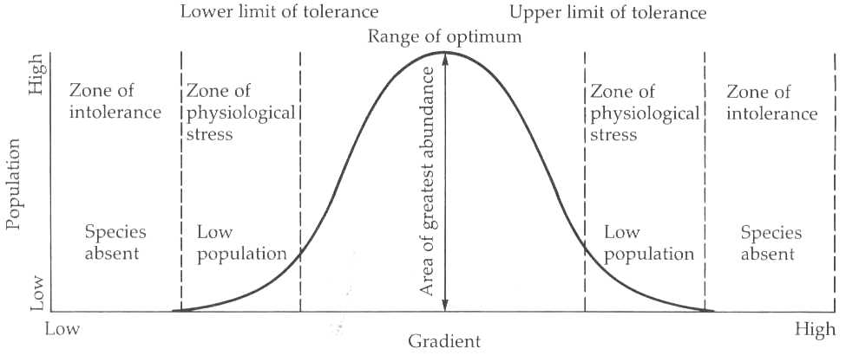
Range of Tolerance

Slide 27
Limiting Factors by Biome
Biomes = precipitation and temperature
Forests
SOIL (acidic, erosion)
Deserts
PRECIPITATION
Grasslands
RAINFALL AND FIRES

Slide 28
Warm Up #5
(a) Under optimal conditions, the emission rate of methane by termites is approximately 70 kilograms of CH4 per year per 1,000 termites.
(i) According to the data, what are the optimal temperature and relative humidity for termite activity?
(ii) Given a density of 4.5 × 10⁷ termites per hectare and optimal conditions, calculate the annual amount of methane emitted, in kilograms, by the termites inhabiting a 2,000-hectare tropical rain forest.
(b) It has been observed that soon after a tropical rain forest is cleared, termite density increases to an estimated 6.8 × 10⁷ termites per hectare. Thereafter, the termite population size decreases dramatically.
(i) What is the most likely reason that the density of the termites increases when a tropical rain forest is cleared?
(ii) Why do the termite populations eventually decrease dramatically?
(c) Describe one way, other than changes in termite activity, that tropical rain forest destruction contributes to anthropogenic climate change.

Slide 29
Quick Quiz #4
You are in a desert. Give two examples of abiotic factors and two examples of biotic factors in a desert.
Why are estuaries, like mangrove forests, important?
We used salinity in the Mangrove Forest example. Name some other examples of limiting factors? Give an example of how one of those limiting factors can influence the tolerance of an environment.

