Slide 1
Warm Up #1
Describe the size of plants in a tundra. Why are they this size, given their location? (give two reasons)
What regions of Earth have boreal forests? Describe the soil of this biome and why it would be this way.
How does an alpine tundra differ from an arctic tundra?
What does it mean to be “semi-arid?” How do you think that affects the types of animals that live in this region?

Slide 2
Biomes

Slide 3
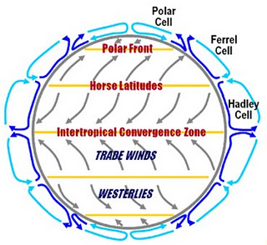
Wind Cells and Wind Patterns Convection Currents
Hadley cell - closest to the equator. (0 – 30 degrees latitude)
Counterclockwise
Ferrel cell – 30 – 60 degrees latitude
Clockwise
Polar cell – 60-90 degrees latitude
Counterclockwise

Slide 4
Climates Between Wind Cells
Between Hadley Cells – warm, moist air rises (equator)
Result: Tropical Rain Forest
Between Hadley and Ferrel – cool, dry air falls (30º latitude)
Result: Desert
Between Ferrel and Polar – warm, moist air rises (60º latitude)
Result: Evergreen Forest

Slide 5
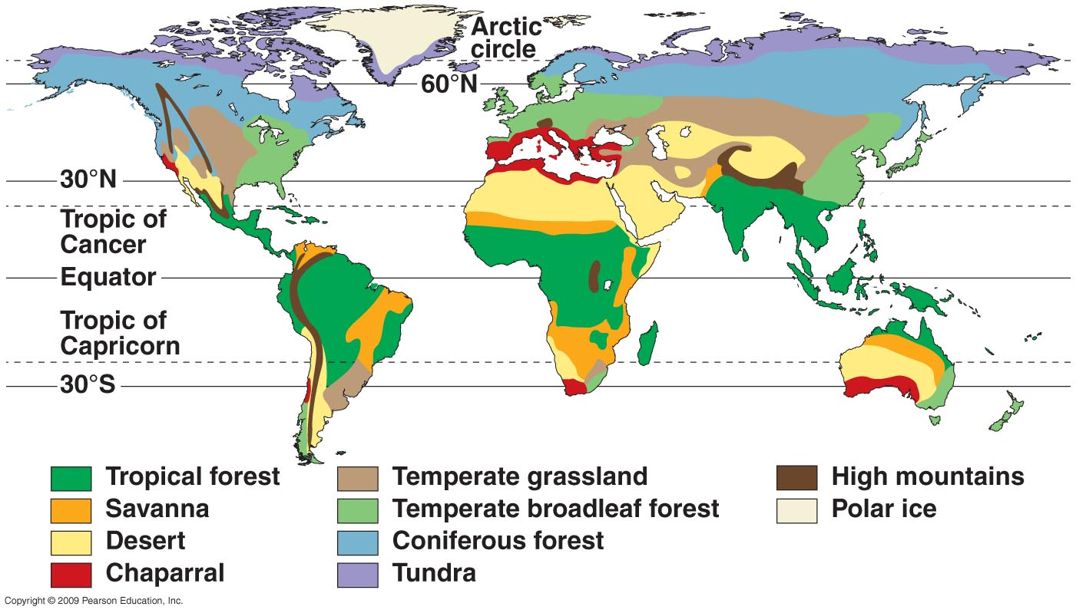

Slide 6
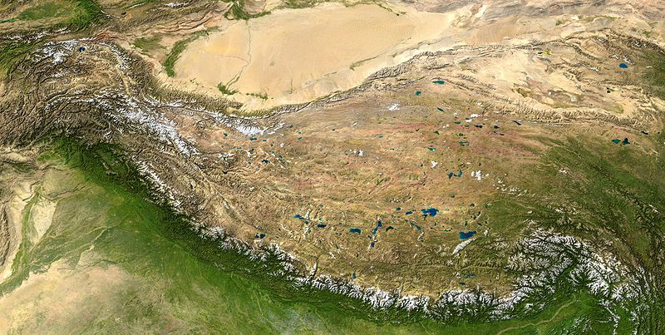
Investigate: Himalayan Mountains
Microclimate – climate of a particular region due to effects of topographic features (mountains, valleys, etc).
Rain Shadow Effect – differing conditions on sides of mountain
One side = moist, cool air
Cool air rises, unable to retain moisture (rain)
Other side = dry, arid, desert

Slide 7
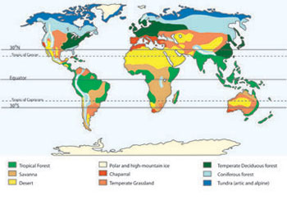
Biome Overview
Biome – land regions sharing distinct characteristics including climate
Climate – temp. and rainfall (precipitation) over yearly span
Limiting Factors:
Temperature
Soil content
RAINFALL

Slide 8
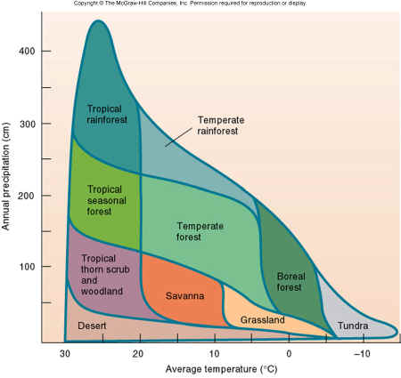
Adaptations
Vary in Latitude and Altitude
Latitude = distance from equator (North/South)
Further north/south = colder
Altitude – height above sea level
Further up = colder

Slide 9
Plants Adapting: Part 1
Desert – little rain, a lot of sunlight, hot
Result: Succulent (fleshy) plants – cacti
Store water, no leaves
Tundra – little rain, very cold
Result: small plants – shrubs
Retain heat, water

Slide 10
Plants Adapting Part II
Tropical Rainforest – a lot of rain, sunlight, heat
Result: tall, broad-leaf evergreen plants (green all year round)
Photosynthesis, keep heat out
Deciduous Forest – cold and dry winters
Result: deciduous trees (lose leaves) – oak, maple
Retain heat

Slide 11
Quick Quiz #2
What are the three main limiting factors to a biome?
Given what you know about a deciduous forest (think New England), why do you think these plants would lose their leaves?
How does altitude affect the climate of a biome?

Slide 12
Warm Up # 3
Describe the rainfall in a hot and dry desert, and how it explains the temperature variation seen there.
In a tropical forest, what are plants competing for? How do they exhibit this competition?
For both grasslands and savannas, how is the amount of rain distributed throughout the year?

Slide 13
The Biome Quick Quiz
Fill in all of the blanks.
Choices: Cold Desert, Savanna, Temperate Forest, Grassland, Tundra, Semi-Arid Desert, Tropical Forest, Boreal Forest, Hot & Dry Desert, Chaparral
TEMPERATURE
RAINFALL

Slide 14
Human Impact on Biomes

Slide 15
Potential Effect on Climate
Ozone Layer – found in stratosphere layer of atmosphere (just above tropo.)
Prevents 95% UV A, B & C rays from reaching Earth
Thermal Cap – prevents warm gasses of troposphere from entering stratosphere (human activity = danger)
Effects?

Slide 16
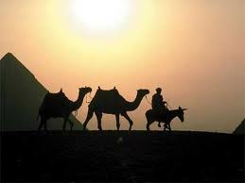
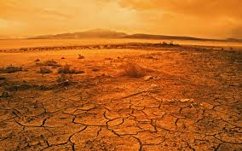
Deserts are so hot right now. Literally and figuratively.
Sunlight
Perfect city locations
Farming
Oil

Slide 17
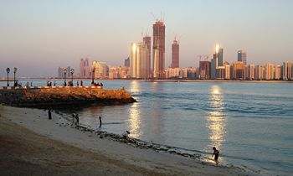
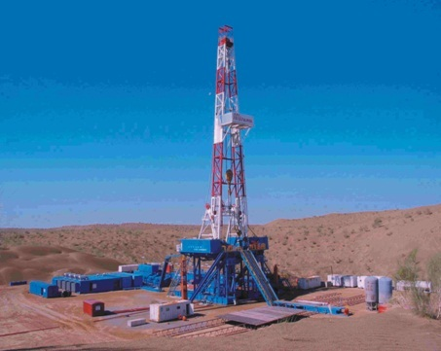
Negative Human Impact
Building cities = destroying habitat
Habitats SLOWLY recover
Radioactive Waste
Over-salinization (farming)
Fossil fuel depletion

Slide 18
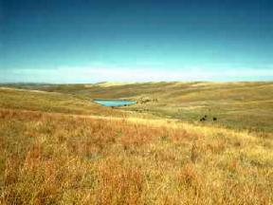
We Love Grasslands.
Livestock
Farming gold mine
Minerals/fossil fuels
Biodiversity

Slide 19
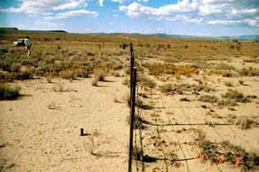
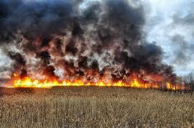
Negative Human Impact
Over-grazing → creates deserts
Over-hunting (bison) for cows/chickens
Wildfires
CO₂ release (burning savanna)

Slide 20
Save the Forests, Bro.
Biodiversity
Self-sustaining
Food sources (fertile soil)
Rare, endangered species

Slide 21
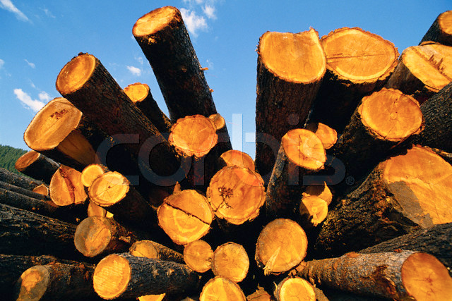
Negative Human Impact
Over-logging
Replacing with croplands
Over-hunting, extinctions
Biodiversity threatened
Acid rain (coal)

Slide 22
Quick Quiz #4
Why are deserts such powerhouses (literally)? Give at least two examples.
How are humans contributing to global warming in grasslands?
Why is replacing a natural forest habitat with cropland a bad thing? Give at least two reasons.

Slide 23
Warm Up #5
You are given enough funds and resources to save one type of biome (out of the 11 we have discussed in class).
Which biome would you save? In a paragraph (at least 5-6 sentences) provide at three reasons or more on why you would save this one over any of the others.

Slide 24
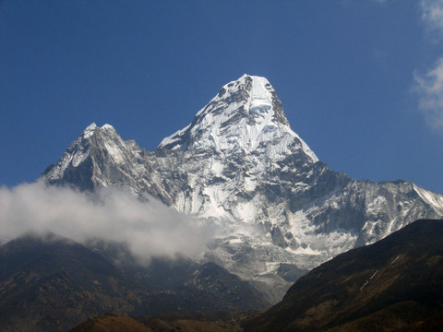
Mountains are Important too, Bro
20% earth’s land
Vegetation, soil, climate, animal changes = DRASTIC
Biodiversity
Climate control, forests

Slide 25
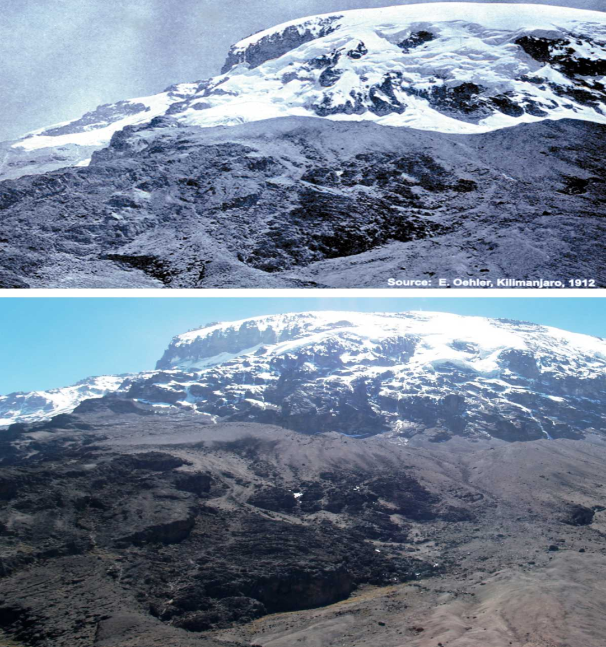
Killing the Mountains
Human population, tourism
Over-logging and climate change
Dams (damn…)
Air pollution

