Slide 1
Warm Up #4
Place the following numbers in standard form.
8.41x10⁴ 2.1x10⁻² 8.3x10¹
Find the products/sums of the following, rounding appropriately:
(2x10⁷)(7.51x10⁻⁴) (3.111x10⁶)+(5.72x10⁶)
What must be done to make any experiment legit? (list four things)

Slide 2
Warm Up # 5
A person runs 3000 inches. If 1 inch is equal to 2.54cm, how many meters does this person run?
School lasts 180 days each year. If the average school day is 6 hours and 45 minutes long, how many seconds of your life are spent in school each year?
A ball is heading toward your face at a speed of 80 km/hr. How fast is this in miles/sec? (remember 1.6 km = 1 mile). Will it hurt you upon impact?

Slide 3
Lab 101

Slide 4
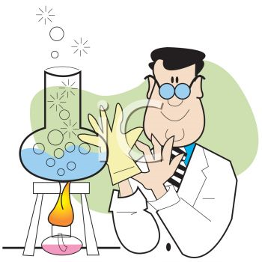
When Doing Labs
Use the Scientific Method – accepted method for scientists to explain how things work
Steps:
State Problem and Collect Data
Formulate Hypothesis
Perform Experiments

Slide 5
Step 1: Collecting Data [Two Types] Quality vs. Quantity?
Qualitative (Quality)
NO NUMBERS involved
Ex. The sky is blue
Ex. The solution is cloudy
Quantitative (Quantity)
NUMBERS involved
Ex. The solution is 34.50 grams
Ex. Water boils at 100 degrees

Slide 6
Step 2: Hypothesis
Hypothesis – a POSSIBLE explanation for why something happens
Observations are NOT hypotheses
Ex. the solution is cloudy (observation)
Ex. the solution is cloudy because it is contaminated (hypothesis)

Slide 7
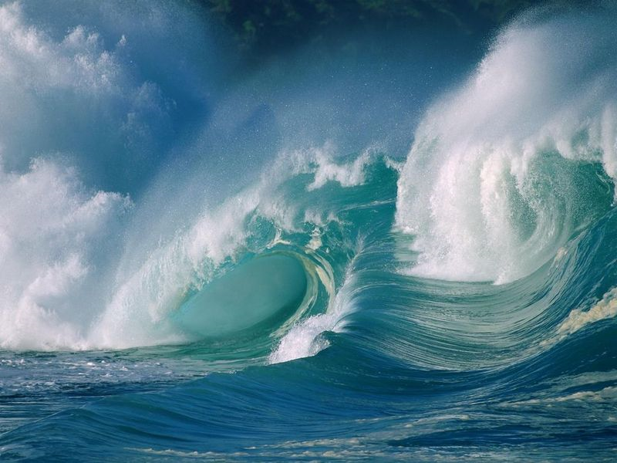
Step 3: Experiments
Use controls and variables
Control – the constant
Variable – the thing that changes in the experiment
Lake vs. Ocean
Perform multiple Trials – attempts at experiment

Slide 8
Step 3.5: Types of Variables
Independent Variable - controlled by the scientist
What is changing
Ex. Stirring a beaker
Dependent Variable – responds to changes made to the independent variable
Response to the change (JH, bro)
“What are you trying to find?”

Slide 9
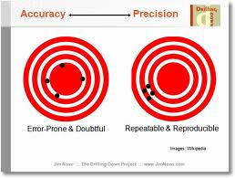
Step 4: Experiment
Data and Observations
Perform multiple trials!
Ensures precision, less errors
Accuracy vs. Precision
Accuracy – achieving goal of experiment
Hitting bulls-eye
Precision – achieving same answer multiple times
Same spot on dart board twice

Slide 10
Step 5: Theory vs. Law
Theory – a hypothesis supported by repeated testing
Theory of Evolution
CAN be disproven, although HIGHLY UNLIKELY
Law – generalized observations with NO exceptions
Law of Gravity
Something that just “is.”

Slide 11
Quick Quiz #1
Caffeine appears to have a profound effect on most people. I am designing an experiment to test the effects of caffeinated coffee on test subjects. Half the samples receive decaffeinated coffee, and the other half receive caffeinated coffee. Upon ingestion of the substance, the caffeinated subjects performed 50% better on their test than those who drank the placebo.
What is the control? Why?
What is the independent variable? Why?
What is the dependent variable? Why?
What conclusion can be made? What can be done to improve this experiment?

Slide 12
Warm Up # 5
In this lab we are testing the effects of salt on the boiling point of water. Beaker 1 contains water. Beaker 2 contains the same amount of water, plus salt. We will be placing both beakers on a hot plate, and measuring their temperatures in 2 minute intervals over a period of ten minutes.
What are three controls in this experiment?
What is the independent variable? How do you know?
What is the dependent variable? How do you know?

Slide 13
Review: Scientific Method
Hypothesis – possible explanation of phenomena
Multiple Trials = ensures precision (and accuracy)
Control – the constant (what you are comparing your experiment to)
Independent Variable – the thing the scientist is changing
Dependent Variable – “what are we trying to find?”
Theory (proven via testing) vs. Law (exists)

Slide 14
Lab Safety

Slide 15
Types of Chemicals
Flammables and Combustibles – chemicals that can catch on fire
Corrosives – things that damage/burn through skin tissue
Pressure – chemicals that are dangerous at different pressures

Slide 16
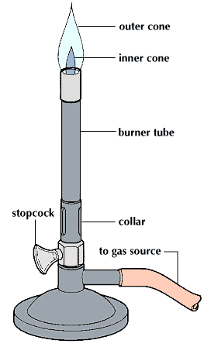
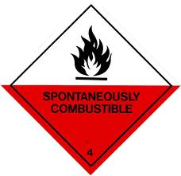
Flammables
Ex. Bunsen Burners (used in this lab!)
Precaution: WEAR GOGGLES!
Similar but NOT the same as COMBUSTABLES – catch fire at HIGH temperatures

Slide 17
Handling Boiling/Hot Chemicals
DON’T TOUCH WITH BARE HANDS!
USE TONGS or “Hot Hands”

Slide 18
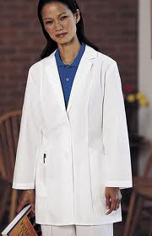
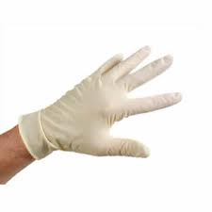
Corrosives
Corrosives = acids and bases that can damage skin
Precautions: WEAR GLOVES, PROTECTIVE CLOTHING (long-sleeves) AND GOGGLES

Slide 19
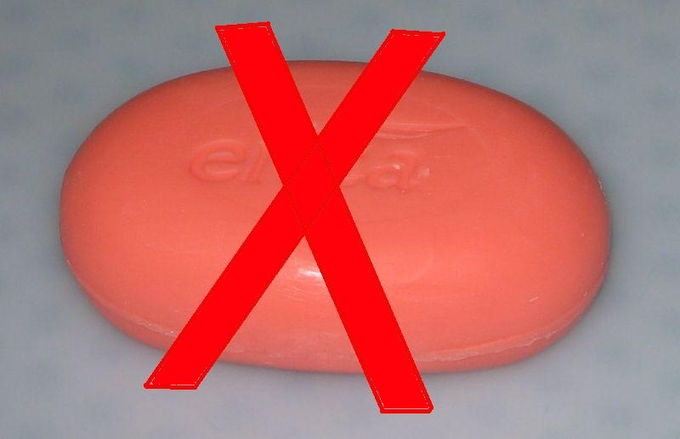
If Corrosive Chemicals Get On Skin…
RINSE IMMEDIATELY
continuous running water (NOT SOAP)
Eyes – RINSE IMMEDIATELY for at least 5 minutes under eye wash.

Slide 20
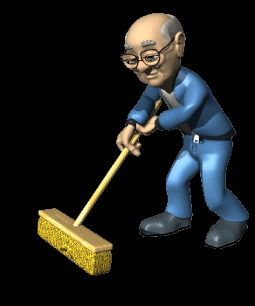
Broken Glass
Accidents happen (no, really)
Broken glass (beakers, test tubes, thermometers, etc) LET ME KNOW ASAP!
Move away from station until glass is cleared

