Slide 1
Warm Up #3
Find the molar masses of the following:
H₂O MgSO₄ Cu(NO₃)₂
Convert:
45.0 g H₂O = ____ mol H₂O
2.3 mol MgSO₄ = ____ g MgSO₄

Slide 2
Warm Up #3
Caffeine (C₈H₁₀N₄O₂ ) is one hell of a drug.
If we were using Avagadro’s number, what would the correct unit for caffeine be and why?
Convert the 150.0 grams of caffeine I just ingested into moles. And also into atoms (or whatever the correct unit should be).
Finally, find the molar mass of caffeine, and also TRY to figure out what percentage of that mass is made up of Carbon…the element that makes this an organic compound.

Slide 3
Chapter 10.3
Percent Composition

Slide 4
Review
STP = standard
temperature and pressure
0ºC, 1 atm
Volume of 1 mol of gas at STP = 22.4 L
Unit Conversions:
Grams Moles Atoms

Slide 5
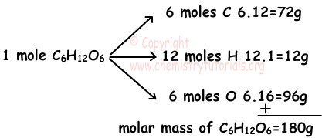
Percent Composition
Percent Composition – percentage of compound = a particular element
Use molar mass and mass of compound
Formula:
MASS OF ELEMENT
MASS OF COMPOUND
× 100%

Slide 6
Example: C₃H₈ (propane)
Mass of C₃H₈ = 44.11 grams
% Carbon:
3 (12.01 grams)
44.11 grams
% Hydrogen:
8 (1.01 grams)
44.11 grams
= 81.68 % C
× 100%
× 100%
= 18.32 % H

Slide 7
Using C₃H₈ again.
You know that there is a 7.50 gram sample of C₃H₈. How much of this sample is:
Carbon? [81.68% of molecule]

