Slide 1
Warm Up #1
What is a gas?
As the temperature of a gas increases, what happens to the speed of the gaseous molecules? Why do you think so?
As the temperature of a gas increases, what happens to the density of the gaseous molecules? Why do you think so?

Slide 2
Warm Up #2
You leave your water bottle sitting outside on a hot day, how do you think that affects the pressure inside the bottle? How can you tell?
When someone sprays a strong perfume, why do you think you don’t smell its scent after a while?
How do you think the pressure of air changes (if at all) as you climb a mountain? Why do you think so?

Slide 3
Chapter 13.1
Properties of Gasses and Kinetic Energy

Slide 4
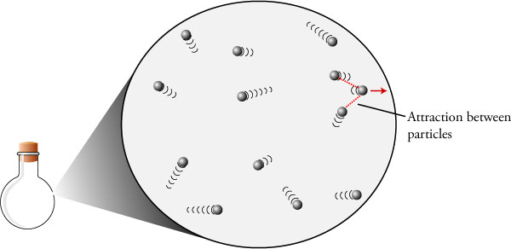
Kinetic Energy Applied
Kinetic Theory – all matter in constant state of motion
Kinetic = motion
Kinetic Energy – energy generated due to motion/collisions
Gas…no definite shape or volume
Motion = constant, rapid and random
Perfume smell goes away
Gas particles collide (elastic)
No net kinetic energy lost or gained

Slide 5
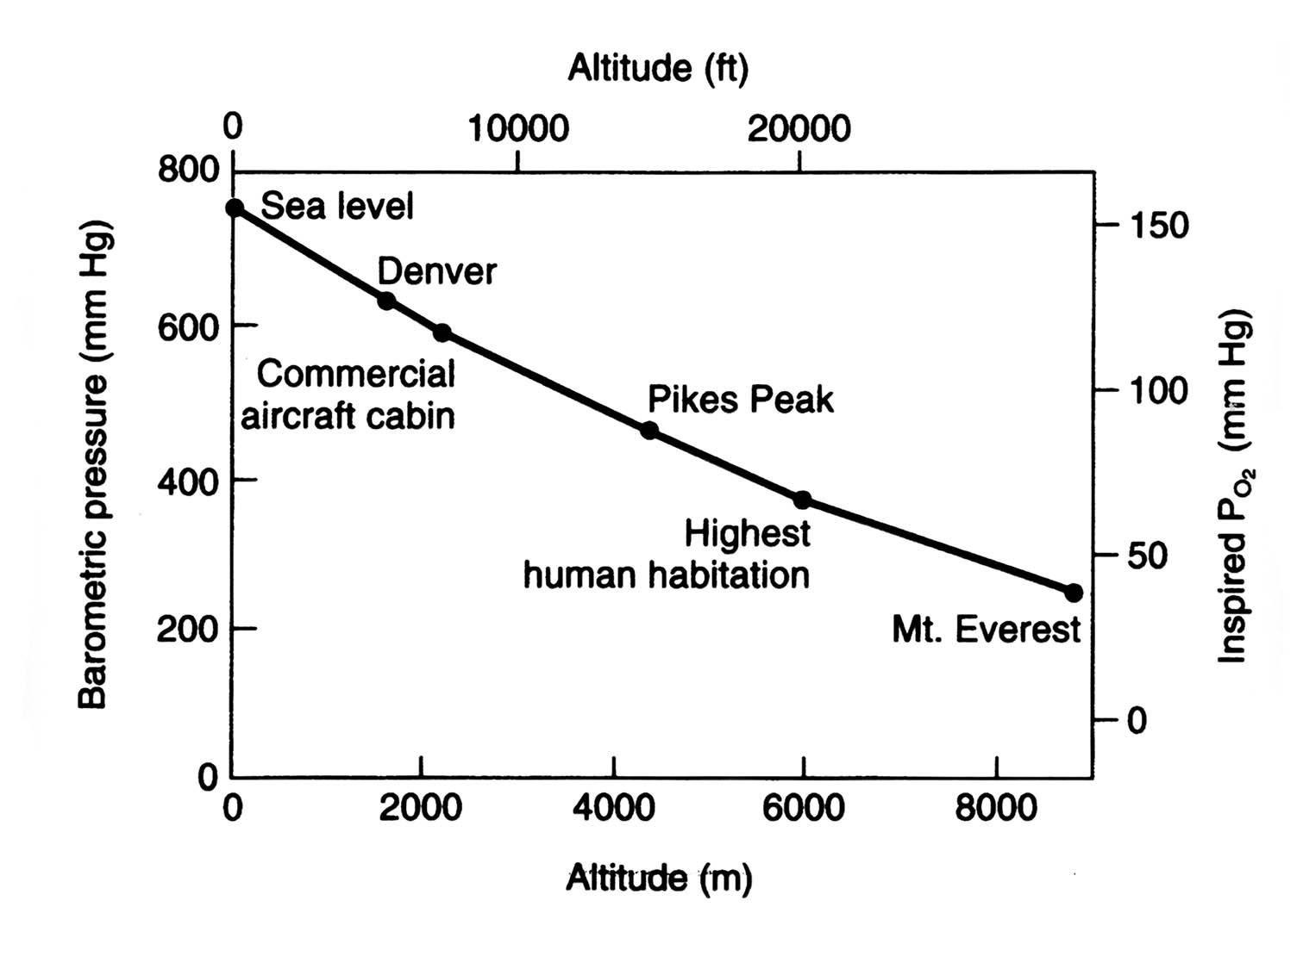
Pressure
Pressure – created by particles colliding
Vacuum – empty space with no particles and (therefore) no pressure
Related to volume and temp.
Barometer – used to measure gaseous pressure
Units
Standard Atmospheres (atm)
Kilopascals (kPa)
Millimeters of Mercury (mmHg)
1 atm = 760 mmHg = 101.3 kPa

Slide 6
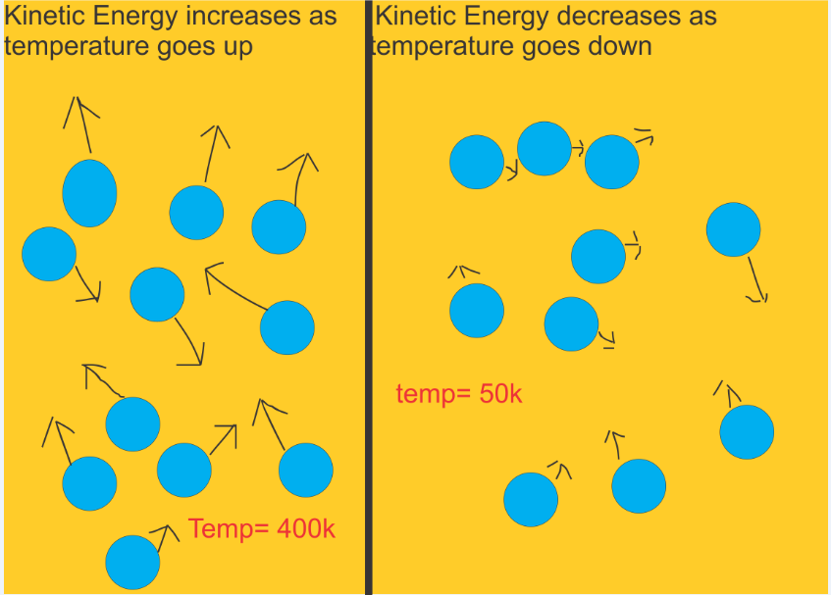
Gas Pressure: Temp and Elevation
Temperature – directly related to pressure
As temperature INCREASES, pressure INCREASES
More collisions
Elevation – inversely related to pressure
As elevation INCREASES, pressure DECREASES
Less collisions

Slide 7
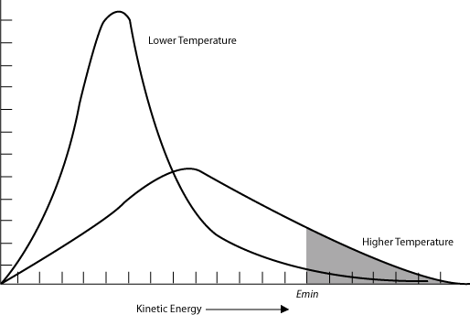
Kinetic Energy and Kelvin Scale
ºC → K = add 273
Average Kinetic Energy – avg. energy atoms of substance generate
Same kinetic energy for ALL substances at given temp.
Kinetic energy INCREASES with temp.
More collisions
Directly proportional to Kelvin scale
Ex. Gas at 200 K TWICE as much energy as gas at 100 K

Slide 8
Quick Quiz #1
What is the difference between an inverse proportion and a direct proportion? Use relevant gas examples to explain the difference.
Convert 590 mmHg into: kilopascals (kPa) and atmospheres (atm)
Use the terms “average kinetic energy” and “collisions” to explain how gaseous particles respond to a decrease in temperature.

