Slide 1
Warm Up #3
How does the kinetic energy and number collisions relate to the temperature? With this logic, how could someone die from hypothermia (being in cold temperatures too long)?
230 kPa = ____ atm? … _____ mmHg?
How does pressure relate to elevation? Why does this relationship exist?
Name two phase changes (going from one state of matter to another), and describe this phase change.

Slide 2
Chapter 13.2
Properties of Liquids
Phase Changes

Slide 3
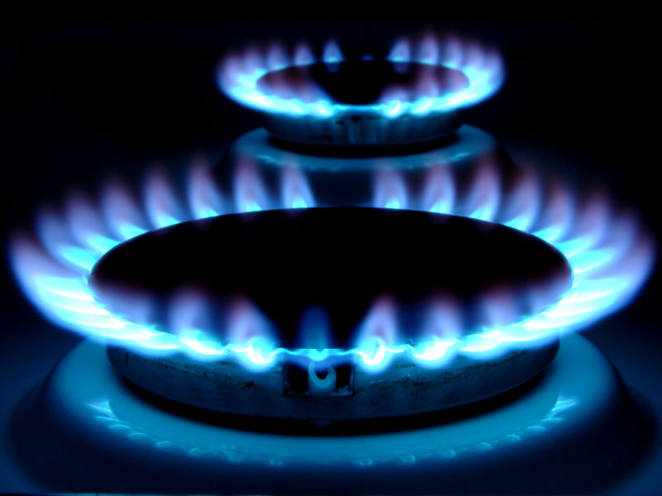
Review: Gasses
Kinetic Theory – all matter in constant motion
Except absolute zero (0K)
Pressure: # collisions/unit volume
mmHg, atm, kPa
Temp. = DIRECT relationship
Elevation = INDIRECT relationship

Slide 4
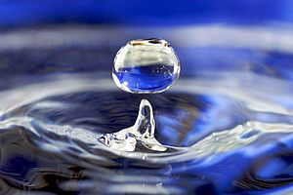
Liquids
Liquids – take shape of container, definite volume
More dense than gas
More attractive forces at work
Liquids = condensed
Difficult to compress

Slide 5
Liquids and Pressure…a straw
Gases/Liquids prefer moving from HIGH to LOW pressure
Sucking action = DECREASES pressure INSIDE straw/mouth
Pressure of water draws liquid UP straw into mouth
To a point (20 meters)

Slide 6
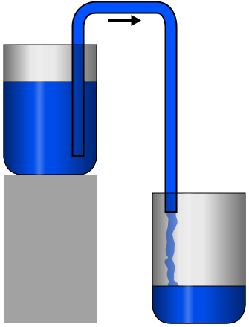
Siphoning
Siphoning – flowing liquids through tubes
Atmospheric Pressure pushes liquid up
HIGH to LOW pressure
Gravity pushes liquid from top of straw into bottom container

Slide 7
Phase Change: Vaporization/Evaporation
Vaporization – liquid to a gas/vapor
Evaporation – occurs on surface of liquid not boiling
MINIMUM kinetic energy required to become gas
Lower than that = liquid
Evaporation = a cooling process!

Slide 8
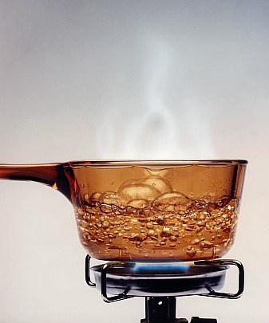
Vapor Pressure
Boiling in CLOSED container
Condensation – gas becoming a liquid
Sides of cup of water
Equilibrium – a balance
Evaporation rate = Condensation rate
Boiling Point – temp. when vapor pressure = external pressure
Liquid NEVER hotter than this

Slide 9
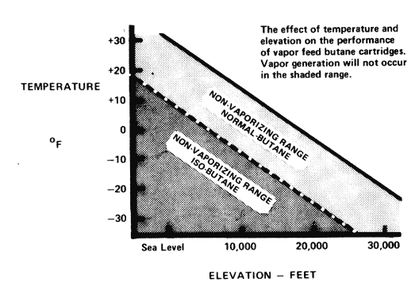
Boiling Point and Elevation
B.P. when vapor pressure = external pressure
Normal boiling point = when pressure = 101.3 kPa
As elevation increases, pressure decreases
Inverse proportion
SO
As elevation increases, boiling point decreases

Slide 10
Quick Quiz #2
How does the kinetic energy influence the state of matter something will be in? Why are liquids not really compressible?
Review: you transfer water from one container, to another container at the same temperature. How will that effect the kinetic energy of the water? Why?
Why will the boiling point lower as elevation increases?

