Slide 1
Warm Up #4
Graph the following for isopropyl alcohol. Using temperature as your X-axis.
Temperature (ºC) | Vapor Pressure (kPa)
0 | 0.06
20 | 3.05
40 | 12.3
60 | 47.0
80 | 114
100 | 301
What is the normal boiling point for this substance?
When the standard pressure is doubled, what is the boiling point of this substance?
How do you define boiling point? How would the boiling point change with increased elevation, and why?

Slide 2
Chapters 13.3 and 13.4
Solids and Phase Changes

Slide 3
Review: Liquids
No definite shape, definite volume
Not easily compressed, stronger attractive forces, fluidity
High pressure to low pressure gradient
Straw, siphoning, hot air rising
Evaporation vs. Boiling
Evaporation = liquid to gas BELOW boiling point (cooling)
Boiling Point = when vapor pressure = external pressure
Mt. Everest – B.P. is LOWER than sea level (less external pressure)

Slide 4
Solids
Solid – has definite shape and volume
Particles in solids VIBRATE in fixed positions, don’t flow
Solids MELT – go from solids to liquids
Same temperature as freezing (for H2O, normal = 0ºC)
Melting/Freezing Equilibrium – temp hot enough for particles to move more freely
Ionic – HIGH
Covalent - LOW

Slide 5
The Silly Putty Question: Solid or Liquid
Viscosity – fluidity of a substance (ability to move around)
Liquids: how thick is it?
Water = flows easily (low viscosity)
Silly Putty = liquid with high viscosity

Slide 6
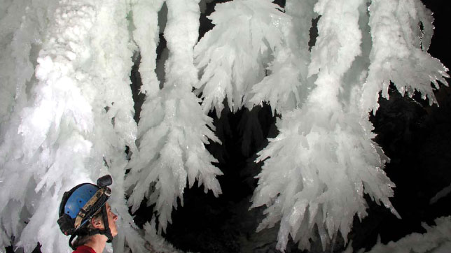
Solid Shapes
Crystals – orderly arrangement of particles
NaCl
Unit Cells = most basic shape
Lattice = repeating array of unit cells
Allotropes – two or more different crystal forms
Carbon compounds
Amorphous – random arrangement
Plastic, rubber, glass

Slide 7
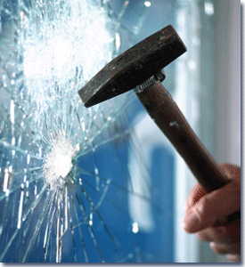
Glass and Temperature
Pouring cold water into hot beaker = SHATTER
Heat → Solids expand
Pressure increase
Outside of beaker
Cold → Solids contract
Pressure decrease
Inside of beaker
Amorphous glass structure = shatter into random fragments

Slide 8
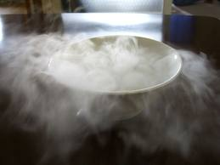
One More Phase Change
Sublimation – solid to gas state
Dry ice, iodine
vapor pressure HIGHER than external pressure at room temp.
Uses:
Coolant for frozen foods
Mixture separation

Slide 9
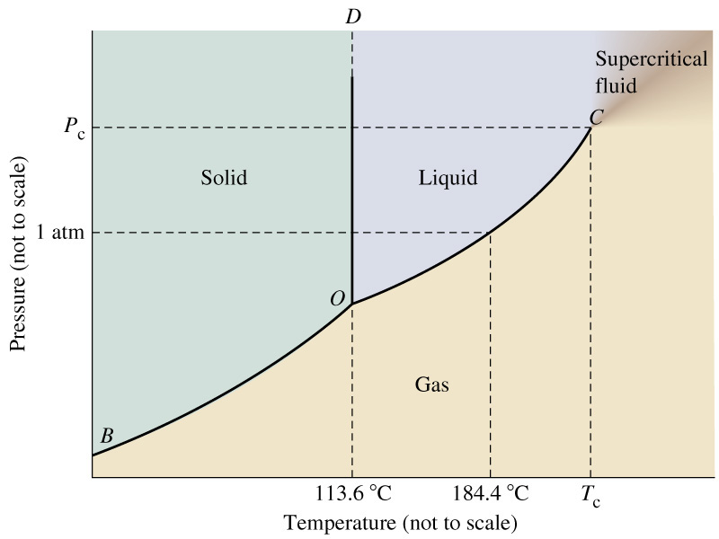
Phase Diagrams
Indicate conditions that determine substance state of matter
X-axis = temperature
Y-axis = pressure
“Normal” – temp. at standard pressure
1 atm, 760 mmHg, 101.3 kPa
Triple Point – conditions where all three states of matter exist at same time

Slide 10
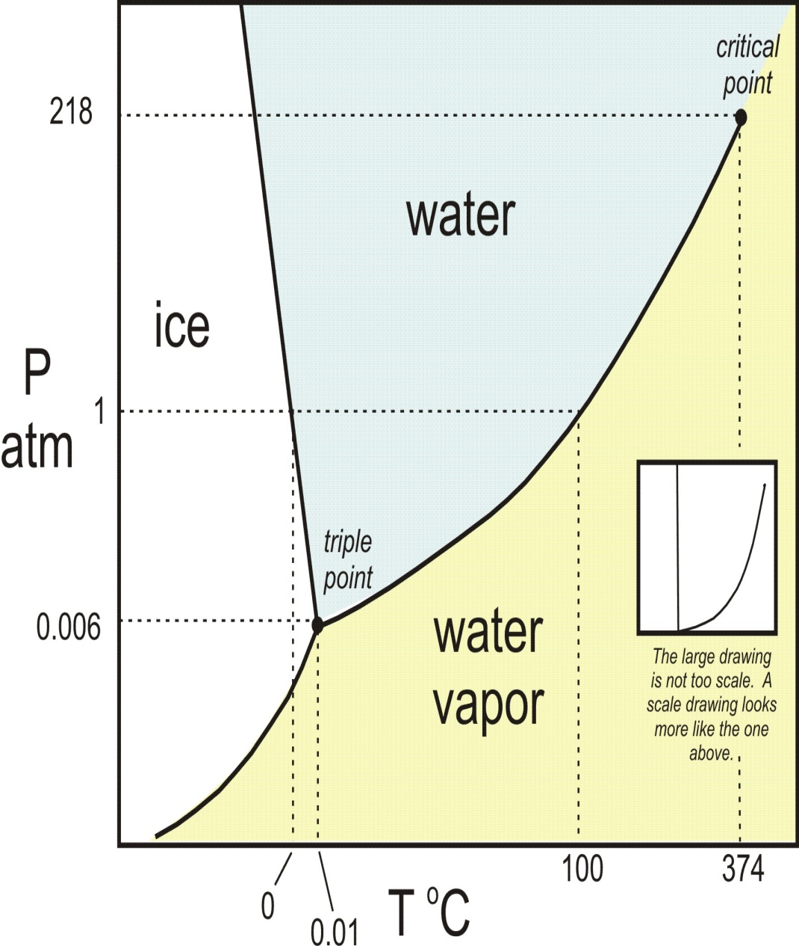
A Phase Diagram Explained: Water
Normal (1atm):
FP/MP = 0ºC
BP = 100ºC
Triple Point conditions:
Temp = 0.01ºC
Pressure = 0.006 atm
If temp. constant oºC:
0 atm = gas
0.006 atm = solid
1 atm = solid/liquid
> 1 atm = liquid

Slide 11
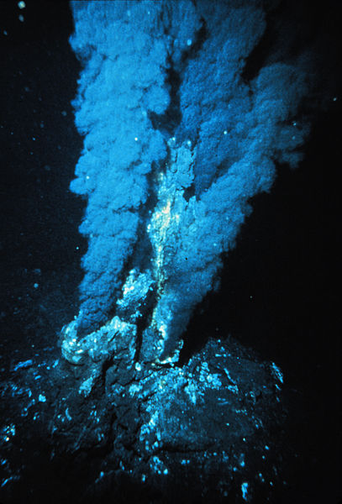
Phase Diagram Extremes
Critical Point – liquid/gas phase limit of pressure and temp.
Beyond these conditions = supercritical fluid
Ex. Hydrothermic vents
Bottom of ocean
Uses: decaf coffee, beer-making, dry cleaning

Slide 12
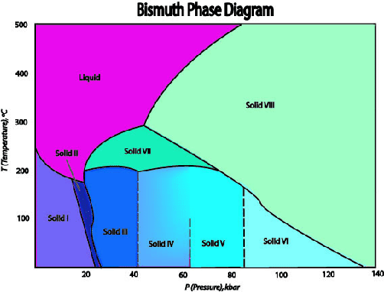
Cray Cray Things

Slide 13
Quick Quiz #3
Explain why, when glass shatters, it breaks apart into unequal fragments.
Why do ionic solids have an unusually high melting point?
Define sublimation, and why this phenomenon occurs.
What are the two major influences of the state of matter of a substance?

