Slide 1
Warm Up #1
As temperature of a gas increases, how do you think this affects the pressure inside the container?
As the size, or volume, of the container decreases, how does this affect the pressure of a gas? Why does this happen?
Describe the relationships between pressure and temperature/volume.

Slide 2
Chapter 14.1-14.2 Gas Laws

Slide 3
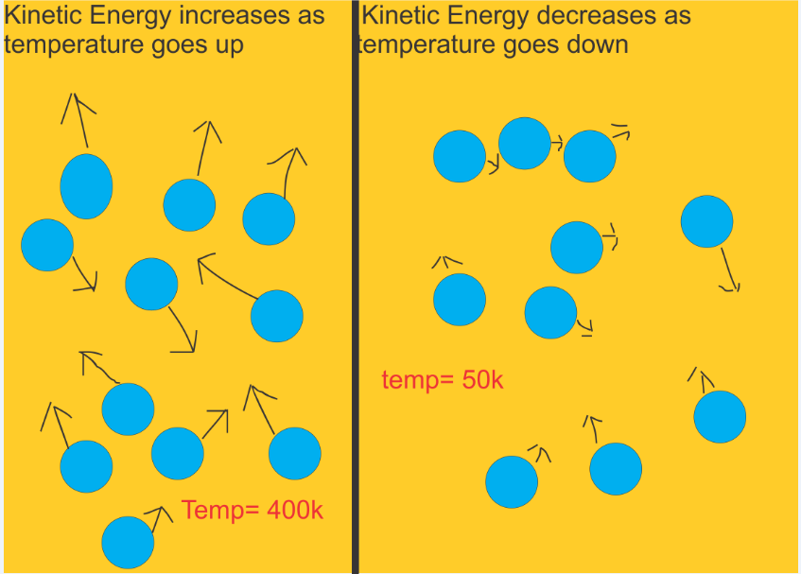
Kinetic Energy and Pressure
Kinetic Theory – everything is in motion
Kinetic Energy – energy from movement
Increased by: higher temps and smaller volume
When gas particles move, they collide…creating pressure
More collisions = more pressure

Slide 4
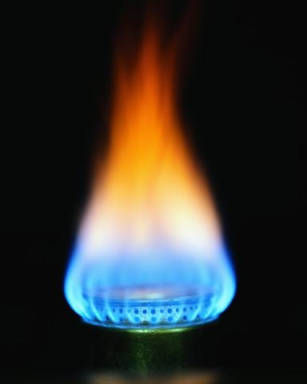
Gas Facts
No Definite Shape
No Definite Volume
Compressible
Elastic Collisions
Why?
WEAK Attractive Forces

Slide 5
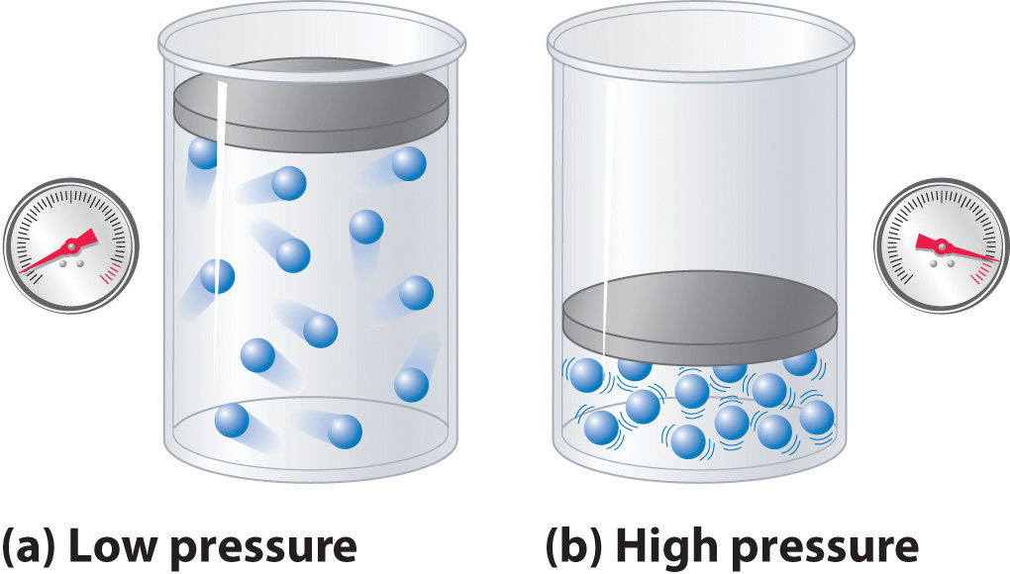
Pressure in Response to…
VOLUME
At constant temperature
As volume decreases, pressure increases
Inverse relationship – as one goes down, the other goes up
Why?
Smaller space = more collisions!
Remember: more collisions = more pressure.

Slide 6
Volume and Pressure: Boyle’s Law
Boyle’s Law – at constant temperature, the pressure will increase as the volume decreases
Volume = Liters (L)
Pressure = atm

Slide 7
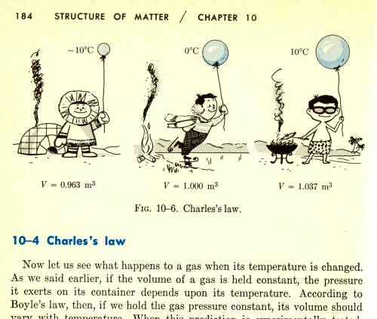
Volume in Response to….
TEMPERATURE
At constant pressure
As temperature increases, volume will also increase
Direct relationship – as one thing goes up, so does the other
As temperature increases, gasses move faster
More kinetic energy
To keep pressure the same inside, balloon gets bigger
As the temperature outside gets hotter…the size of the balloon gets bigger!!

Slide 8
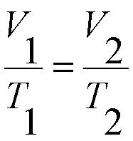
Volume and Temperature: Charles’s Law
Charles’s Law – at constant pressure, volume will increase as temperature increases
Volume = Liters (L)
Temp. = Kelvin (K)

Slide 9
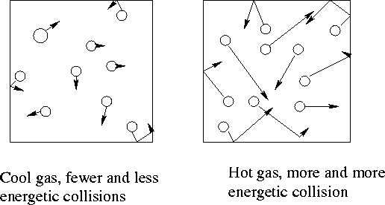
Pressure In Response to…
TEMPERATURE
At constant volume
As temp. increases, pressure increases
Direct relationship
As temp. increases, Speed of molecules increases
more collisions = higher pressure

Slide 10
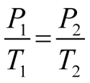
Temp and Pressure: Gay-Lussac’s Law
Gay Lussac’s Law – if volume is constant, pressure will increase if temp. increases
Temp = Kelvin (K)
Pressure = atm

Slide 11
Putting it all Together…
COMBINED GAS LAW

Slide 12
Conversion Reminders
Pressure
1 atm = 101.3 kPa = 760 mmHg
Atm = atmospheres
kPa = kilopascals
mmHg = millimeters of Mercury
Volume
1 L = 1000 mL = 1000 cm³
Temperature
ºC + 273 = Kelvins
(ex. 78 ºC + 273 = 351 K)
(ex. 351 K – 273 = 78 ºC)

Slide 13
Example Problem
A balloon of air occupies 2400mL of space in a room at 22ºC. How big will the balloon be if the room was -36ºC?
Volume and Temperature = CHARLES’ LAW
Label all numbers...and convert
V1 = 2400 mL……or 2.4 L
V2 = ??
T1 = 22ºC…+273 = 295 K
T2 = -36ºC…+273 = 237 K

Slide 14
Example Problem Continued
V1 = 2.40 L
V2 = x L
T1 = 295 K
T2 = 237 K
2.4 = x
237
295(x) = (2.4)(237)
X = 1.93 L

Slide 15
Quick Quiz #1
Solve the problems below, and identify the gas law that explains each phenomenon described.
If a gas has a pressure of 715 mm Hg at the temperature of 500 K, what will the pressure change to if the container is heated to 900 K?
If a gas has a pressure of 4.5 atm when the size of the container is 3.0 L, how will the pressure be affected if the volume is doubled to 6.0L?
If a gas in a 9000 mL container at a temperature of 300 K is placed in a container half of this size. How will this affect the temperature?

