Slide 1
Warm Up #3
You are given a 5000.0 mL container of SO₂ gas with a pressure of 1.4 atm. If the temperature of this gas is at 25ºC, how much gas will you have, in grams?
You have 4.5 L of a gas at a pressure of 450 mmHg and a temperature of 300 K. How would the volume of the gas be different if it was at STP?
You are given a gas with a pressure of 50.4 kPa. If you were to triple the temperature, how would that effect the pressure? Why would this happen?

Slide 2
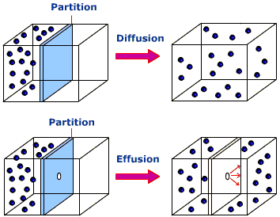
Diffusion vs. Effusion
Diffusion – molecules moving from HIGH to LOW concentration/pressure
Effusion – gaseous molecules escaping through small hole in container (high to low pressure)

Slide 3
Graham’s Law
Graham’s Law – large, fatty molecules move slower than small, skinny ones
M = molar mass
1 = smaller gas
2 = larger gas

Slide 4
Example Problem
Which gas moves faster, N2 or CO2? By how much?
N2 = 28.02 grams (M1)
CO2 = 44.01 grams (M2)
N2 is lighter, so it will move faster…but by how much?
44.01
28.02
This means N2 will move 1.25x faster than CO2
1.25

Slide 5
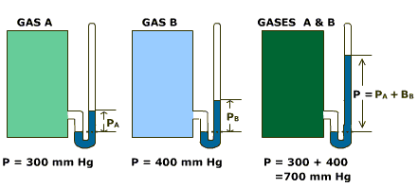
Partial Pressures
Dalton’s Law of Partial Pressures
container filled with multiple gasses
Pressure of container = pressure of each gas
P_{T} = P₁ + P₂ + P₃…

Slide 6
Example Problem
A container with four different gasses has a pressure of 160 mmHg. Gas 1 has a pressure of 20 mmHg, Gas 2 has a pressure of 65 mmHg and Gas 3 has a pressure of 40 mmHg. Find the pressure of Gas 4.
P₄ = P_{T} – P₁ – P₂ – P₃
P₄ = 160 – 20 – 65 – 80 = 35 mmHg
P₄ = 35 mmHg

Slide 7
Quick Quiz #2
Which gas is likely to effuse faster, carbon dioxide or nitrogen gas? Why have you chosen your answer? Show, using Graham’s Law, the difference in speed.
You are given a container containing 4 gasses at 340 mmHg of total pressure. One gas is at 0.09 atm, another at 120 mmHg, and another at 13 kPa. How much pressure is exerted by the final gas?
You have a gas in a 456 mL container. If the molar mass of this gas is 23 grams per mole, find out how many moles of gas you have at STP conditions. Also, find how many grams of gas you have.

Slide 8
Warm Up #4
You are comparing the rates of two gasses: oxygen and a mystery gas. You find out this mystery gas moves 4 times faster than oxygen. What gas is this?
You are given 68.0 g of dinitrogen monoxide gas at 800 K in a 10 L container. How much does this gas exert in mmHg?
You have a gas at a constant volume of 50.0 mL. If you change the current STP conditions to 1100 mmHg, how will the temperature be affected?

