Slide 1
Warm Up #5
Comparing a substance in a solid state to its liquid state, which do you think is more dense? On a molecular level, why have you chosen this answer?
In a cup of ice water, where is the ice found in comparison to the liquid water? Why does this answer not make sense with the earlier question?
Review: What type of bonds are there in a water molecule, ionic or covalent. How do you know?

Slide 2
Chapter 15.1: Water

Slide 3
Part 1: The Preachy Segment

Slide 4
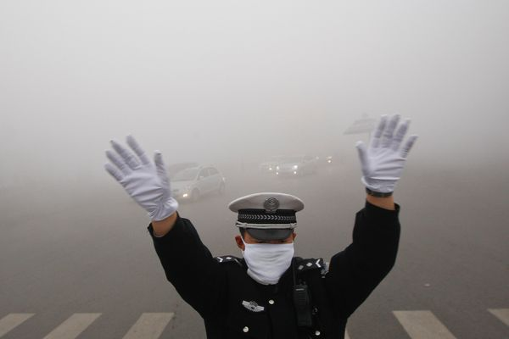
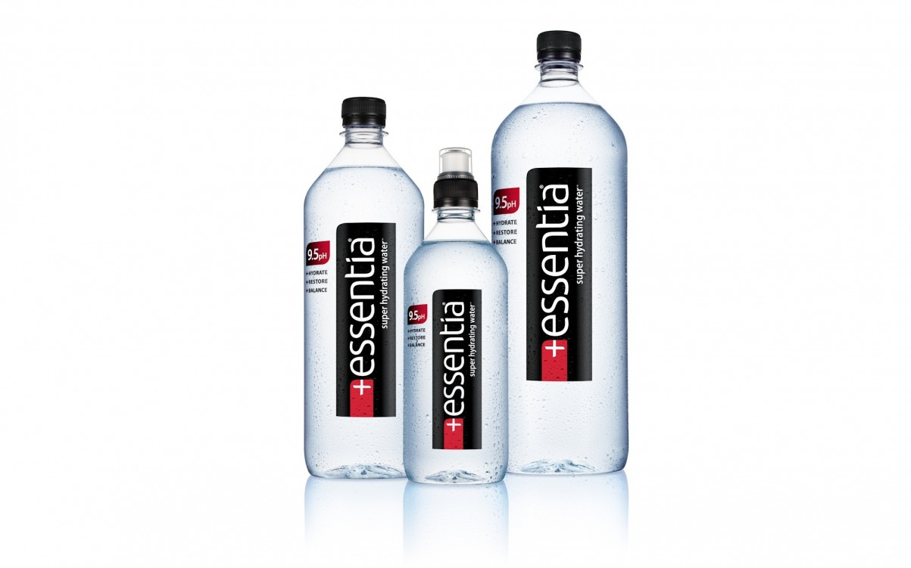
H₂O in pH
70% body = water
pH of pure H2O = 7.0 (neutral)
Rainwater in China = 4.0 (acidic)
Alkaline Water = 9.0 (healthier?)

Slide 5
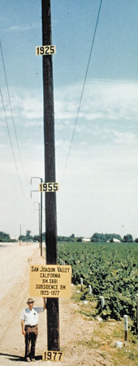
Farming in Deserts
Aquifers
Groundwater “overdrafting”
San Joaquin Valley, CA

Slide 6
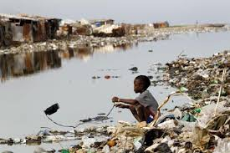
Clean Drinking Water
Mexico
Africa
Cholera outbreaks
1/6 of people on Earth do NOT have clean water source.

Slide 7
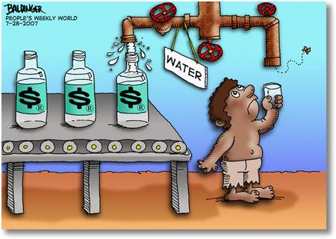
“Owning” Water
Tap vs. Bottled water
Private water companies
Water as a weapon

Slide 9
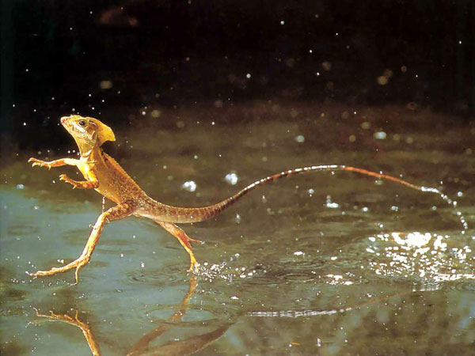
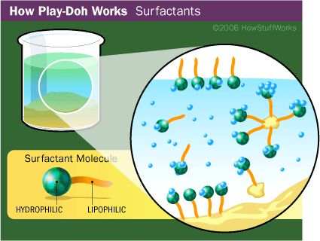
Walking on Water
Surface Tension – force drawing liquids inward, away from surface
Droplet shape forms
Hydrogen bonds = HIGH surface tension for H2O
Surfactant – substance that breaks up H-bonds, lowering S.T. (soap)
Hydrophilic vs. hydrophobic

Slide 10
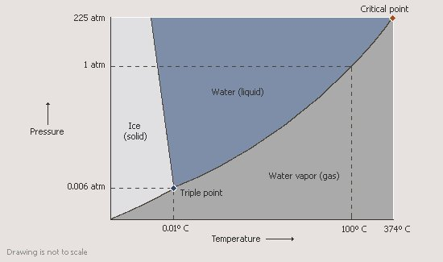
Boiling Water
Heat of Vaporization – Boiling point of H2O
For H2O = HIGH, due to H-Bonds
Climate moderation, keeps oceans/lakes, etc. liquid

Slide 11
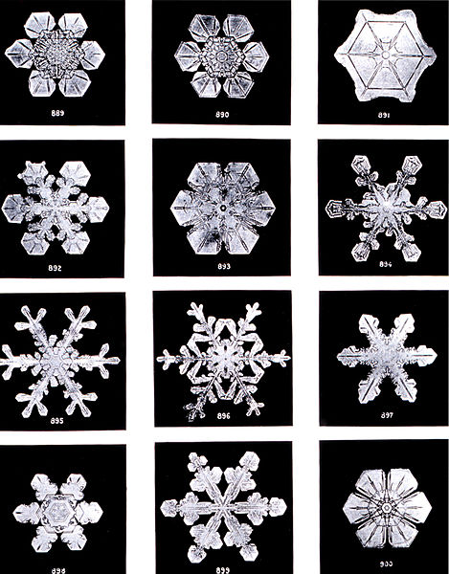
4ºC
Water gets more dense from 100ºC → 4ºC
Normal liquid – as temp. lowers, density increases
4ºC…HIGHEST DENSITY
Below 4ºC…water gets less dense
Why ice cubes float in water

Slide 12
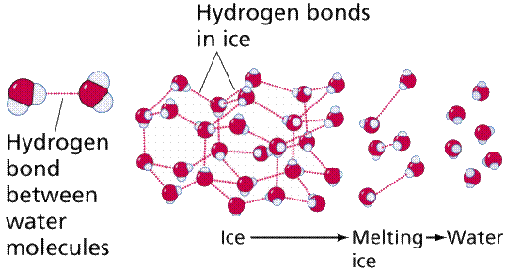
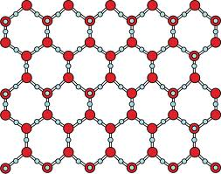
Why Ice Cubes Float
Ice cubes (solid) less dense than liquid water.
Um…what?
H-Bonds = honeycomb shape for solid
Snowflakes
Solid H2O molecules further apart = less dense

Slide 13
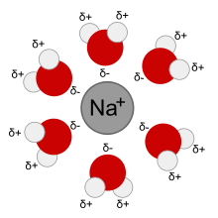
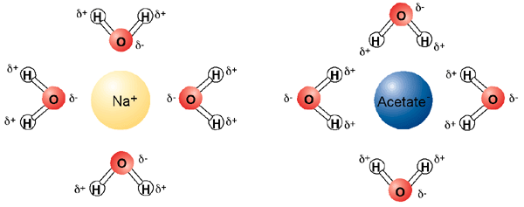
How Solutions Dissolve
Water = universal solvent
Polarity
Good at dissolving polar, ionic compounds
Bad at dissolving nonpolar compounds
Solvation – negatively charged particles break away, positive charged particles surrounded by solvent
Dissolving

Slide 14
Solubility in Water
Water = Universal Solvent?
Polarity of water molecules
Miscible – ability of liquids to fully dissolve in one another
Immiscible Substances:
Non-polar covalent compounds = insoluble in water
Gasoline, oil, methane
“Like dissolves like”
Some ionic compounds = STRONG attractive forces, resist dissolving in water
Ex. CaCO3, BaSO4
Precipitates (review from Ch. 11)

Slide 15
Solubility (in general)
Solubility – ability for something to be dissolved
Measured in grams per 100 grams H2O
Saturated Solution – max amt. of solute that can be dissolved in solvent
Concentrated solution
Unsaturated Solution – max. amt of solute has not been reached
More can be dissolved
Dilute Solution

Slide 16
Solubility Factors: Temperature
As temp. increases, solubility increases
Ex. “Breaking Bad Lab”
Supersaturated Solution – a solution containing more solute that can be dissolved
Result: crystal formation

Slide 17
Solubility Factors: Pressure
As pressure increases, solubility of GAS increases
Liquids = little effect (not compressible)
Henry’s Law – at a given temp. solubility (S) is directly proportional to pressure (P)
S = g/L (grams per Liter)
S1/P1 = S2/P2

