Slide 1
Warm Up #7
You are dissolving 60.0 grams of CH4 into 100. mL of ethanol. If the density of ethanol is 0.789 g/mL, find the molality of this solution.
50.0 grams of salt (NaCl) is added to 170. g of water. What are the new freezing and boiling points of water? ( for water: K_{b} = 0.512; K_{f} = 1.86)
Why does water not mix/dissolve oil or gasoline? (hint: would oil and gasoline mix/dissolve if they were together, why or why not?)

Slide 2
15.2 and 15.3
Electrolytes and Heterogeneous Solutions

Slide 3
Review
Molality – mol solute/kg solvent
Freezing Point Depression and Boiling Point Elevation
ΔT_{f/b} = i • K_{f/b} • m_{solute}
ΔTf/b = CHANGE in temp (f = down, b = up)
i _{= ionic (# ionic particles)}
K_{f/b = constant (given in} º_{C/m)}
m_{solute = molality (mol/kg)}

Slide 4
Electrolyte
Electrolyte – conductor of electricity in aqueous solution
Ionic compounds
Separate via H2O
(like dissolves like)
Ex. NaCl + H2O → Na⁺ + Cl⁻ + H2O
Nonelectrolyte – do not conduct electricity
Most covalent compounds

Slide 5
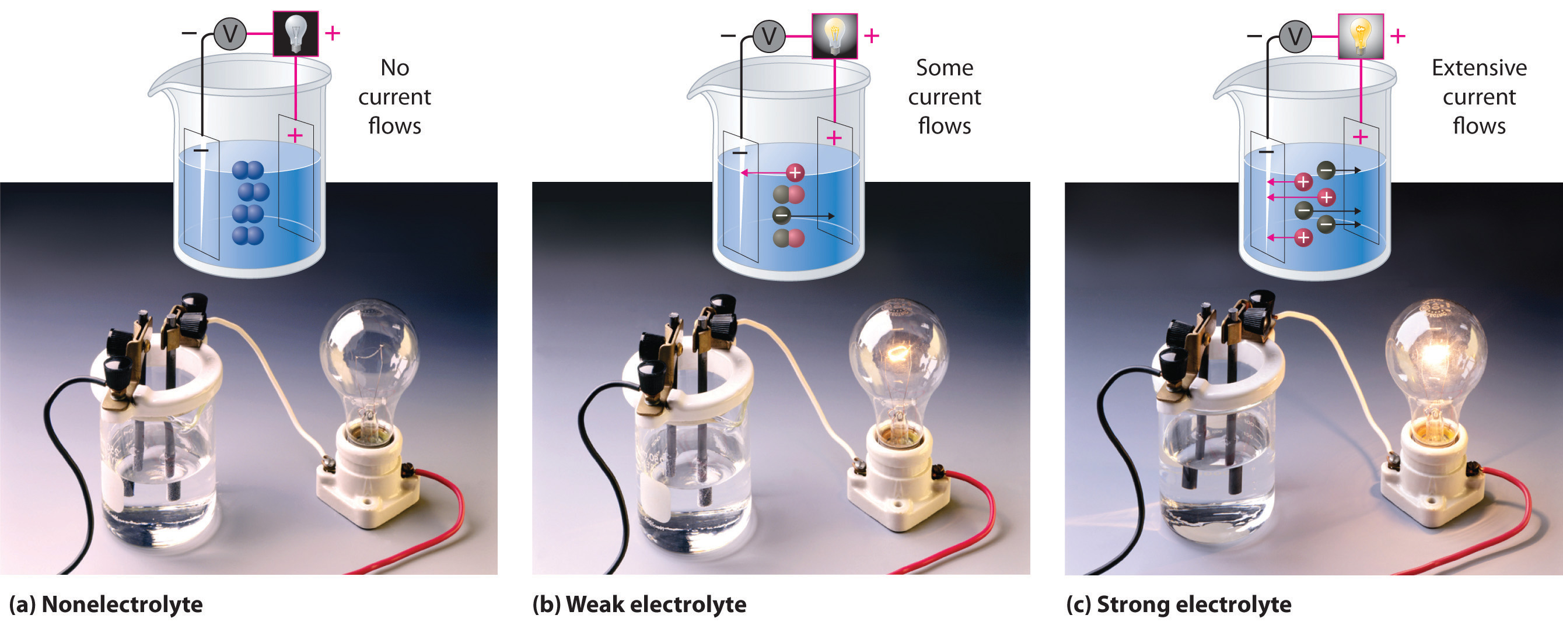
Strong vs. Weak Electrolytes
Ex. Light Bulb Test
NaCl_{(aq)} = BRIGHT
Strong electrolyte – complete breakdown into ions (Na+ and Cl-)
Baking Soda [NaHCO3_{(aq)}] or Gatorade = DULL
Weak electrolyte – incomplete breakdown into ions

Slide 6
Heterogeneous Mixtures
Colloids
Suspensions
Medium particle size
Exhibits Tyndall Effect
Does exhibit Brownian Motion – WILL NOT separate in presence of gravity
Due to collisions inside colloid
Ex. Mayo, Fog, Whipped Cream
LARGE particle size
Exhibits Tyndall Effect – ability to scatter light
Does NOT exhibit Brownian motion – WILL separate in presence of gravity
Ex. Salad Dressing, Clay, Flour

Slide 7
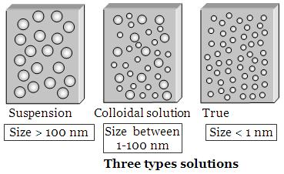
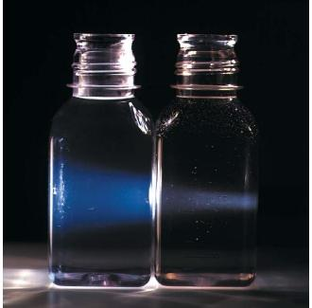
Properties of Solutions
Homogeneous – evenly mixed
VERY small solute particle size
No light scattering
Does not separate due to gravity

Slide 8
Reminder: Soap
Soap = surfactant – disrupts H2O’s surface tension
Nonpolar substance
Soap = cleaning agent …WHY?
Emulsifying Agent – allows liquids to form colloidal mixtures
Soap + H2O allows grease to be cleaned off
Normally H2O and grease…DON’T MIX

