Slide 1
Warm Up #1
What is a catalyst?
In the words “endothermic” and “exothermic,” what do you think the prefixes “endo” and “exo” mean?
What does the Law of Conservation of Mass/Energy state?
Finally, what does the Δ symbol mean?

Slide 2
Chapters 17.1 and 17.2
Thermochemistry

Slide 3
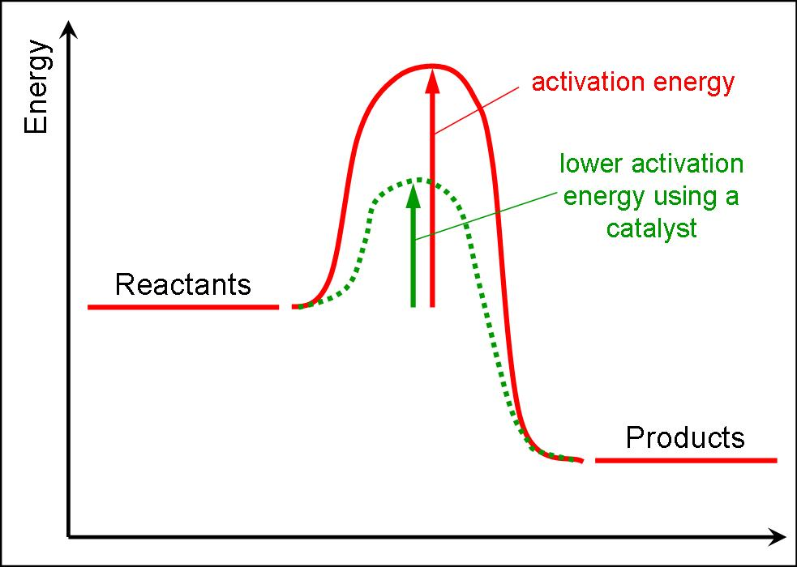
Laying the Foundations
Thermochemistry – study of energy changes in a chemical reaction
Reaction requires Activation Energy – energy required to start a chemical reaction
Catalyst – speeds up reaction by lowering activation energy
Heat (q) – energy transferred
Measured in: JOULES or calories
1 cal = 4.184 J

Slide 4
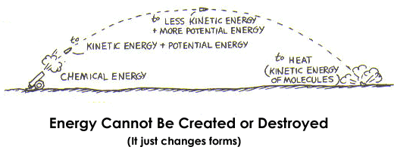
Laws of Thermochemistry
1st Law
Law of Conservation of Energy - energy can not be created or destroyed.
It just changes forms
2nd Law
Law of Energy Transfer - the flow of energy always results in heat loss
Not 100% efficient

Slide 5
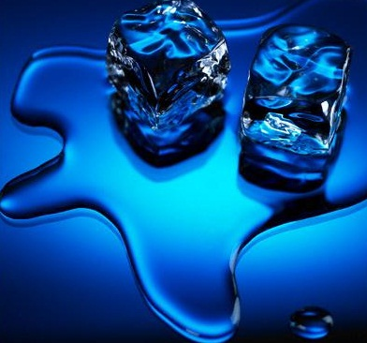
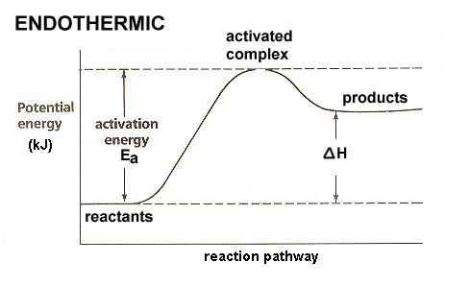
Endothermic Reaction
Endothermic Reaction – when heat is absorbed in a chemical reaction
High activation energy required
q is positive
Energy absorbed = +
Temp of system heats up
Surroundings cool down
Ex. Sitting near a fire, melting

Slide 6
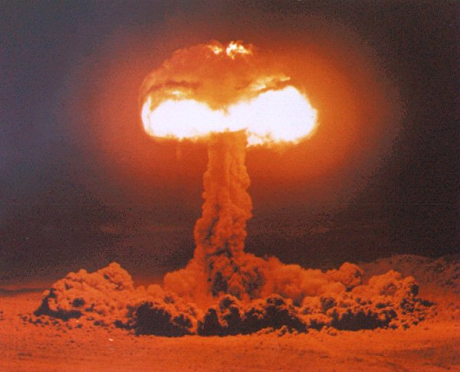
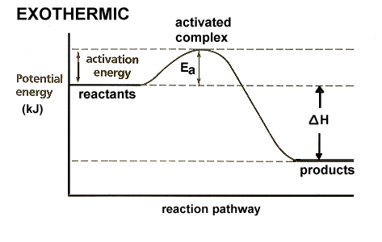
Exothermic Reaction
Exothermic Reaction – when heat is released in a chemical reaction
Low activation energy required
q is negative
Energy released = -
Temp. of system cools down
Surroundings heat up
Ex. Combustion, sweating

Slide 7
Measuring Heat
q = m • c • ΔT
q = “m-cat”
q = heat (J or cal)
m = mass (g) of substance
c = specific heat of substance (given) – amt. of energy required to raise 1 g of substance by 1ºC
ΔT = change in temp. (T_{final} – T_{initial})

Slide 8
Quick Quiz #1
Find the specific heat for a 95.4 gram substance that absorbs 850.0 J of heat when the temperature increases from 25.0ºC to 48.0ºC
In your answer, include the type of reaction occurring.
How much heat is required to raise the temperature of 250.0 grams of mercury by 52ºC. The specific heat of mercury is 0.14 J/(ºC•g).
What type of reaction is occurring? What is the heat of the surroundings of this problem?

