Slide 1
Warm Up # 4
When the temperature for 45.0 grams of water decreases from 90.5ºC to 7.0ºC, how much energy is lost, in kilojoules? The specific heat of water is 4.18J/ºC•g.
What does ΔH mean? Give two examples of phase change in which the ΔH will be positive. Explain why they are positive.
Draw a diagram for an endothermic reaction. Use these specific numbers. The reactants are originally at 50 J of energy, the peak of the energy is at150 J of energy. The products are at 110 J of energy. With these numbers in mind answer the following questions:
How much activation energy is required for the reaction to occur.
What is the ΔH in this reaction? Is it a positive or negative number?

Slide 2
Chapter 17.3-17.4
Amount of Energy with Phase Changes

Slide 3
You have 78.0 grams of ice at -5.00ºC. Calculate how much energy will be generated, in kilojoules (kJ), when you increase the temperature to 125ºC, producing water vapor.
Given information for H₂O:
ΔH_{fus} = 6.01 kJ/mol Melting Point: 0.00ºC
ΔH_{vap} = 40.7 kJ/mol Boiling Point: 100ºC
C = 4.18 J/ºC•g

Slide 4
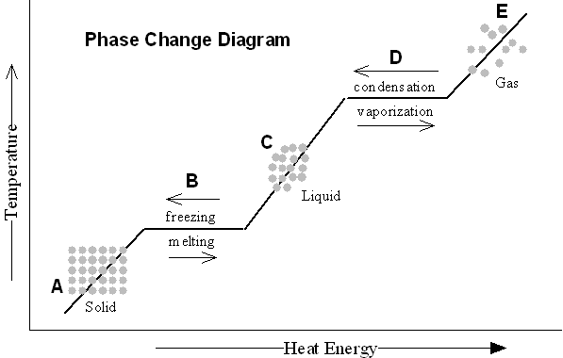
Measuring Heat Energy
A, C and E = temp increases/decreases within a phase: q = (m) (c) (ΔT)
B = solid/liquid phase change: ΔH_{fus} or ΔH_{solid}
D = liquid/gas phase change: ΔH_{vap} or ΔH_{cond}

Slide 5
Step 1: Solid State
-5.00ºC → 0.00ºC (melting point)
How? q = m • c • ΔT
q = (78.0g) (4.18 J/ºC•g) (0.00ºC-[-5.00ºC])
q = ____________
CONVERT TO KILOJOULES
q = ____________

Slide 6
Step 2: Melting
0ºC = melting
How? Use ΔH_{fus} (6.01 kJ/mol)
Since Δ H is in kJ/mol, convert 78.0g H₂O into mol
6.01 kJ/mol = ( x kJ/ 4.33 mol )
x = ____________

Slide 7
Step 3: Liquid State
0ºC → 100ºC
How? q = m • c • ΔT
q = (78.0g) (4.18J/ºC•g) (100ºC – 0ºC)
q = ______________
CONVERT TO KILOJOULES
q = ______________

Slide 8
Step 4: Boiling
100ºC = boiling
How? ΔH_{vap} (40.7 kJ/mol)
Since ΔH in kJ/mol, convert 78.0 g of H₂O to mol
40.7 kJ/mol = (x kJ / 4.33 mol)
x = _____________

Slide 9
Step 5: In Gaseous State
100ºC → 125ºC
How? q = m • c • ΔT
q = (78.0g) (4.18 J/ºC • g) (125ºC – 100ºC)
q = ________________
CONVERT TO KILOJOULES
q = ________________

Slide 10
Review:
Calculate Heat WITHIN a phase:
q = m • c • ΔT
Calculate Heat DURING a phase change: ΔH_{vap/fus}
Convert everything to kilojoules (kJ)

Slide 11
Warm Up #

