Slide 1
Warm Up #1
Balance the following equation:
__ Fe + __CO₃ → __Fe₂(CO₃)₃
What do you think equilibrium means?
Say you are walking on a tightrope, and you shift to the right side, causing you to almost fall…how do you keep your balance so that you stay on the tightrope?

Slide 2
Warm Up #2
__ CH_{4(g)} + __ O_{2(g)} ⇌ __ CO_{2(g)} + __ H₂O_{(g)} + 250 kJ
Balance the equation. Is an endothermic or exothermic reaction? How can you tell? What type of reaction is this?
If the concentration of your reactants decrease, how would the equilibrium shift? Represent that using a new arrow.
If you increased the energy in the reaction, how would that affect the equilibrium shift?

Slide 3
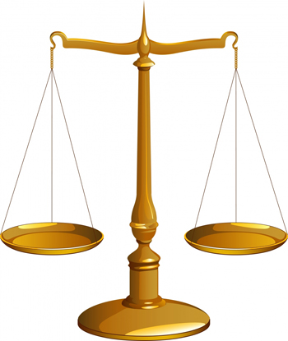
Chapter 18.1-18.2 Equilibrium

Slide 4
What is an Equilibrium?
Equilibrium – there is balance between the reactants and products in a chemical reaction. There is no change in the chemical reaction.
Reactants – starting Products - finishing
In a Chemical Reaction: ⇌ used instead of →
⇌ … REVERSIBLE reaction (equilibrium)

Slide 5
LeChatlier’s Principle
LeChatlier’s Principle - If equilibrium is upset, how the reaction resets itself to be in equilibrium:
How the equilibrium can be affected:
Changes in Concentration
Changes in Temperature
Changes in Pressure

Slide 6
Review: BALANCE the following equation:
N_{2(g)} + H_{2(g)} ⇌ NH_{3(g)}

Slide 7
N_{2(g)} + 3H_{2(g)} ⇌ 2NH_{3(g)} + heat _{changing CONCENTRATION}
Concentration – amt. of a substance
Adding more PRODUCTS (NH₃)
SHIFT: reactants
(more reactants form)
Take away PRODUCTS (NH₃)
SHIFT: products
(more products form)

Slide 8
N_{2(g)} + 3H_{2(g)} ⇌ 2NH_{3(g)} + heat _{changing TEMPERATURE}
In ENDOthermic reactions
Heat on reactants side
Add more: SHIFT RIGHT (products)
Take away: SHIFT LEFT (reactants)
This reaction = EXOthermic
Heat on products side
Add more: SHIFT LEFT (reactants)
Take away: SHIFT RIGHT (products)

Slide 9
N_{2(g)} + 3H_{2(g)} ⇌ 2NH_{3(g)} + heat _{changing PRESSURE}
Pressure = ONLY relates to gasses
Compressible
Look for (g) symbol
In this example:
Reactants side: 4 molecules (1 N₂, 3 H₂)
Products side: 2 molecules (2 NH₃)
Add more: SHIFT less molecules of gas
Take away: SHIFT more molecules of gas

Slide 10
General Trend…
If you ADD MORE
Shift equilibrium in OTHER direction
If you TAKE AWAY
Shift equilibrium in SAME direction

Slide 11
Quick Quiz #1
__ NCl₃(s) + heat ⇌ __ N₂(g) + __ Cl₂(g)
Balance the equation above. How many molecules of gas are present on each side? Is this an endo/exothermic reaction?
How would the equilibrium shift if…
The concentration of products increased
The temperature decreased
The pressure decreased

