Slide 1
Warm Up #3
__C₄H_{8(aq)} + __O_{2(g)} + heat ⇌ __CO_{2(g)} + __H₂O_{(l)} …BALANCE
How do you determine which side of the equation will be affected by pressure the most?
Which side of the equation above will feel affects of pressure more?
How are volume and pressure related? (Review: What law/formula shows this relationship?)

Slide 2
Quick Quiz #2
__SO₂(g) + __O₂(g) ⇌ __SO₃(g) ΔH = -45.0 kJ
Balance the equation above.
If sulfur trioxide is removed, how will the equilibrium shift?
If temperature is increased, how will the equilibrium shift?
If the volume is decreased, how will the equilibrium shift?

Slide 3
Warm Up #4
___F_{2(g)} + ___H₂O_{(l)} ⇌ ___ HF_{(g)} + ___ O_{2(g)} ΔH = +20 kJ
Balance the following equation, and count the number of gas molecules on each side.
If the reaction starts at 40 kJ, and has an activation energy of 100 kJ, draw a diagram showing the reaction pathway.
Show how the equilibrium would shift if…
Temperature was increased
You added more water
The volume increased

Slide 4
Chapter 18.2 Reaction Rates

Slide 5
LeChatlier…General Rules
Goal: balance out equilibrium after an instability
Step 1: figure out which side is more
Where is the heat? Which side has more gas molecules?
Step 2: adding more…shift to the OTHER side
Step 3: taking away…shifting to the SAME side

Slide 6
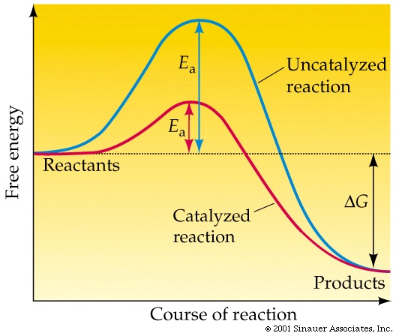
Review: Things Affecting Reaction Rates
Catalyst – something that SPEEDS UP reaction (enzyme)
How? Lowers activation energy.
Other factors:
Temperature
Pressure
Concentration

Slide 7
aA + bB ⇌ cC + dD
Uppercase letters = chemical being reacted
Lowercase letters = coefficients (moles)
Reaction Rate Constant = k
GENERAL FORMULA:
[A] = Concentration of A
[C]^{c} [D]^{d}
k =
[A]ª [B]^{b}

Slide 8
N_{2(g)} + 3Cl_{2(g)} ⇌ 2NCl_{3(g)}
N₂ and Cl₂ = REACTANTS (starting materials)
NCl₃ = PRODUCTS (ending materials)
[Cl₂] measured in Molarity (M) → Moles/Liters
[NCl₃]²
PRODUCTS
k =
[Cl₂]³ [N₂]¹
REACTANTS

Slide 9
Dealing With Exponents
Problem: In the previous equation, you are given a 0.2M sample of N₂ reacting with a 0.5M sample of Cl₂ to form a 1.5M sample of NCl₃. What is the reaction constant?
Top: 1.5 x 1.5 = 2.25 k = 2.25 /0.025
Bottom: 0.5 x 0.5 x 0.5 x 0.2 = 0.025 k = 90
[1.5]²
k =
[0.5]³ [0.2]¹

Slide 10
What is k?
K_{eq} = equilibrium constant
If K_{eq} is GREATER than 1
PRODUCTS favored (long right arrow, short left arrow)
If K_{eq} is LESS than 1
REACTANTS favored (short right arrow, long left arrow)
If K_{eq} is EQUAL to 1
EQUILIBRIUM (both products and reactants are equal)

Slide 11
Quick Quiz #2
N₂O₄(g) ⇌ 2NO₂(g)
At equilibrium a 2 L gas mixture contains 0.44 mol of N₂O₄ and 0.30 mol of NO₂. Write the equilibrium constant expression and solve for it.
2BrCl(g) ⇌ Br₂(g) + Cl₂(g)
At equilibrium in a 3 L gas mixture, 4.00 mol of Cl₂ and 6.00 mol of Br₂ are present. At a certain temperature, the equilibrium constant is 11.1. Calculate the concentration of BrCl with this information. How many moles of BrCl? Grams?

Slide 12
Warm Up #5
Balance the following reaction, and set up a reaction rate equation.
_ PCl_{3(g)} + _ NH_{3(g)} ⇌ _ P(NH₂)_{3(g)} + _HCl_{(aq)} ΔH = + 340 kJ
If the reaction starts at 40 kJ, and has activation energy of 850 kJ, draw a diagram. Show effects of catalyst.
How would the equilibrium shift if the pressure increased. Explain why.
If the concentration of each reactant is .450 M and concentration of each product is .740 M, calculate the Keq for this equation. Are the reactants/products favored?

