Slide 1
Warm Up #1
HCl + NaOH → NaCl + HOH
Name all of the compounds listed above.
NaOH, along with Ca(OH)₂ and KOH, are considered bases. What do they all have in common?
HCl, along with H₂SO₄ and HI, are considered acids. What do they all have in common?
Why do you think it makes sense that when an acid and a base come together, they usually make water?

Slide 2
Acids, Bases
CHAPTER 19.1

Slide 3
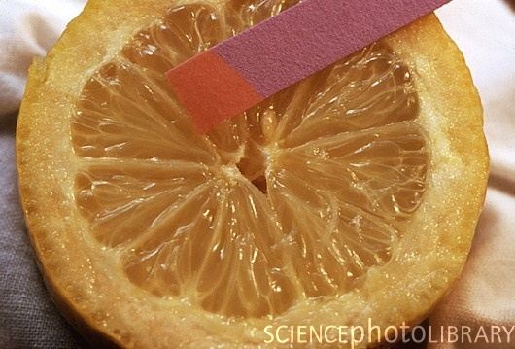
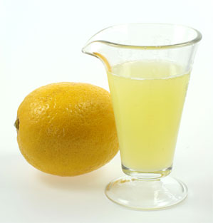
What is an Acid?
Acids – produce HYDROGEN (H⁺) in an aqueous (aq) solution
Properties: Taste sour, pH < 7
Examples: Citrus Fruits (lemons, oranges), Soda, Coffee

Slide 4
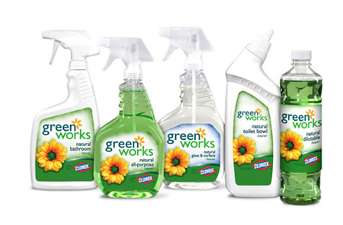
What is a Base?
Bases – produce HYDROXIDE (OH⁻) in an aqueous (aq) solution.
Properties – Bitter taste, slippery feel, pH > 7
Examples: Soap, ammonia, hair remover

Slide 5
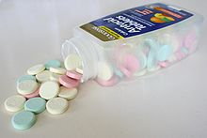
Real Life Application: Antacids
Antacids = “anti-acids”
Used for treating “heartburn” – caused by eating spicy foods (very acidic).
Causes burning sensation in esophagus
Antacids neutralize acid with a base (goal: pH = 7)

Slide 6
Conjugate Acids/Bases

Slide 7
Review
Acids (H+)
Bases (OH-)
Sour Taste
pH LESS THAN 7
Ex. Lemons, soda
DONATES H+ (hydrogen)
Bitter Taste
pH MORE THAN 7
Ex. Antacids, cleaning products
RECEIVES H+

Slide 8
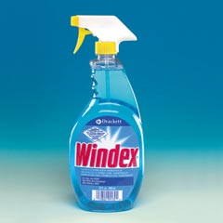
Ways to Tell an Acid from a Base
Look for an H or an OH
H = Acid (HCl, H₂SO₄)
OH = Base [NaOH, Mg(OH)₂]
Exception: Ammonia (NH₃) = BASE (cleaning product)

Slide 9
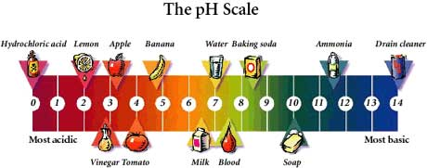
Bronsted-Lowry Acids and Bases
Bronsted-Lowry Model – Acids are H+ donors and
Bases are H+ receivers
Form:
HA + H₂0 → H₃0⁺ + A-
H₃0⁺ = HYDRONIUM ION

Slide 10
Conjugate Acids and Bases
HA + H₂0 → H₃0⁺ + A-
HA donates H⁺ to H₂0 (acid) to become A-
H₂0 receives H⁺ (base) to become H₃0⁺
Acid
Base
Conjugate Acid
Conjugate Base

Slide 11
Warm Up #5
HCl + H₂O → _______ + _________
Identify products, label everything, set up K equation.
If the pH of HCl is 1.50, calculate the…
[H+]
pOH
[OH-]
What is the name of this acid?

Slide 12
Conjugate Acids/Bases
HA + H₂0 → H₃0⁺ + A-
Conjugate Acid – formed when base (H₂0) RECEIVES the H⁺
Conjugate Base – formed when acid (HA) DONATES the H⁺
Form Conjugate pairs (arrows in equation)
Acid
Base
Conjugate Acid
Conjugate Base

Slide 13
Naming Acids and Bases
Acids:
If NOT polyatomic (HCl, H₂S, etc)…
Hydro_____ic Acid
Hydrochloric acid, hydrosulfuric acid, etc.
If polyatomic (H₂SO₄, HNO₃, H₃PO₄)
_____ic Acid
Sulfuric acid, Nitric acid, Phosphoric acid
Bases:
No fancy names. Just _________ hydroxide.

