Slide 1
Warm Up # 6
H₂SO_{4(aq)} + H₂O_{(l)} → ____ + ____
Write a balanced equation, predicting the products and NAMING the reactants. Also, write a k_{eq} equation for this problem (both products are aqueous)
Label the conjugate acid and conjugate base, and how you know which is which.
What does it mean to neutralize an acid? Use pH numbers in your answer.

Slide 2
19.3 - pH

Slide 3
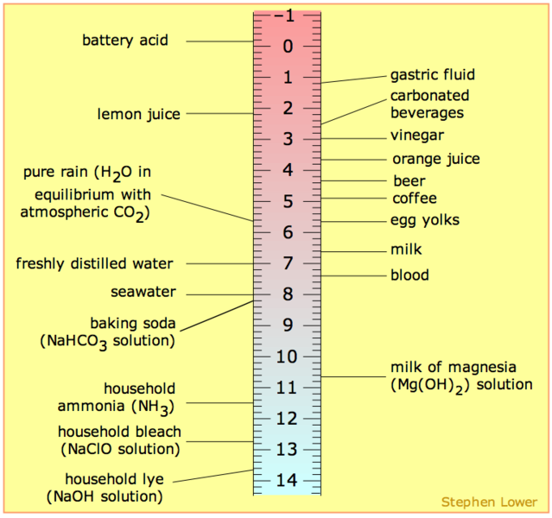
pH…what is it?
pH – measures how much Hydrogen (H⁺) is in the solution.
More H⁺ = MORE acidic.
Opposite: pOH – how much Hydroxide (OH⁻) is in the solution.
More OH⁻ = LESS acidic (more basic)

Slide 4
[H⁺] → pH [OH⁻] → pOH
For pH:
Use concentration of H
[H⁺] – molarity (mol/L)
pH = -log[H⁺]
For pOH
Use concentration of OH
pOH = -log[OH⁻]

Slide 5
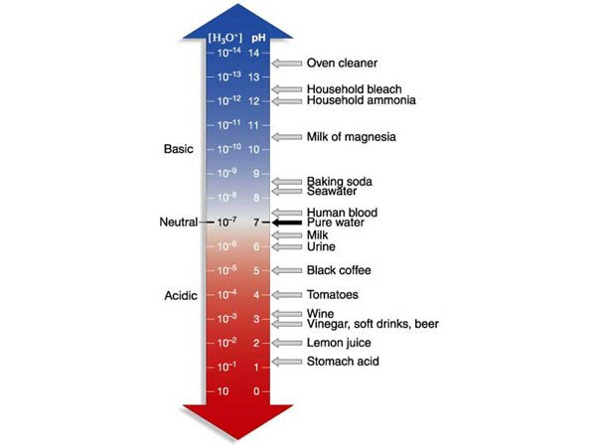
pH → [H⁺] pOH → [OH⁻]
pH = power of Hydrogen
[H⁺]: 10^{-pH}
[OH-] = 10^{-pOH}
pH scale = logarithmic
pH of 5 is 10x more acidic than pH of 6 (100x more acidic than 7)

Slide 6
pH → pOH
K_{w} = Water Constant = 14
pH + pOH = 14
Ex. Lemon Juice
pH = 2
pOH = ??
14 - 2 = 12 = pOH

Slide 7
Strong Acids and Bases
Strong Acids/Bases – dissociate (break down) completely in water
Strong Acids: HCl, HBr, HI, HNO₃, HClO₃, H₂SO₄
Strong Bases: Any Alkali/alkaline metal with OH (except Mg)
HCl → H⁺ + Cl⁻ (HCl : H⁺ = 1 : 1 ratio)
H₂SO₄ → 2 H⁺ + SO₄⁻² (H₂SO₄ : H⁺ = 1 : 2 ratio)
Weak Acids/Bases – do NOT break down completely in water (ex. NH₃ – ammonia, weak base)

Slide 8
Where things get (a little) tricky…
Ex. [HCl] = 4.5 M
In this case: [H⁺] = 4.5 M
1 H in HCl (monoprotic)
BUT: [H₂SO₄] = 4.5 M
In this case: [H⁺] 4.5 x 2 = 9.0 M
2 H’s in H₂SO₄ (diprotic)

Slide 9
Naming Acids and Bases
Acids:
If NOT polyatomic (HCl, H₂S, etc)…
Hydro_____ic Acid
Hydrochloric acid, hydrosulfuric acid, etc.
If polyatomic (H₂SO₄, HNO₃, H₃PO₄)
_____ic Acid
Sulfuric acid, Nitric acid, Phosphoric acid
Bases:
No fancy names. Just _________ hydroxide.

