Slide 1
Warm Up #
In order to produce one shirt for the new J. Crew campaign, workers need to pick 1.0x10⁴ grams of raw cotton. Of that amount, 40% of the cotton is utilized for the shirt, while the rest is discarded as waste. Of that 40% that is used, 90% of it is processed and treated with dye, while the remaining percentage is discarded as additional waste.
How much cotton, in kilograms, is actually used to make this T-Shirt?
How much cotton, in decagrams, is discarded as waste?
If the cost of treating the cotton with dye is $25/lb. How much does it cost to dye and treat 5 cotton shirts (1 kg = 2.2lbs)?

Slide 2
Welcome to APES

Slide 3
Lab 101

Slide 4
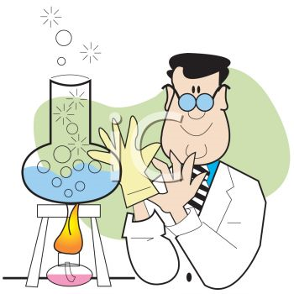
When Doing Labs
Use the Scientific Method – accepted method for scientists to explain how things work
Steps:
State Problem and Collect Data
Formulate Hypothesis
Perform Experiments

Slide 5
Step 1: Collecting Data [Two Types] Quality vs. Quantity?
Qualitative (Quality)
NO NUMBERS involved
Ex. The sky is blue
Ex. The solution is cloudy
Quantitative (Quantity)
NUMBERS involved
Ex. The solution is 34.50 grams
Ex. Water boils at 100 degrees

Slide 6
Step 2: Hypothesis
Hypothesis – a POSSIBLE explanation for why something happens
Observations are NOT hypotheses
Ex. the solution is cloudy (observation)
Ex. the solution is cloudy because it is contaminated (hypothesis)

Slide 7
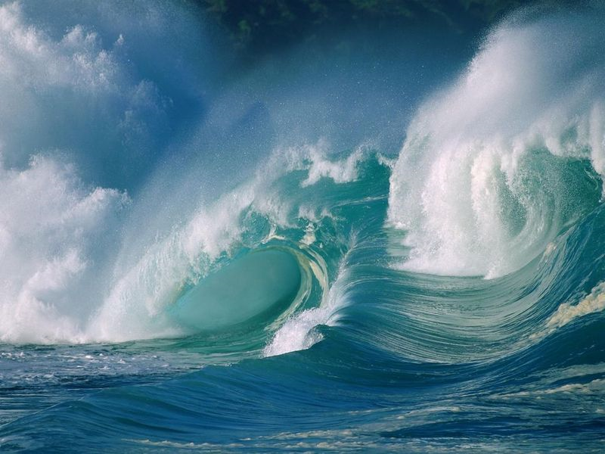
Step 3: Experiments
Use controls and variables
Control – the constant
Variable – the thing that changes in the experiment
Lake vs. Ocean
Perform multiple Trials – attempts at experiment

Slide 8
Step 3.5: Types of Variables
Independent Variable - controlled by the scientist
Ex. Stirring a beaker
Dependent Variable – responds to changes made to the independent variable
Ex. Time taken for sugar to dissolve via stirring

Slide 9
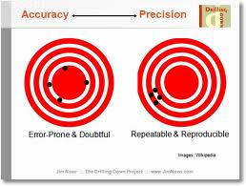
Step 4: Experiment
Data and Observations
Perform multiple trials!
Ensures accuracy, less errors
Accuracy vs. Precision
Accuracy – achieving goal of experiment
Hitting bulls-eye
Precision – achieving same answer multiple times
Same spot on dart board twice

Slide 10
Step 5: Theory vs. Law
Theory – a hypothesis supported by repeated testing
Theory of Evolution
CAN be disproven, although HIGHLY UNLIKELY
Law – generalized observations with NO exceptions
Law of Gravity
Something that just “is.”

Slide 11
Quick Quiz # 2
Caffeine appears to have a profound effect on most people. I am designing an experiment to test the effects of caffeinated coffee on test subjects. Half the samples receive decaffeinated coffee, and the other half receive caffeinated coffee. Upon ingestion of the substance, the caffeinated subjects performed 50% better on their test than those who drank the placebo.
What is the control? Why?
What is the dependent variable? Why?
What is the independent variable? Why?
What conclusion can be made? What can be done to improve this experiment?

Slide 12
Graphing 101
6 Steps for a Perfect Score
Draw X and Y Axis
LABEL Title, X and Y Axis
0 in bottom left corner
EVEN SPACING
Go up by same amt. each time
Plot points, connect dots
KEY (if necessary)

Slide 13
Warm Up #7
In your warm-up, list examples of things/places that are PUBLICALLY OWNED. Discuss what being “publically owned” means to you.
Include how publically owned institutions make you feel (seriously), especially when compared to privately owned things/places similar to what you listed.
In your answers, think about the level of cleanliness, accessibility, overall maintenance and, most importantly, WHY you think there is a difference between publically and privately owned things/places.

Slide 14
Warm Up #8
What does the word “sustainability” mean to you?
Why do YOU think the environment is not in good shape currently? Identify and describe at least 3 reasons.
How does supply and demand work in relation to cost? Use a relevant example when explaining this relationship?

Slide 15
Environmental Science: An Introduction

Slide 16
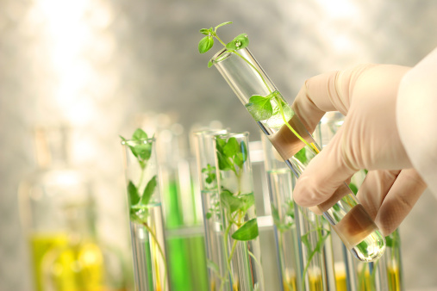
What is Environmental Science?
Environmental Science – study of the environment, how it is used and solutions to environmental problems:
Overcrowding
Pollution
Habitat Disruption
Blends:
Biology, chemistry, ecology, physics, earth science, economics, politics, philosophy, etc.

Slide 17
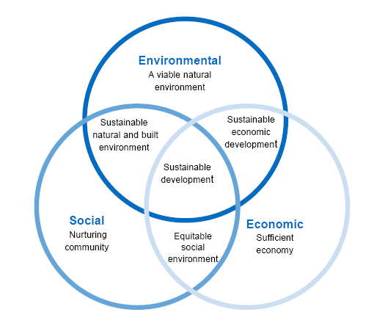
Key Environmental Terms
Sustainability – ability to meet current human resource needs WITHOUT compromising needs of future generations.
Stewardship – taking care of resources we are given

Slide 18
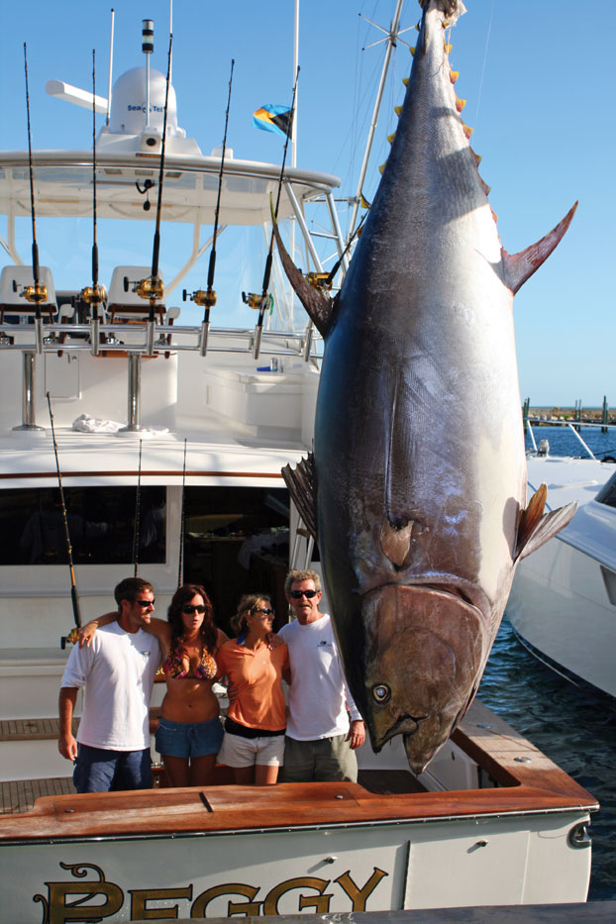
Bluefin Tuna
Sushi restaurateur Kiyoshi Kimura paid 7.36 million yen (about $70,000) for a 507-pound (230-kilogram) bluefin tuna in the year's celebratory first auction at Tokyo's Tsukiji market on Sunday, just 5 percent of what he paid a year earlier (about $1.8 million) despite signs that the species is in serious decline.

Slide 19
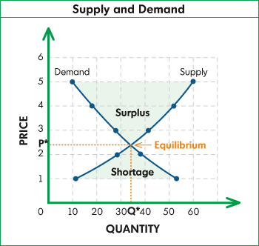
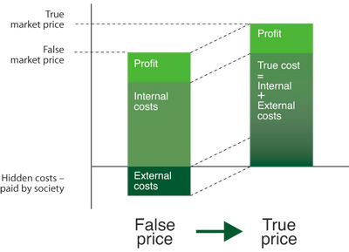
Global Economics
Internal vs. External Costs
Internal – visible costs (labor, supplies, etc)
External – invisible costs (health, enviro., pollution, disposal)
Fast food vs. Produce

Slide 20
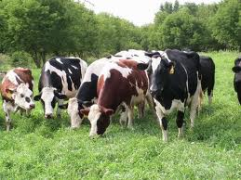
Does Nature Have Value?
Inherent vs. Instrumental Value
Inherent Value – value simply for existing
Not directly affecting humans
Instrumental Value – value due to something serving a purpose FOR HUMANS DIRECTLY

Slide 21
Is it possible to be an economically successful country…WITHOUT destroying the environment? Explain your reasoning.

Slide 22
Warm Up #9
How does a thermostat work (obviously not in this building…but in normal, non-public school buildings)?
Describe the Industrial Revolution in America. Identify and describe three reasons why this paradigm shift could have adverse effects on the environment?
Is it possible to be an economically successful country…WITHOUT destroying the environment? Explain your reasoning (what other things COULD contribute to environmental impact, other than just consumerism?)

Slide 23
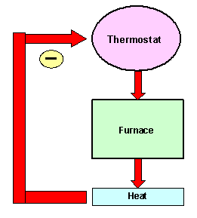
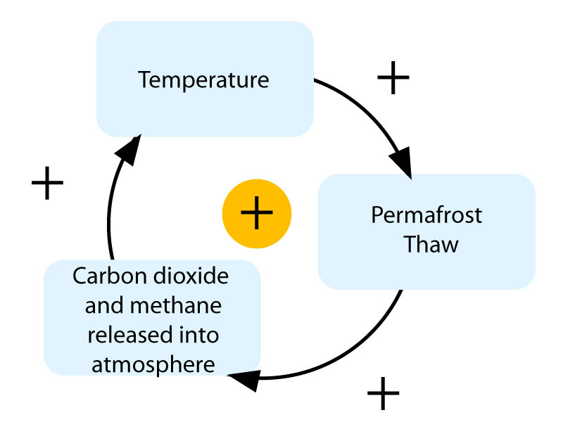
Feedback Loops
Negative Feedback – when a system is balanced (homeostasis)
Ex. Thermostat, Predator-Prey relationship, etc.
Positive Feedback – exponential growth/decline
Ex. Global warming, cancer cells,

Slide 24
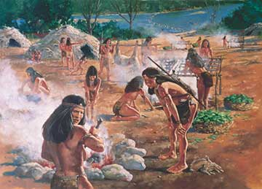
Changes in Sustainability over Time
Hunting/Gathering – moving to find food and survive
60,000 years ago
Nomadic lifestyle – no conservation, extinctions of large animals

Slide 25
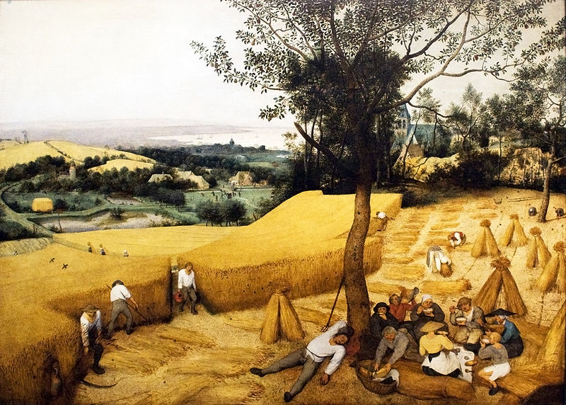
Agricultural Revolution approx. 10,000 years ago
Animal domestication, plant cultivation
Shifting Cultivation – shifting areas after plot dries up
Increase in birth rates, energy, urbanization, irrigation, disinterest in plant/animal survival

Slide 26
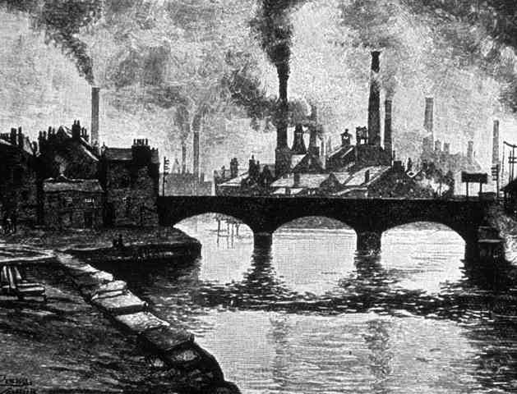
Industrial Revolution approx 300 years ago
Shift from renewable to non-renewable resources
Wood and water → fossil fuels
Increase urbanization, decrease rural
Increased productivity, size, pollution, information
Too much?

Slide 27
IPAT Model of Impact
I = Impact
P = Population (high in developing countries)
A = Affluence (high in developed countries)
T = Technology
I = P x A x T
Developed Countries – a LOT of affluence, but also many environment-friendly options

Slide 28
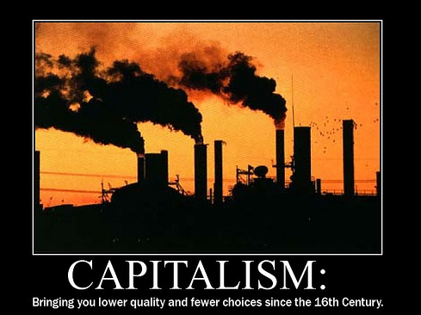
Why the Environment is in Bad Shape
Non-renewable resources
Convenience of goods and services (instant)
Laissez-Faire Capitalism – Unregulated consumerism
Gross Domestic Product – total amount of stuff your country buys
More stuff = more successful

Slide 29
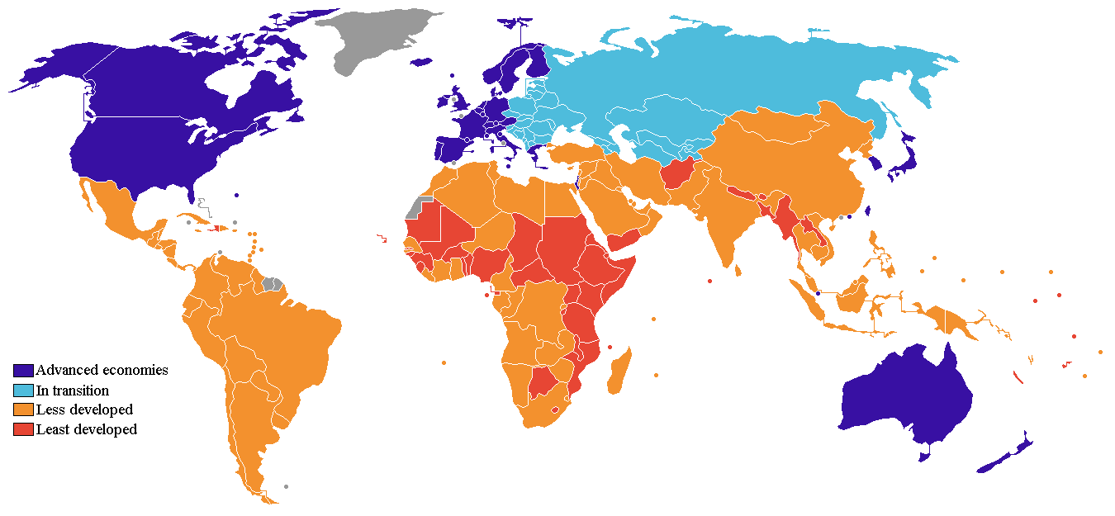
Developing Countries
Developing Countries = third-world countries
Goal: to become capitalistic / successful
World Bank – will give out low-interest for third world countries
Goal : to end poverty
Consequences?

Slide 30
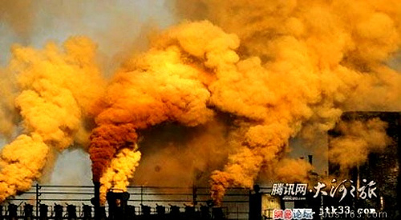
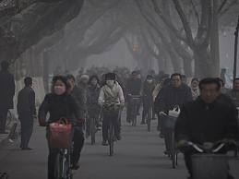
China: A History
Since 1940’s – China = industrial revolution
Mao Zedong – Great Leap Forward
Second biggest power in world BUT…
Most polluted place on Earth
Most energy = coal (dirty)
Lax enviro. Regulations
Why? To make more money!

Slide 31
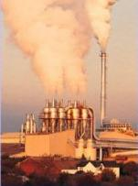
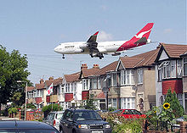
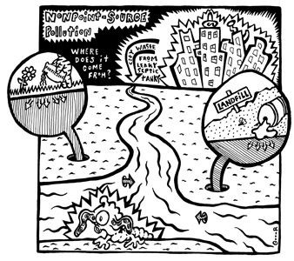
Key Terms Cont’d
Point Source Pollution – pollution coming from ONE discernable source
Ex. ONE factory
Non-Point Source Pollution – pollution coming from various sources, not one particular epicenter.
Ex. A city

Slide 32
Something Old…Something New…

Slide 33
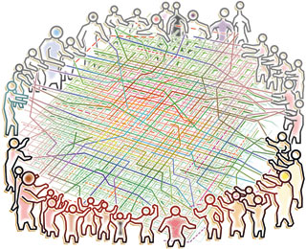
Tragedy of the Commons
Commons = water, air, animals and minerals (i.e. things of monetary “value”)
Short term profits > long term profits
Economy = short-term, Environment = long-term
Commons not created equal
Commons owned by diff. people/nations (diff. rules and regs)
Land, lakes easier to regulate than air, oceans

Slide 34
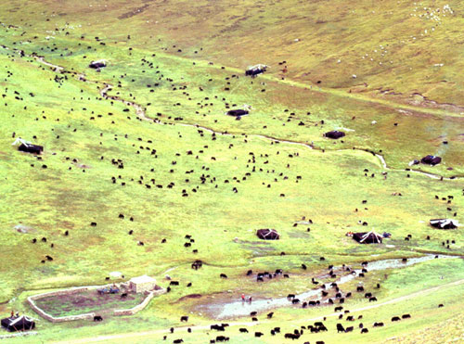
T of C Explained: Cows Grazing
Dilemma 1: shared land, grazing cows owned by different farmers
Goal: graze the most (most $ - short term)
Problem: overgrazing (long-term)
Dilemma 2: gov’t control of land
Goal: prevent overgrazing
Problem: abuse power, why control “commons?”, outsider

Slide 35
Another Example: Aral Sea
Soviet irrigation (1960s) → aqueducts from sea.
Overuse = depletion of Aral Sea
Environmental Effects?
Health
Wildlife
Toxicity
Economic Problems

Slide 36
Review: Part 1
Sustainability
Stewardship
Positive Feedback
Negative Feedback
Point Source Pollution
Non-Point Source Pollution
Inherent Value
Instrumental Value

Slide 37
Review: Part 2
Developed Countries → World Bank
Capitalism (Laissez-Faire) and environmental effects
Hunters/Gatherers → Agriculture → Industrial
John Muir and Sierra Club (Preservation of environment)
Internal vs. External Costs…Supply and Demand

Slide 38
Multiplying and Dividing with Sci. Notation
To Multiply → ADD exponents
(n x 10ª) • (m x 10^{b}) = (n · m) x 10^{a+b}
Ex. (5.0 x10⁴) • (2.5 x10³ ) = 12 x10⁷ → 1.2 x10⁸
To Divide → SUBTRACT exponents
(n x 10ª) ÷ (m x 10^{b}) = (n ÷ m) x 10^{a-b}
Ex. (6.2 x10⁵) ÷ (3.1 x10²) = 2.0 x10³

Slide 39
Review: Scientific Method
Hypothesis – possible explanation of phenomena
Multiple Trials = ensures precision (and accuracy)
Control – the constant (what you are comparing your experiment to)
Independent Variable – the thing the scientist is changing
Dependent Variable – “what are we trying to find?”
Theory (proven via testing) vs. Law (exists)

Slide 40
Warm Up #1
Graph the following: Regular vs. Catalyzed Reaction
What effect does the catalyst appear to have on the reaction?
The peak of each line graph represents “activation energy.” Using this term, apply this to your earlier answer comparing a catalyst to a normal reaction.
Time (sec) | 0 | 2 | 4 | 6 | 8 | 10 | 12 | 14
Energy Regular (J) | 59 | 76 | 132 | 167 | 149 | 47 | 23 | 9
Energy Catalyst (J) | 59 | 63 | 78 | 97 | 82 | 34 | 15 | 9

Slide 41
Metric System & Scientific Notation

Slide 42
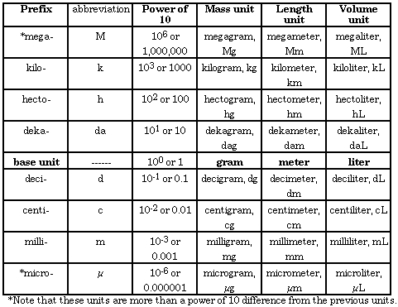
The Metric System Song!
Kilo-
Hecto-
Deka-
-Meter, -Liter, -Gram (yeah!)
Deci-
Centi-
Milli-
Now I understand!
Others:
Mega- (1 million)
Micro- (1 millionth)

Slide 43
Quick Quiz
Convert:
24.5 km = ___ Mm? 34.2 cL = ____ hL?
90.00 g = ___ mg? 1 km = ___ mm?
Which is more?
4 L ___ 517 cL? 2494g ____ 837 hg
52 mg + 276 cg + 3881 g _______ 7 cg + 46 g + 350 kg ?

Slide 44
Scientific Notation: Brief Overview
General Formula: M x 10^{n}
M = between 1 and 10 n = number of spaces moved
LARGE NUMBERS
Move decimal behind first number (n = positive)
SMALL NUMBERS
Move decimal behind first non-zero number (n = negative)

Slide 45
Warm Up #2:
Human farts release methane gas (CH4) into the atmosphere. Let’s say 100 kg of CH4 per year per 10 people was released into the atmosphere.
Given a population density of 7.0x10⁴ humans per hectare. Calculate the amount of methane emitted in a 3000 hectare city.
NO CALCULATOR

Slide 46
Multiplying and Dividing with Sci. Notation
To Multiply → ADD exponents
(n x 10ª) • (m x 10^{b}) = (n · m) x 10^{a+b}
Ex. (5.0 x10⁴) • (2.5 x10³ ) = 12 x10⁷ → 1.2 x10⁸
To Divide → SUBTRACT exponents
(n x 10ª) ÷ (m x 10^{b}) = (n ÷ m) x 10^{a-b}
Ex. (6.2 x10⁵) ÷ (3.1 x10²) = 2.0 x10³

Slide 47
Crazy APES Math
General Topics:
Energy Conversions
Water Treatment
Pollution
General Unit Conversions
NO CALCULATORS!!!! (jerks…)

Slide 48
Practice Problem
Kudzu is a menace in the southern states. Assume that the area in the South inhabited by kudzu is 3.0x10¹² m². They only grow vertically at a rate of 3hm/year. Assume the density of kudzu is 2.0x10² kg/m³.
Calculate the annual increase in volume, in m3, of kudzu.
Calculate the current annual increase in mass, in kg, of kudzu.

Slide 49
Warm Up #3
Estimate the potential reduction in petroleum consumption (in gallons of gasoline per year) that could be achieved in the US by introducing electric vehicles under the following assumptions:
The mileage rate for the average car is 25 miles per gallon of gasoline
The average car is driven 10,000 miles per year
The US has 150 million cars
10% of the US cars could be replaced with electric vehicles

