Slide 1
Warm Up # 1
You have iron, and it rusts. What is happening to the iron? Is it still the same substance? Why or why not?
When something goes from a solid to a gas, what is happening to the molecules of the substance? Does the substance stay the same? Why or why not?
Something like water, H2O, is said to be a compound (as opposed to an element). What is a compound, and how do you know this?

Slide 2
Chapter 2.1-2.3
Commonly Used Chemistry Terms

Slide 3
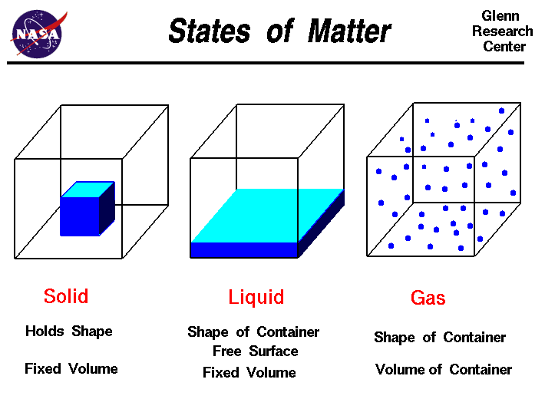
What is Matter? [And Why Does it Matter?]
Matter – Anything with a mass, and occupies volume
[Volume = Space – measured in liters, milliliters, etc]
Mass = grams, kilograms, etc
Three Main Forms:
Solid, Liquid, Gas

Slide 4
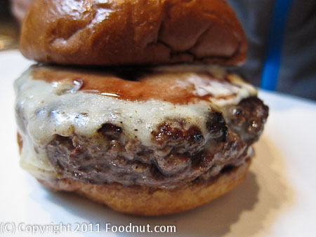
Common Terms Part 1
Substance – made up of the SAME matter uniformly (pure)
Meat patty = substance
Lettuce = substance
Mixture of Substances – made up of different matter
Hamburger (whole)

Slide 5
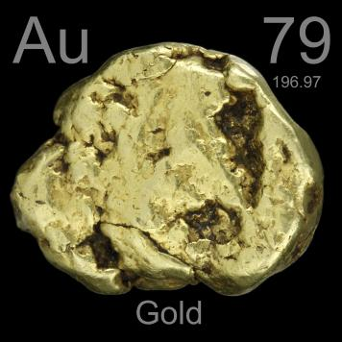
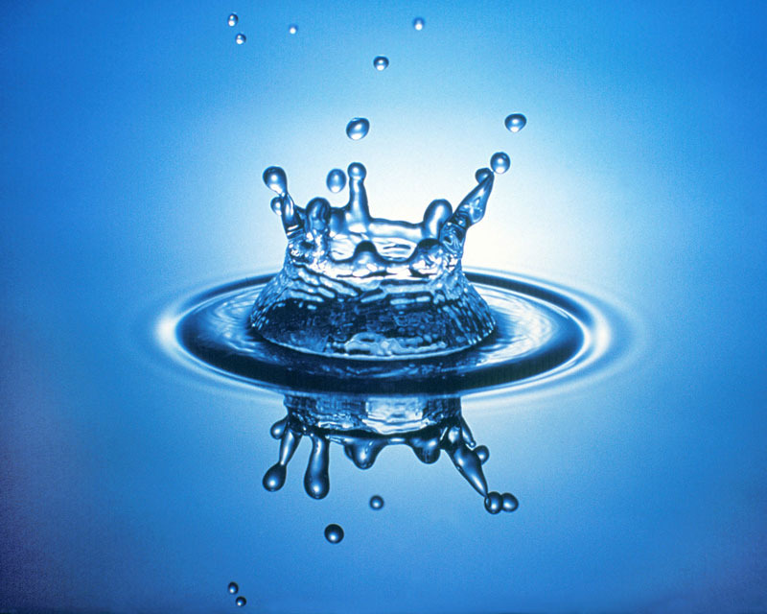
Common Terms Part 2
Two types of substances:
Element – simplest form of matter
Hydrogen, oxygen, iron…anything on Periodic Table
Can NOT be broken down further
Compound – 2+ elements combined
H2O = water compound

Slide 6
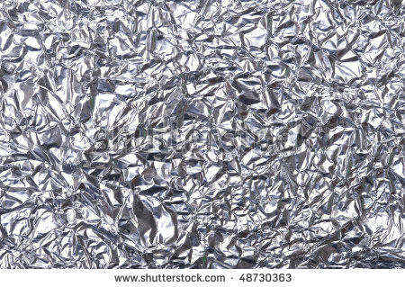
Physical Properties
Review: observations
Qualitative vs. quantitative
Physical – any observation of a substance that doesn’t alter it permanently
Color, hardness, conductivity
Malleability – how easily it can be changed

Slide 7
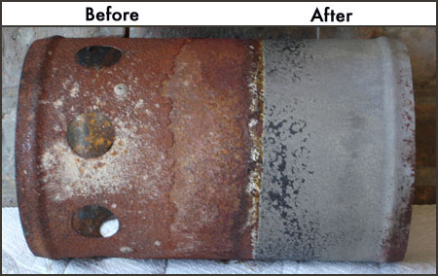
Chemical Properties
Chemical Property – ability of substance to CHANGE chemically
Iron rusting (iron + oxygen)
Also, burn, decompose, explode, corrode
NOT reversible (except for another chemical change)

Slide 8
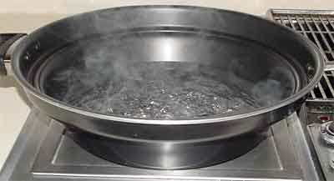
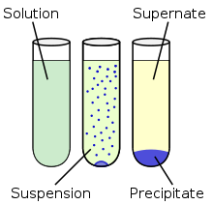
Physical vs. Chemical Changes
Physical Change – a change that doesn’t alter it’s chemical composition
Melting, boiling, freezing, cutting, grinding, etc.
Chemical Change – DOES alter chemical composition
Heating, electricity, chemical reaction
Precipitate – a solid residue forming after chem. reaction

Slide 9
What about cooking an egg?

Slide 10
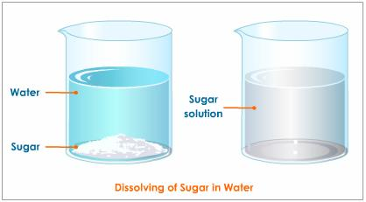
What about Dissolving?
Dissolving – when a substance breaks down
Solute – the thing being dissolved
Solvent – thing doing the dissolving
Salt water…a physical change

Slide 11
Quick Quiz #1
You have a piece of aluminum foil that you wrap your sandwich with. Has the aluminum foil gone through a physical or chemical change? How do you know?
You are BBQ-ing some steak, which requires you to burn charcoal. Is the charcoal going through a physical or chemical change? How do you know?
What qualifies something to be considered a substance, rather than a mixture?

