Slide 1
Warm Up #2
Describe how the sun uses nuclear fusion for energy.
Why is nuclear fusion able to be possible on the sun?
How does nuclear fusion differ from nuclear fission?

Slide 2
Warm Up #3
Determine the half-life of Radium-222 when you discover that, after 5 days, 4.0 grams of the original 25 gram sample have remained.
The half-life of radon-226 is 50.0 years. How long will it take for 59% of your original sample to decay?
You have a 50 gram sample of a radioactive substance. How much of that sample remains after 3 half-lives?

Slide 3
Warm Up #2
A nuclear reaction involves splitting an atom. What part of the atom do you think is splitting? How do you know? (hint: “nuclear” may have something to do with it)
Nuclear fission and nuclear fusion are opposite processes, breaking down the words, what do you think they mean?
Why can a nuclear bomb have long-term, negative effects?
[yes, it’s hot inside/outside. you’re very observant. ☺ ]

Slide 4
Warm Up #1
What comes to mind when you think of the word “Radioactive” (other than the Imagine Dragons song)?
How do you think nuclear bombs work?
How do you think nuclear reactors work?
Why is nuclear/radioactive technology dangerous?
[yes, it’s hot inside/outside. you’re very observant. ☺ ]
#sassafras

Slide 5
Warm Up #2
You have Americium-256, and it undergoes a series of decays.
It undergoes alpha decay.
The product undergoes beta decay
The product undergoes two alpha decays
The product undergoes a gamma decay
The product undergoes two beta decays.
What isotope do you have?

Slide 6
Nuclear Decay
Chapter 25

Slide 7
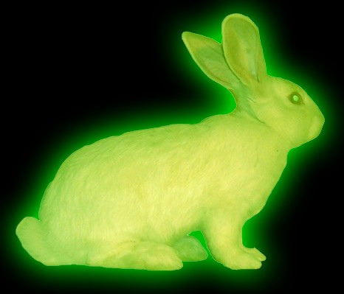
It’s Radioactive…so what?
Radioactive – the element is UNSTABLE
Too many neutrons
Result: Nuclear Fission - The nucleus spontaneously DECAY (breaks down)
releases energy
Opposite: Nuclear Fusion – nuclei combine together (on the sun)

Slide 8
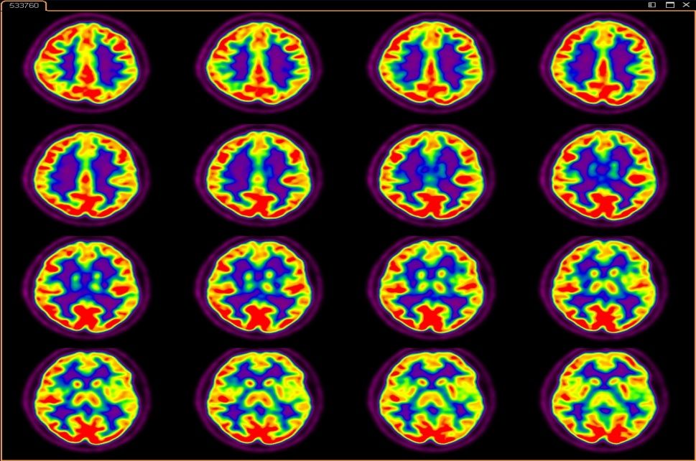
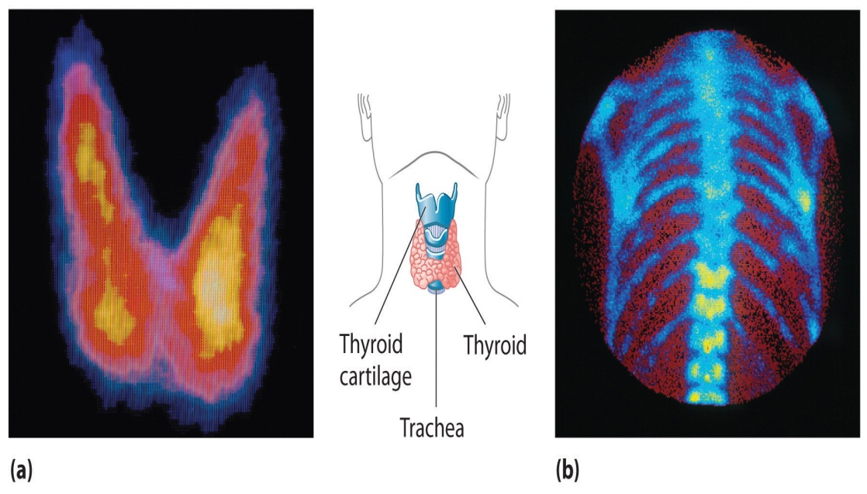
Radioactive Dyes in Medicine
Nuclear Medicine – using radioactive isotopes in medicine
Ex. Iodine-131 – Dye used to detect thyroid gland activity and brain activity
CT Scans
Short half-life
Permanent Damage?

Slide 9
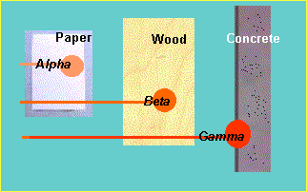
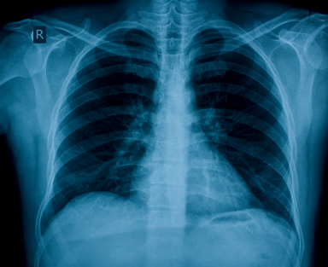
How We Measure Radiation
Measured in REM (Roentgen-Equivalent, Man)
Common things with radiation:
X-Rays
Cell Phones
TV’s
Microwaves
All are VERY small doses (way less than 1 REM)

Slide 10
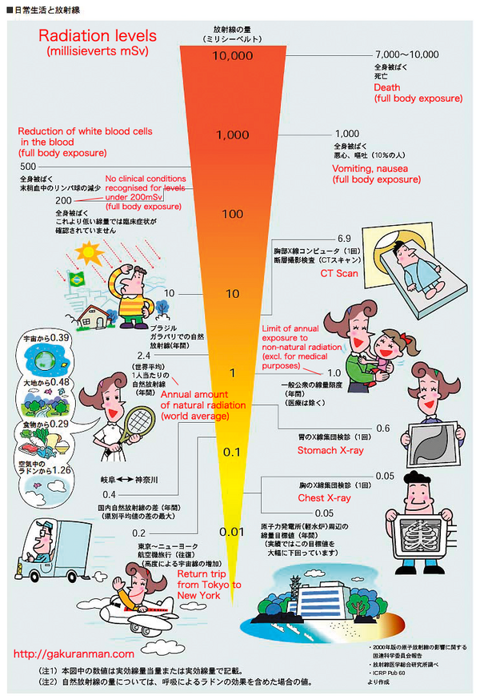

Slide 11
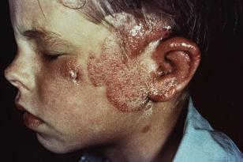
Effects of Radiation
50-100 REM = feeling sick
100-500 REM = immune system damage, burns
500-1000 REM = nausea, digestive tract damage, death within days
1000+ REM = coma, death within hours

Slide 12
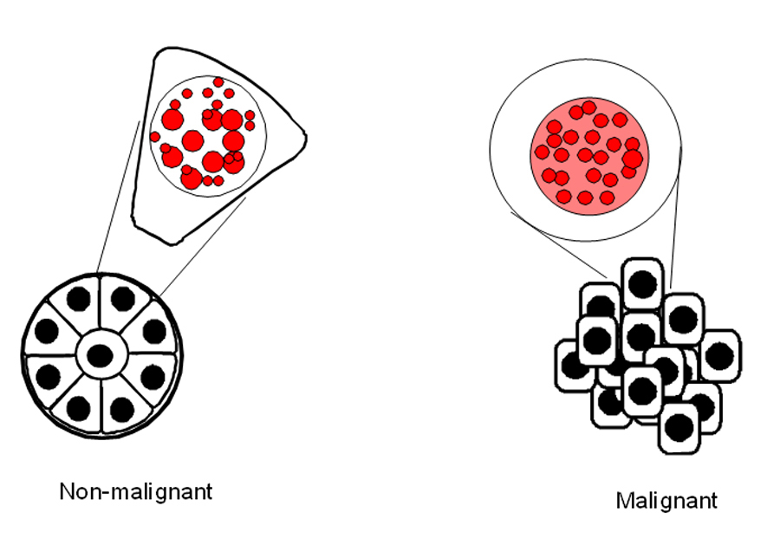
Chemotherapy - Good
Used to treat cancer patients
Inject radioactive drugs into body, killing A LOT of cells (including cancer cells)
Lose hair/feel awful = effects of radiation and healthy cell death

Slide 13
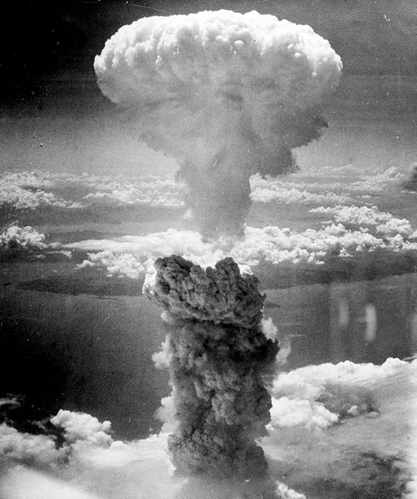
Hiroshima - Bad
1945 – Atomic bomb dropped, killing 77,000 instantly
Over the next 5 years, 200,000+ died
Why? Radiation poisoning, burns, and cancer as a result of bomb
Nuclear Fission

Slide 14
Nuclear Power
Nuclear Power – using the energy released via nuclear fission for power.
NOT energy efficient, but VERY powerful
Nuclear waste
Chernobyl, Fukishima

Slide 15
COPY
You have 50. grams of Cesium-226. It has a half-life of 40 years. How long does it take for 35 grams of the sample to decay?

Slide 16
COPY
You have 50. grams of Cesium-226. It has a half-life of 40 years.
What form(s) of decay are necessary to go from Cesium-226 to Tellerium-218?
How long does it take for 35 grams of the sample to decay?
What would the half-life of Cesium-226 be if it took 60. years for 35 grams of the original 50. grams to decay?

Slide 17
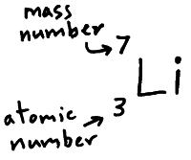
Review
Example: Lithium-7
Mass Number =
# Protons + Neutrons (7)
ON TOP
Atomic Number =
# Protons (3)
ON BOTTOM

Slide 18
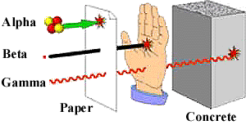
Types of Radioactive Decay
Alpha – large particle, little penetrating power
If ingested, can damage lung/organ cells
Beta – smaller than alpha, cannot penetrate skin, but can burn it
Gamma – smallest, can penetrate almost anything, doing a lot of damage

Slide 19
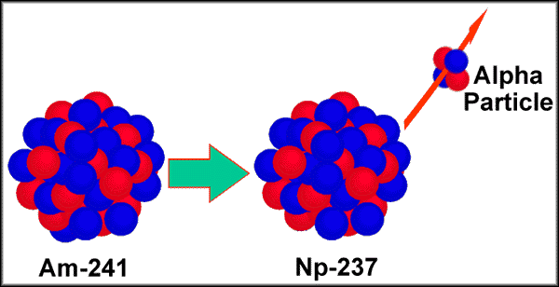
Types of Decay [Greek Alphabet Status]
Alpha – Element breaks down to release a HELIUM molecule
HEAVY decay
Mass # LOSES 4 (helium’s mass is 4)
Atomic # LOSES 2 (helium’s atomic is 2)

Slide 20
Types of Decay Continued
Beta Decay – Element breaks down to form a loose ELECTRON
Positron Production – Element breaks down to form POSITRON (positively charged electron)
e

Slide 21
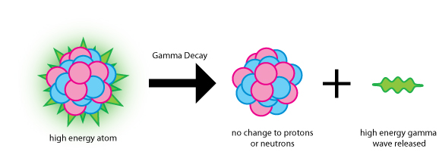
One More…
Gamma Decay – an element loses ENERGY, not particles.
Element STAYS the same, just in less excited state
Gamma symbol: γ

Slide 22
Quick Quiz #1
Mendelevium-260 undergoes a series of decays.
It first undergoes alpha decay
It then undergoes TWO beta decays
It then undergoes a positron emission
It finally undergoes TWO alpha decays.
Identify the final product.

Slide 23
Post-Lab Questions
Post-Lab Question #1: Look at your data for how much remained after 30 seconds. Calculate an exact half life for your substance. How close was this to the projected 10 seconds?
Post-Lab Question #4: Given how many M&M’s were in your bag (think of these as the number of nuclei), and given the half-life of Post-Lab #1, calculate the activity of your Mendelevium, in Curies. (1 Ci = 3.7x10¹⁰ decays/sec)

Slide 24
Warm Up #
You are given Thorium-250.
Write it with Mass # on top, Symbol, then Atomic # on bottom
Show what would happen if it underwent ALPHA decay.
After alpha decay, it underwent BETA decay.
After beta decay, it underwent another ALPHA decay.

Slide 25
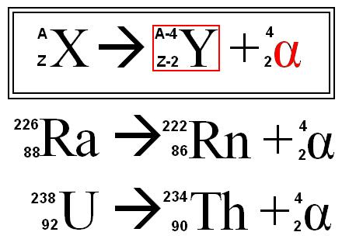
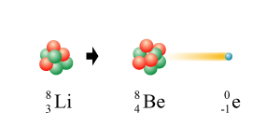
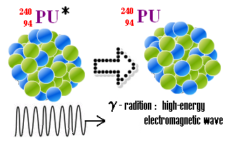
Types of Decay
Alpha - release of helium
Ex. Radium-226
Ex. Uranium - 238
Beta – release of electron
Ex. Lithium-8
Gamma – release of energy
Ex. Plutonium-240
MOST HARMFUL (can penetrate almost everything)

Slide 26
Warm Up #4
Show Thallium-220 undergo 2 alpha decays, 3 beta decays and 2 positron emissions. What isotope do you have?
Complete a graph from the data table below.
Looking at the data table, what seems to happen to the 40 gram sample after each half-life?
Half-Life | 0 | 1 | 2 | 3 | 4 | 5 | 6
Amount (grams) | 40 | 20 | 10 | 5 | 2.50 | 1.25 | 0.75

Slide 27
Half-Life

Slide 28
Half-Life
Half-Life – how long it takes for half of a substance to decay
Exponential function – will NEVER reach zero
If NOT Given Half-Life
If Given Half-Life
N = N_{o}e^{(-kt)}
[exponential decay formula]
N = amt. at the end
N_{o} = initial amt.
k* = rate of decay
t = time elapsed
** e and ln are opposites
T_{1/2} = -ln(1/2)/k
Half-life equation
T_{1/2} = half-life
k* = rate of decay
* k is the SAME in both equations

Slide 29
Warm Up #3
Show Americium-240 undergoing three major forms of radioactive decay.
You start with 233 grams of Uranium-238, and after 2 years only 231 grams remain. Calculate the half-life of Uranium-238.
The half-life of Carbon-14 is 5740 years. How long will it take for 25% of your Carbon-14 sample to remain?
A scientist believed it would only take 1,170 years for 25% of carbon-14 to remain. Explain why this answer could not be possible.

Slide 30
The half-life of Carbon-14 is 5740 years. How long will it take for 25% of your Carbon-14 sample to remain?
A scientist believed it would only take 1,170 years for 25% of carbon-14 to remain. Explain why this answer could not be possible.

Slide 31
Warm Up #
You are given a 60.0 gram sample of Erbium-160. The half-life of this substance is 2.50 minutes.
How many nuclei have decayed in one half-life?
Calculate the activity level of your substance, in curies. (1 Ci = 3.7x10¹⁰ decays/sec)
How much of your sample has decayed after 12.5 minutes? What percent of your sample is this?

Slide 32
Warm Up #IDK
You are handling an unknown amount of Uranium-235, with a half-life of 4.9x10⁴ years.
You know this sample of Uranium underwent 2 alpha decays, a beta decay and a positron emission to become what it is today (Uranium-235). What was the isotope ORIGINALLY?
If you discover that this sample of uranium-235 traced back to the bombing in Hiroshima in 1945, and that there were originally 3.1x10³ grams of it, how much do you have now?
With this information, determine the activity of this sample of Uranium-235. (hint: multiply the “k” value by the amount of nuclei that have DECAYED).

