Slide 1
Warm Up #1
Graph the following: Regular vs. Catalyzed Reaction
What effect does the catalyst appear to have on the reaction?
The peak of each line graph represents “activation energy.” Using this term, apply this to your earlier answer comparing a catalyst to a normal reaction.
Time (sec) | 0 | 2 | 4 | 6 | 8 | 10 | 12 | 14
Energy Regular (J) | 59 | 76 | 132 | 167 | 149 | 47 | 23 | 9
Energy Catalyst (J) | 59 | 63 | 78 | 97 | 82 | 34 | 15 | 9

Slide 2
Chapter 3.1
Precision, Accuracy and Significant Figures

Slide 3
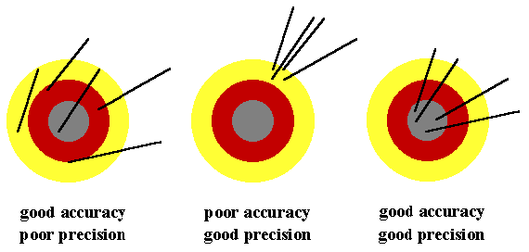
Precision vs. Accuracy
Precision – how close together objects are to one another
Accuracy – how close object is to goal
Can you be precise without being accurate?
Can you be accurate without being precise?

Slide 4
Determining Percent Error
Let’s say you didn’t reach your goal…let’s see how much of a failure you are…
Experimental Value – the number YOU got in your experiment
|Absolute Value| - any number inside = POSITIVE
% Error: [|(experimental value – accepted value)| ÷ accepted value ] x 100
Practice: you measured boiling water to be 99.1ºC, when the accepted value is 100ºC…% Error?

Slide 5
Significant Figures (“Sig Figs”)
Significant Figures – digits that are important
Digits = amt. of #’s there are within a #
Ex. 100.00 = 5 digits
Why know this?
ROUNDING your final answer

Slide 6
Significant Figures “Sig Figs”
Rule 1: all non-zero digits are significant
Ex. 45.68 (4 sig figs)
Rule 2: all zeros BETWEEN non-zero digits are significant
Ex. 450.008 (6 sig figs)
Rule 3: LEADING zeros are NOT significant
Ex. 0.00052 (2 sig figs)

Slide 7
Sig Figs Continued
Rule 4: TRAILING zeros ARE significant (if a decimal is present)
Ex. 0.000520 (3 sig figs)
Rule 4.5: Trailing zeros are NOT significant (if decimal is absent)
Ex. 1805000 (4 sig figs, not 7)

Slide 8
Sig Fig Steps
Cross out ANY leading zeroes
Ask: Is there a decimal?
If so, count ALL other digits as sig.
If not, cross out ALL trailing zeroes
Digits left = significant

Slide 9
Multiplying/Dividing Sig Figs
Rule: round to least # of SIG FIGS
Ex. 56.80 x 0.049
56.80 = 4 sig figs
0.049 = 2 sig figs
ANSWER: 2 sig figs
56.80 x 0.049 = 2.8 (NOT 2.783)

Slide 10
Adding/Subtracting Sig Figs
Rule: round to least amount of DECIMAL PLACES
Ex. 100.0 + 1.111
100.0 = 1 decimal place
1.111 = 3 decimal places
ANSWER: 1 decimal place
100.0 + 1.111 = 101.1 (NOT 101.111)

Slide 11
COMBINING +/- and x/÷
Ex. (67.93 + 98.456) x 27.0
FOLLOW THE ORDER OF OPERATIONS
Parentheses first, multiply second
Step 1: 67.93 + 98.456 = 166.39 (2 #’s after decimal)
Step 2: 166.39 x 27.0 = 4,490 (3 total sig figs)

Slide 12
Review:
When adding…SMALLEST DECIMAL SPACE
When multiplying…LEAST SIG FIGS
If both…Parentheses → Multiply/Divide → Add

Slide 13
Quick Quiz #1
How many significant figures are in the following:
780.0
0.0000890
91.11
0
Solve the following using correct sig figs:
89.0 + 876 = ?
9.0 x 7.25 = ?
(91.0 + 12) x 2.00 = ?

