Slide 1
Warm Up # 3
Convert the following units:
24 m = ____ mm?
567 dL = ____ kL?
Express the following in scientific notation:
490 x 12.0 = _____?
30000 x 200 = ______?

Slide 2
Chapter 3.2
International System of Units and T-Charts

Slide 3
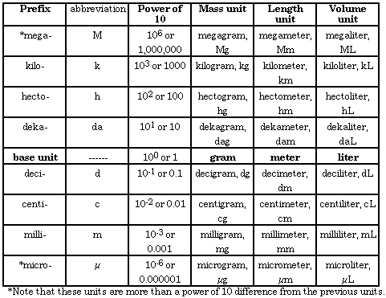
Review: Metric System
MAJOR METRIC PREFIXES:
Kilo (k), Hecto (h), Deka (da), BASE (meter, liter, gram), Deci (d), Centi (c), Milli (m)
OTHERS:
Micro (µ) (1 meter = 1x10⁶ µ m)
Nano (n) (1 meter = 1x10⁹nm)
Mega (M) (1 meter = 1x10⁻⁶Mm)

Slide 4
What the Metric System Means…
Meter (m)
Measures Distance – how far apart objects are
Liter (L)
Measures Volume – amount of space an object takes up
Gram (g)
Measures Mass – how much matter an object has

Slide 5
Mass vs. Weight
Mass – how much matter is in an object
NO GRAVITY
Mass stays same anywhere
Grams, kilograms, etc.
Weight – mass + gravity
Changes depending on where you are
Kilograms, pounds, etc.
One more…

Slide 6
Important Metric to Amurrican Conversions
Distance: Volume:
1 in. = 2.54 cm
12 in. = 1 foot 1 gallon = 3.7 liters
1 mile = 5,280 feet
3.1 miles = 5 kilometers
Time:
1 hour = 3600 seconds
Temperature:
K = Kelvin – another method of measuring temperature
From ºC to K = ADD 273
From K to ºC = SUBTRACT 273

Slide 7
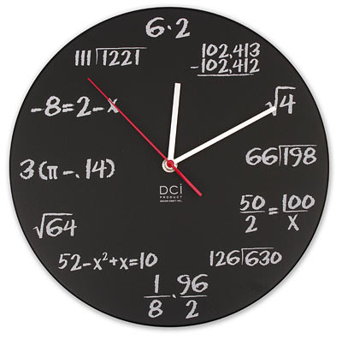
Setting up T-Chart
Example: Maria took 20 minutes to take her test. How many seconds is that?
Start - Write what you’re given, then draw T
20 minutes

Slide 8
T- Chart Continued
Next – convert units (MINUTES TO SECONDS)
Start with minutes – put it on the bottom
End with seconds – put it on the top
20 minutes
Seconds
Minutes

Slide 9
T-Chart Continued
Finally – put 1 next to larger unit (minutes)
Convert smaller unit (seconds)
Cross out same units on top and bottom
Multiply top numbers together
Divide by bottom number
20 minutes
60 Seconds
1 Minute
20 x 60
1

Slide 10
Practice Problem
A MULTI-STEP T-CHART
If there are 10. boxes of grapes in a crate, and each box contains 3.0 bunches, and each bunch contains 29 grapes, how many grapes are in eighteen crates?

Slide 11
Something Harder: km/hr into m/s
Start: 50.0 km/hr = ____ m/s
[Kilometers per hour → meters per second]
Answer: (50.0 x 100 x 1) ÷ (1 x 3600) = 13.9 m/s (3 sig figs)
50.0 kilometers
1000 meters
1hour
hour
1 kilometer
3600 seconds

Slide 12
Quick Quiz #3:
McKayla Maroney runs 30. meters before vaulting perfectly (because she’s awesome). How many inches is this?
I am going at a speed of 20 miles per hour. What is this speed in kilometers per second?
If there are 15 boxes of cherries in a crate, and each box contains 3.0 bunches, and each bunch contains 30. cherries, how many cherries are in 5.0crates?

