Slide 1
Warm Up #2
How many significant figures are in the following:
780.0 0.0000890 91.11 000080000000
Solve the following using correct sig figs:
(89.7 + 876) • 0.034 = ?
9.0 + 7.25 = ?
91.0 • 12 • 2.00 = ?
You are asked to express the number 10,000 in one, two and six significant figures respectively. How would you do this?

Slide 2
Warm Up #2
Find the number of sig figs each number has:
9000000.
9000000
9000002
0090000.
Find the correct answer, using correct sig figs
96.3 + 100.00 =
23.0 x 0.50 =
2.00 x 9 x 10. =

Slide 3
Chapter 3.3
Scientific Notation

Slide 4
REVIEW: Sig Fig Steps
Cross out ANY leading zeroes
Ask: Is there a decimal?
If so, count ALL other digits as sig.
If not, cross out ALL trailing zeroes
Digits left = significant

Slide 5
A Big (or Small) Problem
Sure we’ve been dealing with small numbers, but:
What about fatty numbers?
Ex. 1,200,000,000,000
What about anorexic numbers?
Ex. 0.000000000000045
I ain’t dealing with this…BUT WAIT!

Slide 6
Scientific Notation: Your Sig Fig Savior
Scientific Notation – way of making REALLY big or REALLY small numbers easy to read.
General Form:
M x 10^{n}
M = number between 1 and 10
n = number of decimal places you move

Slide 9
Quick Quiz #1
Multiply 123456 x 7890 on your calculator
What was your answer (with CORRECT sig figs)
Write your answer in scientific notation
Do the same for the following problems (with CORRECT SIG FIGS):
98765 x 43210 = ?
10000 x 892800 = ?
90 x 9 = ?

Slide 12
Review:
WITH NUMBERS WAY BIGGER THAN 1
MOVE DECIMAL TO THE LEFT
n VALUE WILL BE A POSITIVE NUMBER
WITH NUMBERS WAY SMALLER THAN 1
MOVE DECIMAL TO THE RIGHT
n VALUE WILL BE A NEGATIVE NUMBER

Slide 13
How This Applies to Sig Figs:
Problem: 956.89 x 29.3 = 28036.877 (gross)
You NEED: 3 sig figs
How? SCIENTIFIC NOTATION
28036.877 BECOMES 2.80 x 10⁴ (3 SIG FIGS)
(GENIUS!!)

Slide 14
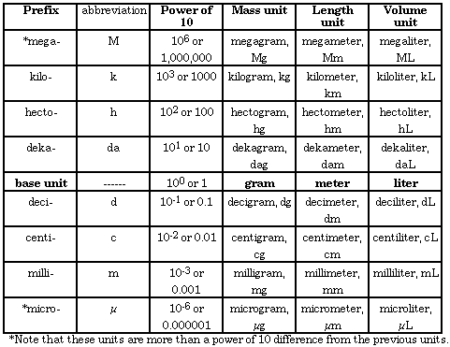
The Metric System Song!
Kilo
Hecto
Deka
Meter, Liter, Gram (yeah!)
Deci
Centi
Milli
Now I understand!

