Slide 1
Warm Up #6
Convert 50.0 inches/hour into meters per second. (1 inch = 2.54 cm)
The boiling point of water is 100.0ºC. On average, your measurement for Beaker 1 was 95.5ºC. Calculate your percent error.
Which is heavier, a pound of lead or a pound of feathers? Why have you chosen this answer?

Slide 2
Chapter 3.4
Density

Slide 3
DENSITY
Density – how tightly packed object is in given space
Ex. Packing for 2 day trip vs. 2 month trip.
DENSITY= MASS/VOLUME
D = M/V
Mass – -grams
Volume - -liters OR cm³ (or dm³)
1 mL = 1 cm³

Slide 4
Density and Temperature
Inverse Proportion – as one goes up, the other goes down
Opposite: Direct Proportion – as one goes up, the other goes up (and vice versa).
With density: as temperature increases, density decreases
Ex. Melting butter

Slide 5
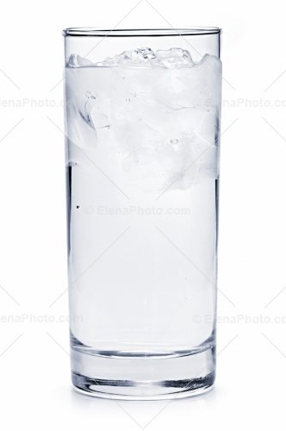
Why Do Ice Cubes Float?
Density dec. as Temperature inc.
exceptions?
Comparing densities: a solid vs. water
Liquid water = 1.00 g/mL
Solid objects MORE dense…sink
Lead = 11.4 g/mL
Solid objects LESS dense…float
Ice = 0.917 g/mL

Slide 6
Quick Quiz #4:
A scientist has a sample of gold with a mass of 45 grams. With this information, calculate the volume of this gold sample.
Mr. Lockett has a mystery substance with measurements of 3.0cm, 10.0mm and 5.0cm and mass of 40.5 grams. Find the density of this mystery substance, along with its identity.
I have an unknown amount of lead, and I place it in a graduated cylinder. The water rises from 10.0mL to 15.5mL. With this in mind, calculate the mass of lead, in grams.
* Hint: look at Table 3.6 in your textbook (pg. 90)

