Slide 1
Warm Up #2
Label the following as a physical or a chemical change:
Blow drying hair
Burning wood
Dissolving chocolate syrup in milk.
The atom consists of three “subatomic particles.” What are they? Name any/all that you know, and what charges they have.
Do you think all atoms of carbon look exactly the same? If not, how do you think they’re different?

Slide 2
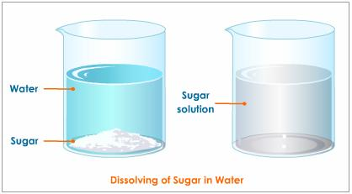
What about Dissolving?
Dissolving – when a substance breaks down
Solute – the thing being dissolved
Solvent – thing doing the dissolving
Salt water…a physical change
You can separate the salt from the water

Slide 3
Chapter 4
The Atom – Most Basic Unit of Matter

Slide 4
Nucleus Discovery

Slide 5
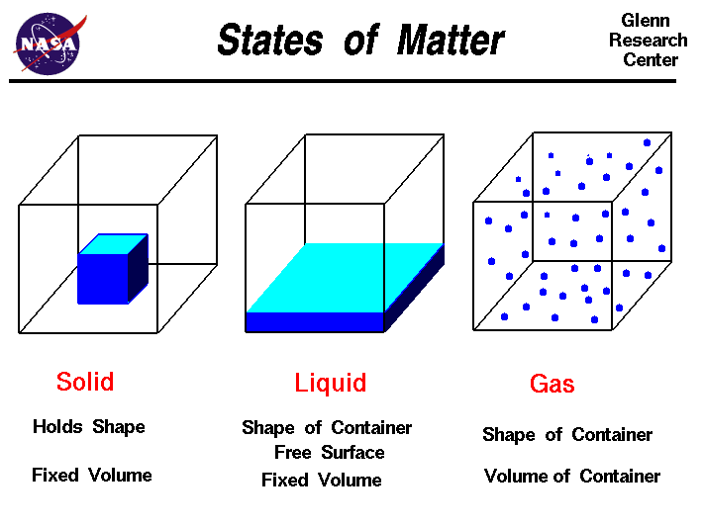
What is Matter? [And Why Does it Matter?]
Matter – Anything with a mass, and occupies volume
[Volume = Space – measured in liters, milliliters, etc]
Mass = grams, kilograms, etc
Three Main Forms:
Solid, Liquid, Gas

Slide 6
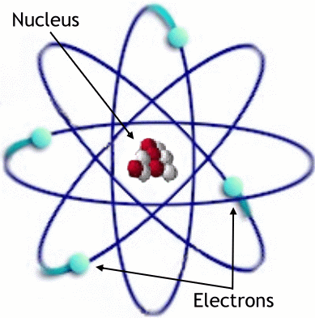
Atom
Atom – basic unit of matter
Greek Word (atomos - “indivisible”)
Has Nucleus (center) and “rings”
Consists of SUBATOMIC PARTICLES (sub = below)

Slide 7
Dalton’s Atomic Theory
All elements have atoms that are indivisible. (WRONG)
“sub atomic particles = PLUM PUDDING”
Atoms of same element are identical. (WRONG)
Atoms of different elements CAN mix together.
Chemical reactions occur when atoms are joined or separated.

Slide 8
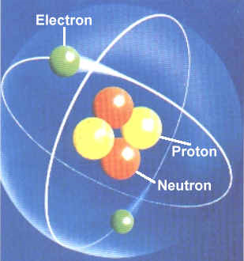
Subatomic Particles – Nucleus
Nucleus – Center of Atom
Consists of TWO subatomic particles
Protons – positive charge (+)
Neutrons – no charge (0)
Relatively same mass (1 amu)
Nucleus = VERY dense

Slide 9
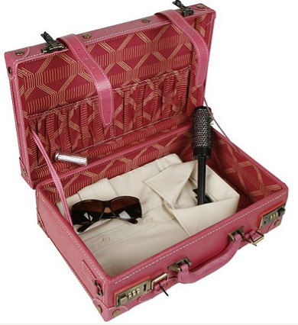
Density Review
Density – how tightly packed things are in a given space.
More dense = more tightly packed
Small, weighs a lot
Mass over Volume (g/mL)

Slide 10
Also Keep in Mind…
Charges = positive, negative, neutral
Like charges REPEL
Positive repels Positive
Negative repels Negative
Opposite charges ATTRACT
Positive attracts Negative
Negative attracts Positive

Slide 11
Quick Quiz #1
What parts of Dalton’s atomic theory were wrong, give examples of why they are wrong.
How do you make chocolate milk? Using the terms “solute” and “solvent,” explain the process. Also, explain whether this is a physical or chemical change and why.
The density of gold is 19.3 g/cm³. If the water level of your graduated cylinder changes from 25.0 mL to 37.5 mL after an amount of gold is added, calculate the mass of gold.

