Slide 1
Warm Up #2
Label the following as a physical or a chemical change:
Blow drying hair
Burning wood
Dissolving chocolate syrup in milk.
The atom consists of three “subatomic particles.” What are they? Name any/all that you know, and what charges they have.
Do you think all atoms of carbon look exactly the same? If not, how do you think they’re different?

Slide 2
Chapter 4.2-4.4
The Nucleus, Atomic Mass and Isotopes

Slide 3
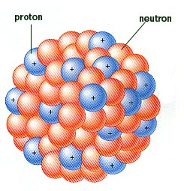
Remember:
Nucleus = protons and neutrons (POSITIVELY CHARGED)
DENSE – a lot of matter in a small space
A VERY small portion of the atom (mostly empty space)

Slide 4
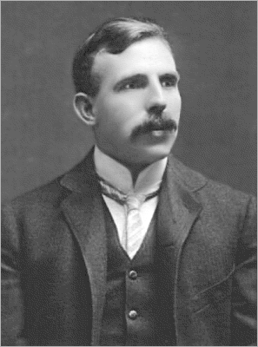
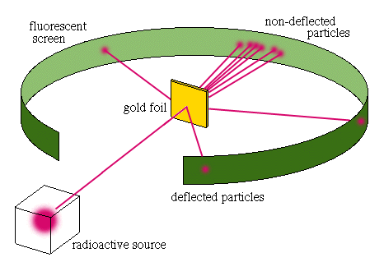
Ernest Rutherford (1871-1937)
Discovered nucleus
Before him: atoms = positively charged blobs with some negative charged particles in it
Experiment: shot laser w/positive charged particles into gold foil

Slide 5
What Rutherford Found…
Most particles go through gold foil
BUT
Some particles deflected
MEANING
Most of gold foil = negative-charged (electrons)
Small positive charged center (NUCLEUS)

Slide 6
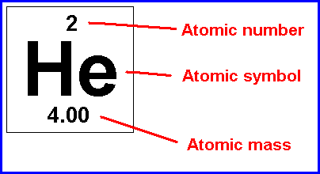
Nucleus Continued
On Periodic Table:
Atomic Number – Number of PROTONS an atom has
STAYS CONSTANT (ALWAYS)
Element Symbol

Slide 7
Nucleus Continued
On Periodic Table:
Atomic Mass – Number of PROTONS AND NEUTRONS together
In grams
# Neutrons = Mass # – Atomic #

Slide 8
Protons and Neutrons
Protons do not always equal neutrons
Ex. Aluminum
Atomic # 13 (13 protons)
Mass: 26.98g (13 protons + 14 neutrons)
Why does this occur?
Aluminum

Slide 9
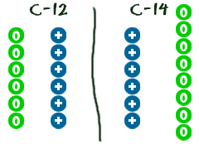
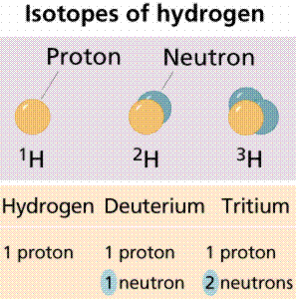
Isotopes!
Isotopes – The same element, but different numbers of neutrons
Different FORMS of the element
Carbon 12 (mass # = 12)
Ex. Carbon
Carbon-12 (6p, 6n)
Carbon-13 (6p, 7n)
Carbon-14 (6p, 8n)
(radioactive)

Slide 10
To Find Atomic Mass…
Take ALL forms of element in universe, and find AVERAGE
Ex. Carbon
Atomic Mass: 12.01 grams
A LOT of carbon-12
Small amount of carbon-13 and 14
Mass # -
# of protons + neutrons
C
12
6
Atomic# -
# of protons
Carbon-12
Shorthand Notation

Slide 11
Quick Quiz
The nucleus consists of protons and neutrons. What charge does the nucleus have then?
Write the correct short-hand notation of Carbon-13 (include mass number and atomic number)
If an element has an atomic number of 30, and a mass number of 65, how many neutrons does it have?

