Slide 1
Warm Up #1
I am a mystery element with 25 protons and a mass of 51.
How many neutrons do I have? How did you find this?
What is my correct notation?
Right now this element has a +25 charge. How can you make this element a neutral charge? (i.e. what other subatomic particle do you need?)

Slide 2
Warm Up #2
You are dealing with magnesium-26, an element with a +2 charge:
How many protons, neutrons and electrons does the element have?
What is the correct shorthand notation for this isotope?
How are electrons arranged in an atom?

Slide 3
Chapter 5
Electrons and Electron Configurations

Slide 4
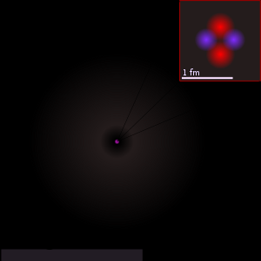
Outside of Nucleus
Third Subatomic Particle
Electrons – negatively charged (-)
Have practically no mass
“Ring” – Atomic Orbitals
[Think orbit – orbit around something]

Slide 5
J.J. Thompson (late 1800’s)
Discovered electrons
Shot negative particles through cathode ray tube (think fluorescent lights above you..)
Ran from negative to positive (opposites attract)
True of ALL metal elements tested

Slide 6
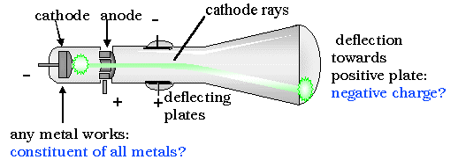
Cathode Ray Experiment Pictured

Slide 7
Electron Function
Electrons balance charge of nucleus
Some elements have CHARGE in nature
Ex. Fluorine (F) = -1 charge
Ex. Calcium (Ca) = +2 charge
To get this charge:
If (-) charge…ADD more electrons
If (+) charge…TAKE AWAY electrons

Slide 8
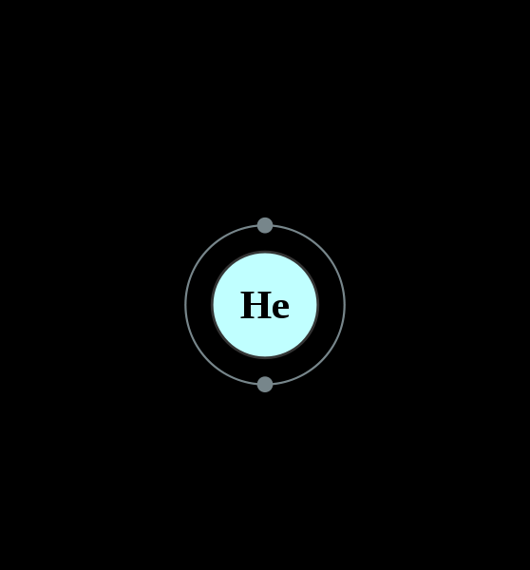
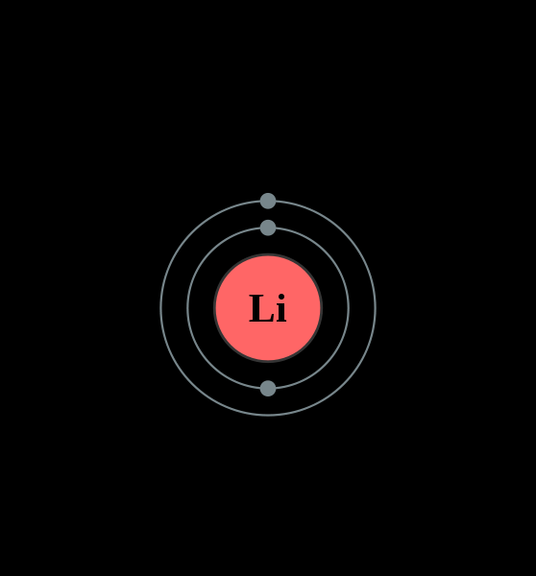
How Electrons are Arranged
Electrons – move around nucleus
Bohr Model – predictable orbits
Electron Shells – places electrons are found
Valence Electrons – electrons in outermost shell
Inner shell = 2
2nd shell = 8
Helium – 2 electrons
Lithium – 3 electrons

Slide 9
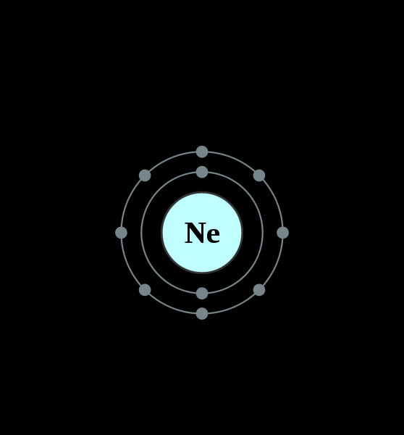
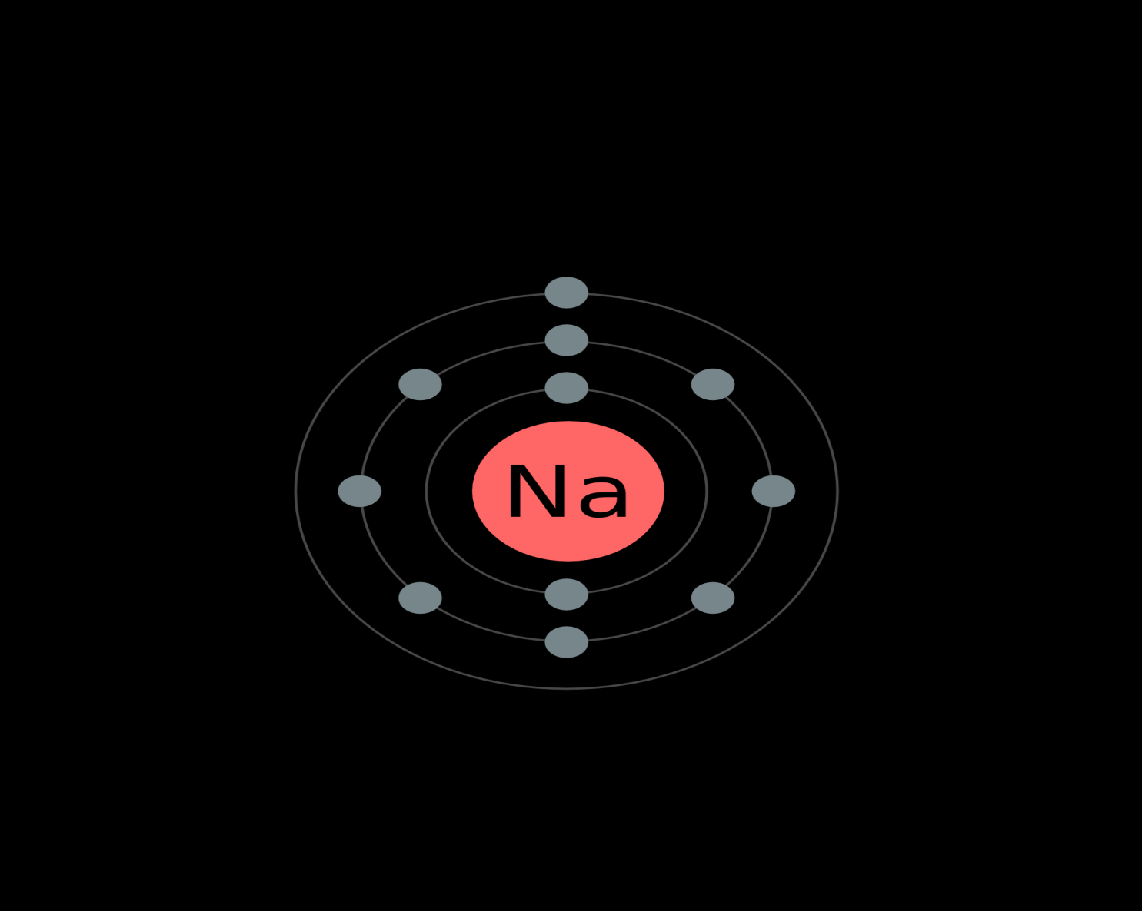
Electron Shells Continued
Neon – 10 Electrons
[2 inner, 8 outer]
Sodium – 11 electrons
[2 inner, 8 middle, 1 outer]

Slide 10
How to Draw Electron Configurations: Bohr Model
Draw big circle in center (nucleus)
Label with element symbol
Draw ring around nucleus (inner shell)
Draw circles on rings (electrons)
Add more rings when needed

Slide 11
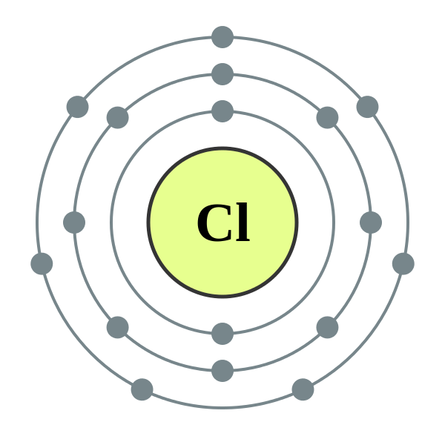
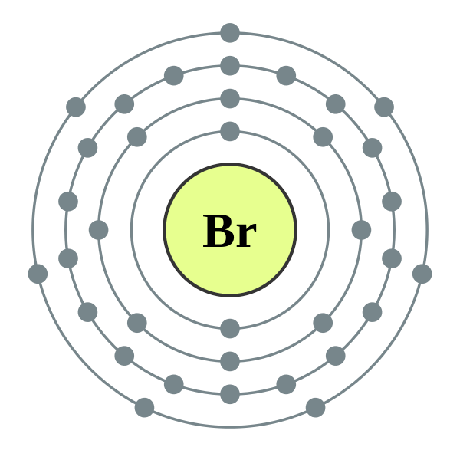
Possible options in the 3rd ring:
1st ring = 2
2nd ring = 8
3rd ring = 8 OR 18
8…if 3rd row (period)
Chlorine: 2, 8, 7
18…if 4th row and beyond (transition metals)
Bromine: 2, 8, 18, 7

Slide 12
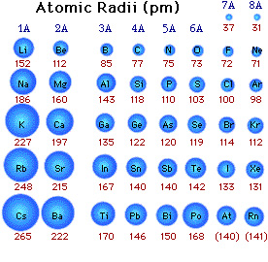
Atomic Size
Each element has a different atomic radius (number of electrons)
Largest = 265 pm (Cs)
Smallest = 31 pm (He)
Pm = Picometer
1 m = 1x10¹² pm
Also: Nanometer (nm)
1 m = 1x10⁹ nm

Slide 13
Quick Quiz # 1
Draw the electron configurations for the following:
Chlorine, neutrally charged
Magnesium, + 2 charge
Nitrogen, -3 charge

