Slide 1
Warm Up #3
Describe the octet rule, and why noble gases satisfy this rule.
Name three elements that have a -3 charge. Where are these elements in respect to one another?
What are the natural charges and group names for each of the following: Na, I, Ar, Cl, Ca, Cs.

Slide 2
Identifying Elements
Chapter 5.2-5.3

Slide 3
You Are Going to a Concert
Your Ticket
Row: 2
Section: P
Seat: 4

Slide 4
Review of Electrons
Negative Charge
Found outside the nucleus
Arranged in Orbitals
Rings around nucleus
Octet Rule – wants 8 valance electrons

Slide 5
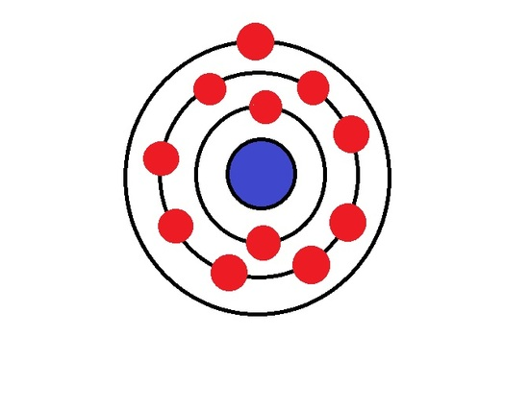
Electron Configurations
Niels Bohr – German chemist
Hypothesized structure of atom:
Positively charged center (nucleus)
Electrons orbit nucleus in rings

Slide 6
Rings? No.
Bohr Model – Electrons move in rings
Electrons in rings = A FILTHY LIE
Electrons – move in WEIRD orbitals
Types:
S P D F

Slide 7
Weird Orbitals Pictured
S Orbital
1 variety
D Orbital
5 varieties
P Orbital
3 varieties
ELECTRONS MOVE IN THESE MUSTARD CIRCLES RANDOMLY

Slide 8
Orbitals on the Periodic Table
Remember:
Horizontal Rows = Periods
Symbol = n (principal quantum number)
When n = 1 (first row):
Hydrogen (H) and Helium (He)
When n = 2 (second row):
Lithium (Li) to Neon (Ne)

Slide 9
The 2 (major) Quantum Numbers
n = principal quantum number
Period the element is in
ℓ = orbital quantum number
Tells what section e- are in
range: 0 ≤ ℓ ≤ (n − 1)
0 = s, 1 = p, 2 = d, 3 = f

Slide 10
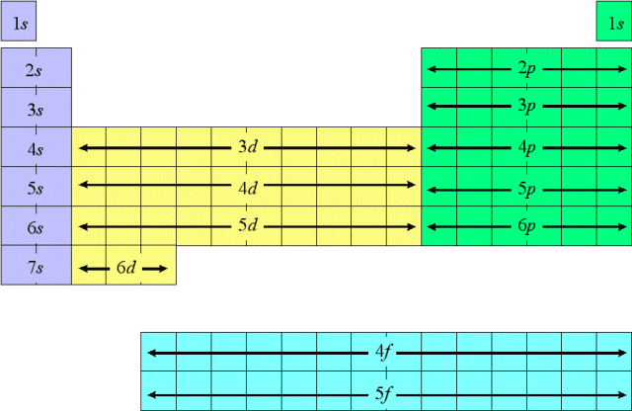
Electron Configuration

Slide 11
S P D F On the Table
Orbital Types = S, P, D, F
S – Left of Transition metals
MAX: 2
P – Right of Transition metals
MAX: 6
D – Transition metals (rectangle)
MAX: 10
F – Lanthanides and Actinides (by themselves)
MAX: 14

Slide 12
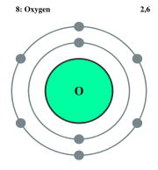
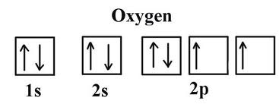
Oxygen: in n = 2, ℓ = 1
In 1st P-orbital section
Right of Transition Metals
Passes Through:
1s (2 elements)
2s (2 elements)
2p (4th element)
Notation: 1s²2s²2p⁴
OR….

Slide 13
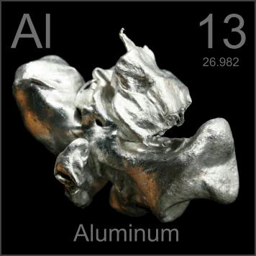
Other examples:
1. Neon (10):
1s²2s²2p⁶
Check:
2 +2 + 6 = 10
2. Aluminum (13):
1s²2s²2p⁶3s²3p¹
Check:
2 + 2 + 6 + 2 + 1 = 13

Slide 14
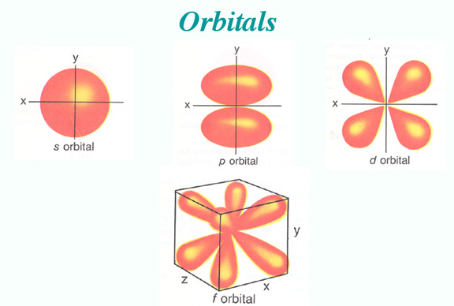
Quick Quiz #2
Write the correct notation or identify the correct element for the following:
Calcium
1s²2s²2p⁵
Sulfur
1s²2s²2p⁶3s¹

