Slide 1
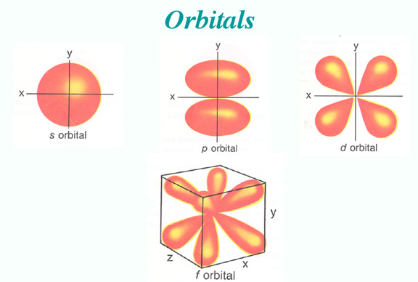
Warm Up #4
Find either the correct element or the correct orbital notation for the following:
Nitrogen
1s²2s²2p⁶3s²3p³
Magnesium

Slide 2
Orbital Notation Part II
D and F Orbitals (and exceptional elements)
Noble Gas Notation

Slide 3
Review
S, P, D, F Orbitals
Ex. Nitrogen (7)
FOLLOW ATOMIC NUMBER
start with 1, and follow it until you get to your destination
1s²2s²2p³
Check: 2 + 2 + 3 = 7
2p³
Row/
Period
Section
Elements # in that section

Slide 4
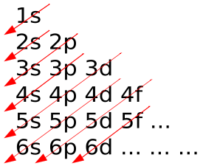
Rules of the Orbitals
Aufbau Principle – electrons occupy lowest energy level first [see pic]
Pauli Exclusion Principle – two electrons per orbital max
Spin in opposite directions
Spin = arrows up and down
Hund’s Rule – must all spin in one direction first, THEN fill in opposite spin second

Slide 5
Example: Titanium
Row: 4
Section: D
Seat: 2
So it should be:
4d²
BUT IT ISN’T!!!

Slide 6
When dealing with D-section:
It’s always (n-1) section
So if in row 4 (n = 4)
D section = 3d
1s²2s²2p⁶3s²3p⁶4s²3d² = Titanium
Check: 2+2+6+2+6+2+2 = 22

Slide 7
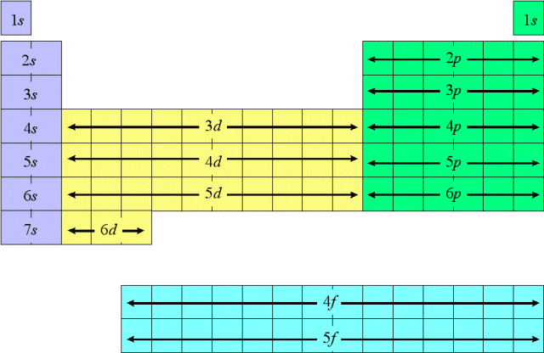
Electron Configuration

Slide 8
Bigger Elements
Selenium =
1s²2s²2p⁶3s²3p⁶4s²3d¹⁰4p⁴
THAT’S WAY TOO LONG!!!
Easier way: Use NOBLE GAS before element
[Noble Gasses: He, Ne, Ar, Kr, Xe, Rn]

Slide 9
Noble Gas Notation
For Selenium (Se – 34):
Noble Gas before: Ar
So: [Ar] 4s²3d¹⁰4p⁴
Check: Ar = 18 + 2 + 10 + 4 = 34
This form = Noble Gas Notation

Slide 10
The F-Section
F section = lanthanides and actinides.
Start in sixth row (n = 6)
BUT: START with 4f
F-section = (n-2)
Max: 14 electrons

Slide 11
Things to Note:
[Xe] 6s²4f²5d¹
Notice: it’s NOT 6f²!
For F-Section: (n-2)
So: [Xe]6s²5d¹4f² = Cerium (Ce)

Slide 12
Look at La and Ce
Look for break off
La = 5d1
So [Xe] 6s² 5d¹
Ce = 4f¹
BUT pass through La first!
So…[Xe] 6s²5d¹4f¹

Slide 13
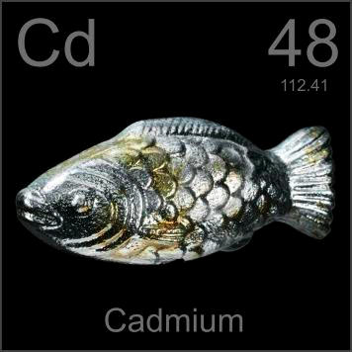
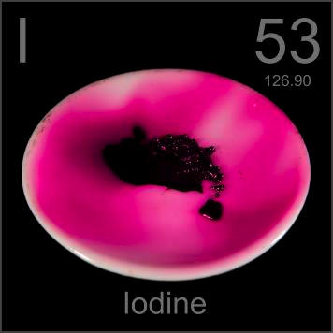
Quick Quiz #3
Express the following in
Noble Gas configuration:
Cadmium
Iodine
[Kr] 5s¹
[Xe] 6s² 5d¹ 4f²

