Slide 1
Warm Up #7
Which is larger, neutral charged lithium, or lithium with a +1 charge? Why?
Where are the most electronegative elements found? Why are the noble gases not considered to be electronegative?
What does n represent? What does ℓ represent?

Slide 2
Electron Configurations
Chapter 5.3

Slide 3
So far…
You’ve learned:
n = Principal quantum number
Row #
ℓ = orbital quantum number
Tells what section you’re in (s, p, d, f)
ℓ = 0 (s), ℓ = 1 (p), ℓ = 2 (d), ℓ = 3 (f)

Slide 4
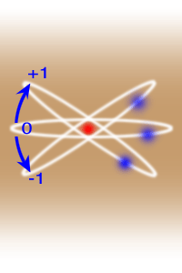
Now…
m _{ℓ} = magnetic quantum number
What PART of the section your electron is in
Range: - ℓ to ℓ
Ex. P-section (3 varieties)
ℓ = 1
m _{ℓ} = -1, 0, 1

Slide 5
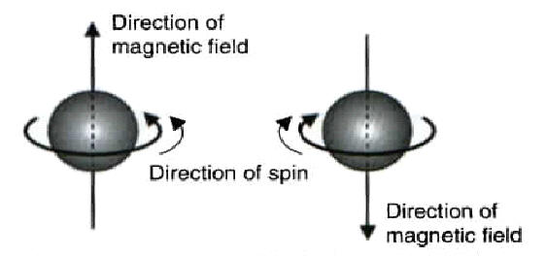
One more number…
m_{s} = magnetic spin. Direction the e- is spinning
m_{s} = - ½ (down arrow) or ½ (up arrow)
Spin in opposite directions (like charges repel)

Slide 6
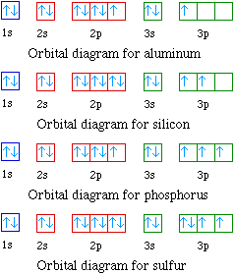
Writing Electrons:
Arrows (up and down)
Ex. Aluminum
Remember:
S = 1 variety (1 line)
P = 3 varieties (3 lines)
D = 5 varieties (5 lines)
2 electrons EACH line
One up, one down

Slide 7
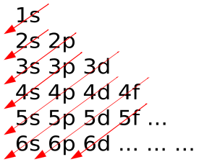
Rules of the Orbitals
Aufbau Principle – electrons occupy lowest energy level first [see pic]
Pauli Exclusion Principle – two electrons per orbital max
Spin in opposite directions
Spin = arrows up and down
Hund’s Rule – must all spin in one direction first, THEN fill in opposite spin second

Slide 8
Putting it all Together
N = 3, ℓ = 1, m _{ℓ} = -1, m_{s} = ½. What element am I?
3rd row, P section.
First line, electron arrow pointing up.
Element: =
Aluminum

