Slide 1
Warm Up #1
Copper chloride turned the fire a bluish green. Blue-Green has a wavelength of 492 nm. Calculate this amount in meters.
What are ALL the major colors in the visible light spectrum?
Why do you think we can see color? Why do you think some people can see certain colors, and some people cannot?

Slide 2
Light

Slide 3
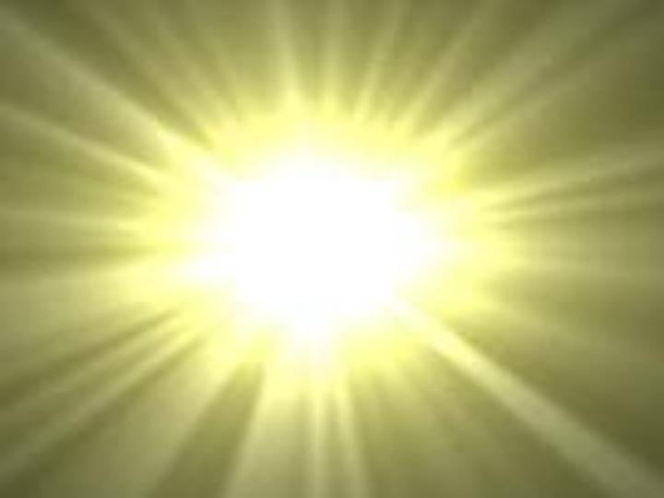
What is Light?
Light = ENERGY
Electromagnetic Radiation – released from nuclear reactions
Big Bang Theory → Light
Speed of light (c ) = 3.0 x10⁸ m/sec

Slide 4
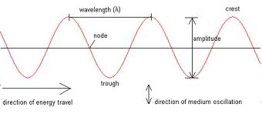
Light in Waves
Wave Model – shows how light moves from place to place
Amplitude = how high to wave is
Crest = peak of wave
Wavelength (λ) = distance between two crests
Nanometers (1x10⁹ nm = 1m)
Frequency (v) = how quickly waves move
Sec⁻¹ (1/sec) Hertz (Hz)

Slide 5
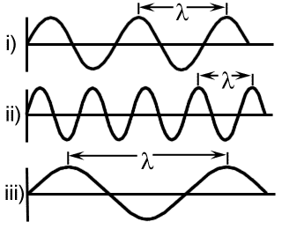
What does Frequency Mean?
Frequent – how often something occurs in given time.
Light = SAME speed, but wave sizes different
Frequency = how often does a new wave occur?

Slide 6
Wavelength and Frequency
Inverse relationship – as one goes up, the other goes down.
Long wavelength, low frequency
Short wavelength, high frequency
v = c / λ
C = speed of light

Slide 7
Practice Problem
A very bright yellow line has a frequency of 5.10x10¹⁴ sec⁻¹. Calculate the wavelength of this yellow light?

Slide 8
Warm Up #2
How are frequency and wavelength related? What type of relationship is this called?
Why can’t we actually say that certain types of light waves move FASTER than others?
Red light has an emission of approximately 630 nm. What is the frequency of this?

Slide 9
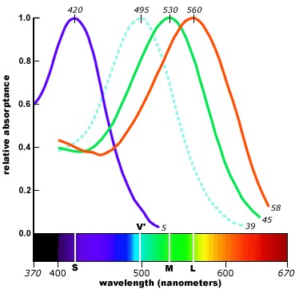
What is Color? Why Can We See It?
Visible Light = ROY G. BIV
red, orange, yellow, green, blue, indigo, violet
Human eyes = rods and cones for color
Cones – blue, green and red light cells
Colorblindness = no red/green cones
Other animals = infrared (heat sensory) vision

Slide 10
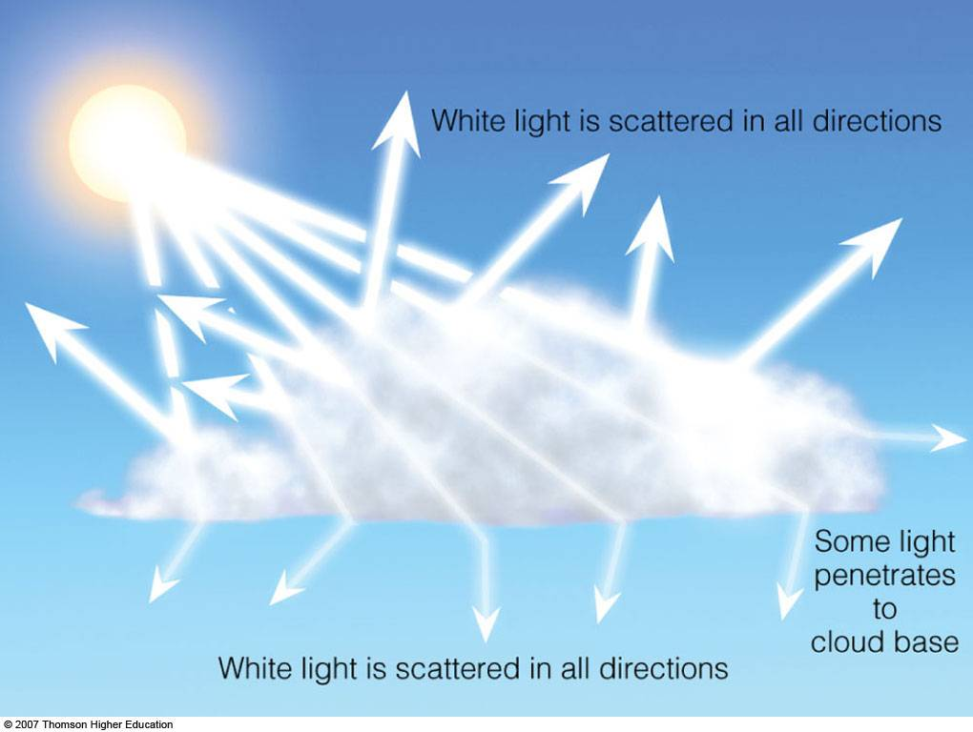
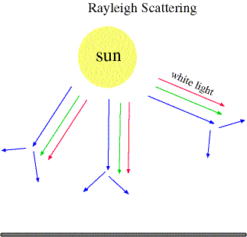
Why is the Sky Blue?
Human Eye: Blue, Green & Red
Blue = smallest λ
Light in Earth’s atmosphere = Light Scattering
Mie Scattering – white light scattered equally (clouds)
Rayleigh Scattering – certain colors scatter, others do not
Blue scatters (smaller) = blue sky
Green and red remain (sun looks yellow)

Slide 11
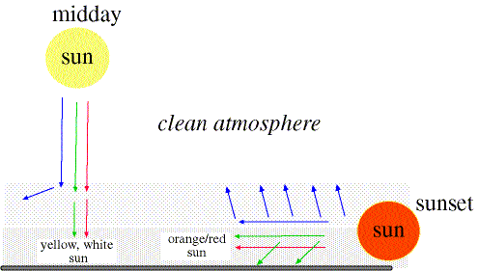
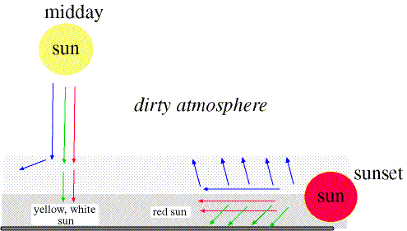
What About Sunset?
Sunset = sun exposed to more atmospheric layers
MORE scattering
Clean atmosphere = blue and SOME green scatters
Greenish red remains (sun appears orange)
Dirty atmosphere = blue and MOST green scatters
Mostly red remains (sun appears red)

Slide 12
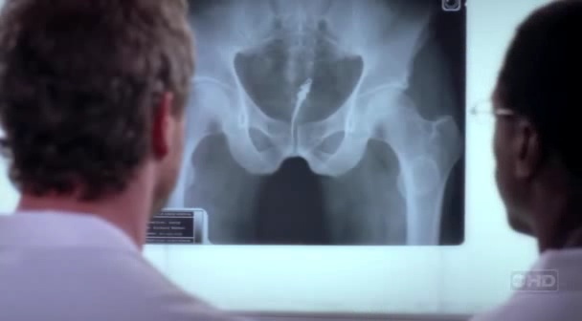
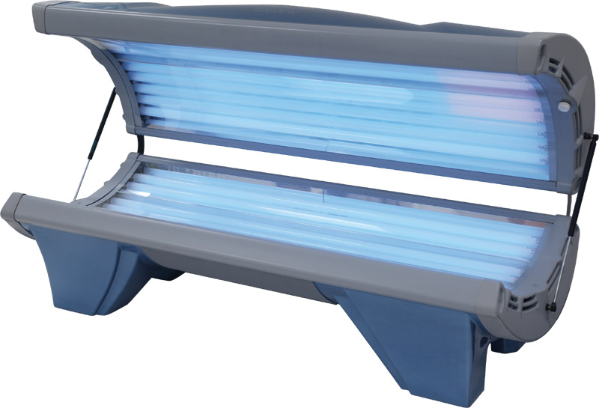
Frequency and Energy
Direct Relationship – if one goes up, the other goes up and vice versa
Higher frequency = more energy (gamma)
Lower frequency = less energy (radio waves)

Slide 13
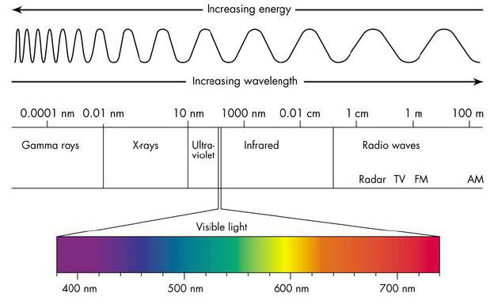
Electromagnetic Spectrum

Slide 14
Electromagnetic Spectrum: Explained
Gamma → X-Ray → UV → Visible Light → Infrared → Microwaves → Radiowaves
Order = smaller to larger wavelength
Review: Larger wavelength = smaller frequency (AND less energy)

Slide 15
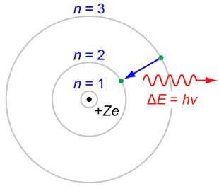
Energy
Planck’s Constant
Light → Movement of electron to lower energy level = energy released.
E = h • v
E = energy (Joules)
h = 6.626x10⁻³⁴ J•sec
Planck’s constant
v = frequency (sec⁻¹)

Slide 16
Practice Problem
Infrared Rays emit a wavelength of approximately 830 nm. Calculate the energy, in joules, released from this type of light.

Slide 17
Warm Up #3
Red light has a wavelength of approximately 650 nm. What is the frequency of this type of light?
A certain type of light gives off an energy of approximately 8.17x10⁻¹⁹ J. Find the wavelength of this type of light. Does it fall in the visible light spectrum range? (400-700nm)?
Blue light has a wavelength of 460nm. What is the speed of this light?

Slide 18
Warm Up #4
Yellow light has a wavelength of approximately 550 nm. What is the frequency of this type of light?
A certain type of light gives off an energy of approximately 9.1x10⁻¹⁶ KJ (1 kJ = 1000 J). Find the wavelength of this type of light. Does it fall in the visible light spectrum range? (400-700nm)?
Infrared light has a wavelength of 790nm. What is the speed of this light?

