Slide 1
Warm Up #3
Draw the electron configurations for the following:
Fluorine (no charge)
Chlorine (no charge)
How many valence electrons do they have?
How many electrons does it need to fill up the outermost shell?
After this change, what charge would each have?
Looking at the Periodic Table, where are Fluorine and Chlorine in relation to each other?

Slide 2
The Periodic Table Explained
Chapter 6.1 and 6.2

Slide 3
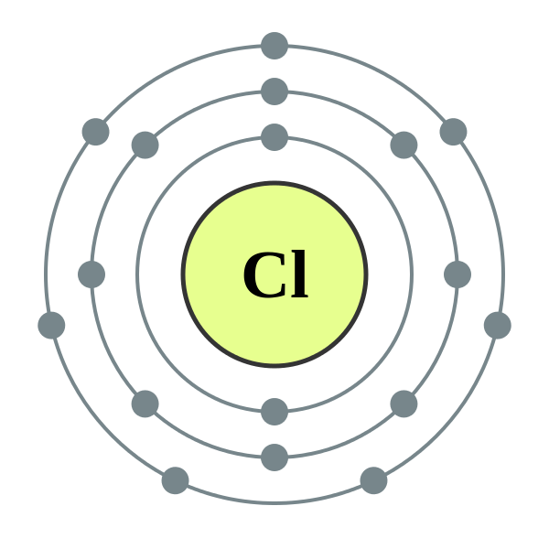
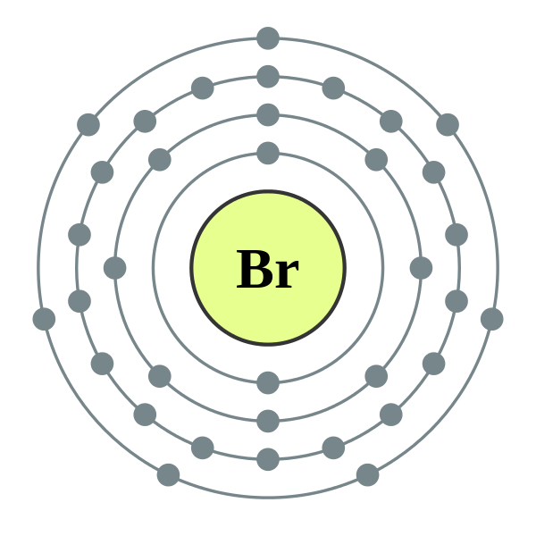
Possible options in the 3rd ring:
1st ring = 2
2nd ring = 8
3rd ring = 8 OR 18
8…if 3rd row/K/Ca
Chlorine: 2, 8, 7
18…if 4th row and beyond (transition metals)
Bromine: 2, 8, 18, 7

Slide 4
Practice:
Draw the Bohr Model notation for:
Silicon
Selenium
Potassium

Slide 5
Creater: Dmetri Mendeleev (1869)
Russian chemist
Organized discovered elements into table:
Rows (Periods) = increasing atomic mass
Our table – increasing atomic NUMBER
Columns (Groups) = similar properties
Left blank spaces (undiscovered elements)
“eka-Cesium” = below Cesium

Slide 6
Mendeleev’s Table (1869)

Slide 7
Periodic Table of Elements Today

Slide 8
His Table vs. Today’s Table
Mendeleev’s Table
Today’s Table
56 known elements
Blank spaces for undiscovered elements
8 Groups (Columns)
No noble gasses (He, Ne, Ar, Kr)
No atomic number (protons)
118 known elements
No blank spaces needed
18 Groups (Columns)
Noble gasses (He, Ne, Ar, Kr)
Atomic numbers (protons)

Slide 9
Periodic Table Pictured (again)

Slide 10
How It Works
Going in order: read like a book (left to right)
Rows (across) = PERIODS
Goes in order of ATOMIC NUMBER
Columns (up and down) = GROUPS
Elements in 1 group = SIMILAR PROPERTIES

Slide 11
How Periodic Table is Arranged
Metals = LEFT side
Non-Metals = RIGHT side
Middle: Combo of metal and nonmetal = METALLOID
Form “staircase” (purple)
Elements: B, Si, Ge, As, Sb, Te, At

Slide 12
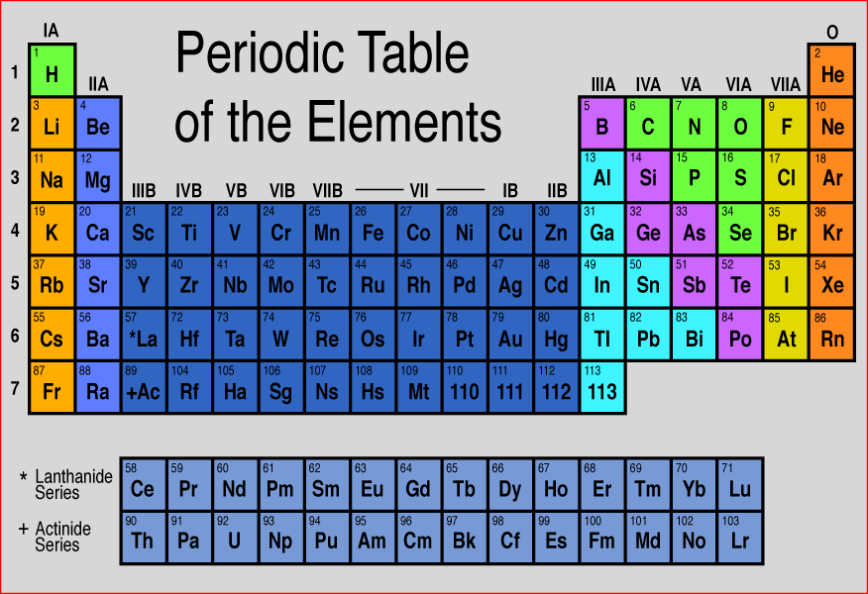
Main Groups
Alkali Metals (gold)
Alkaline Metals (light blue)
Transition Metals (dark blue)
Metalloids (purple)
Non-Metals (green)
Halogens (yellow)
Noble Gasses (orange)
Lanthanides (* at bottom)
Actinides (+ at bottom)

Slide 13
Why Most Elements Have a Charge in Nature
Outermost electrons – VALENCE ELECTRONS
Octet Rule – Want to fill outermost shell (2 or 8)
Review:
Losing e- = POSITIVE
Gaining e- = NEGATIVE

Slide 14
Family/Group 8: Noble Gasses The Popular Girls
Noble Gases: He, Ne, Ar, Kr, Xe, Rn
Traits: 8 valence electrons (Octet Rule OK), NO CHARGE (no drama)
Seen With: NO ONE
Too good for anyone else.

Slide 15
Looking at the Periodic Table
In order to fulfill octet rule…ask yourself:
Is it easier for the element to move FORWARD (gain electrons) to become more Noble?
If so, charge is NEGATIVE
OR
Is it easier for the element to move BACKWARD (lose electrons) to become more Noble?
If so, charge is POSITIVE

Slide 16
Halogens… The female serial monogamists…
Halogens: F, Cl, Br, I, At
Traits: Seven valence e-, -1 charge (easier to gain 1 e-)
(Almost) Always in a Relationship: with male monogamists – VERY REACTIVE

Slide 17
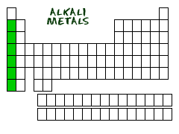
Alkali Metals… The male serial monogamists..
Alkali Metals: Li, Na, K, Rb, Cs, Fr
Traits: One valence e-, +1 charge (easier to lose 1 e-)
(Almost) Always In a relationship: with female monogamists…– VERY REACTIVE

Slide 18
Family/Group 2: Alkaline Earth “Player” Metals
Be, Mg, Ca, Sr, Ba, Ra
Traits: 2 valence electrons, +2 charge (easier to lose 2 e-)
Seen with: Group 7 Halogens (two of them)
OR Group 6 nonmetals (oxygen)

Slide 19
Group: Transition Metals
Scandium to Zinc
Zinc to Mercury
Found in middle of table
Ones in each column = similar properties
Different charges

Slide 20
Quick Quiz #1
Draw the Bohr Model notation for: Phosphorus. Predict its charge, and explain why this would be its charge.
Why did Mendeleev leave blank spaces on the Periodic Table he constructed? Why was Mendeleev not able to arrange his periodic table in order of increasing atomic number?
How does the octet rule explain the natural charges of almost every element on the Periodic Table?

