Slide 1
Warm Up #5
According to the lab, as you go across the periodic table from left to right, what happens to the atomic radius?
Which element will most likely lose an electron, Na or Cl? Why is this true?
Draw the electron configuration (rings) for potassium. Next to it, draw an electron configuration for potassium with a +1 charge. How do the sizes of the atoms differ?

Slide 2
Periodic Trends
Chapter 6.3

Slide 3
Trends Discussed:
Atomic Size/Atomic Radius
Ionic Size
Ionization Energy
Electronegativity

Slide 4
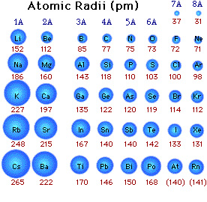
Atomic Size/Radius
Atomic Radius – distance from nucleus to end of atom
Measured in Picometers
1 m = 1x10¹² pm
Trend: due to attraction,
atomic radius DECREASES from left to right, and INCREASES from top to bottom

Slide 5
Laws of Attraction: Applied
Compare: Lithium (Li) vs. Fluorine (F)
Lithium = 3 protons, 3 electrons
Fluorine = 9 protons, 9 electrons
Fluorine = MORE p+ than Li…meaning MORE ATTRACTION of e- (draws them inward)
SO…fluorine is SMALLER than lithium

Slide 6
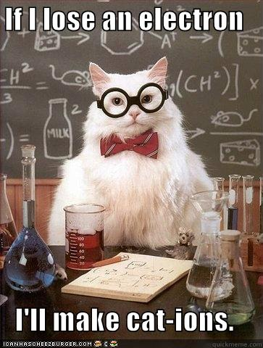
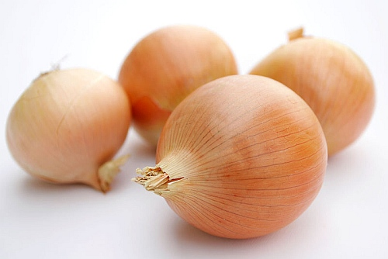
First and Foremost…
Goal: 8 valence electrons (octet rule)
Ion – an atom with a charge (in order to satisfy octet rule)
Cation = POSITIVE charge
Anion = NEGATIVE charge

Slide 7
Ionic Radius
Boron vs. Nitrogen
Boron ion = +3 (loses 3 e-) → Cation
Nitrogen ion = -3 (gains 3 e-) → Anion
Boron…LOSES an energy level (SMALLER than neutral Boron)
Nitrogen…GAINS e- (LARGER than neutral Boron)

Slide 8
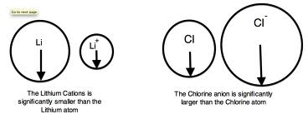
Ionic Radius Trend
Cations = smaller than neutral atom (Left of Carbon)
Lose energy level
Anions = larger than neutral atom (Right of Carbon)
Gain electrons, less attraction
Carbon…goes both ways. Yeah, it’s like that.

Slide 9
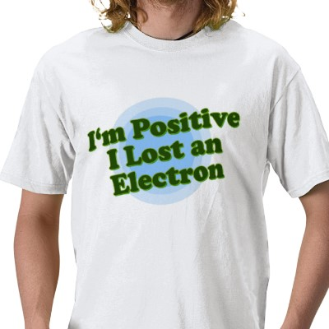
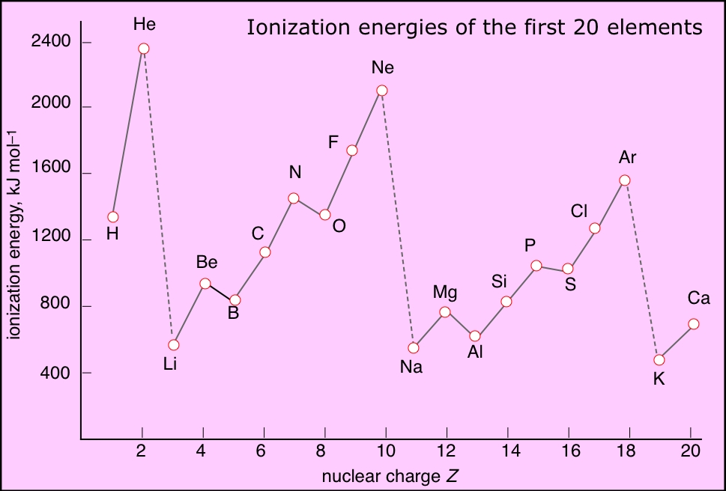
Ionization Energy
Ionization Energy – amount of energy required to LOSE an electron
Trend: INCREASES from left to right, DECREASES from top to bottom
Sodium = easy to lose e-
Chlorine = hard to lose e-

Slide 10
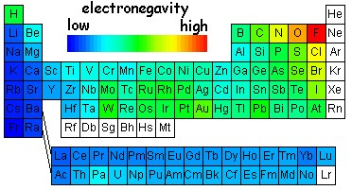
Electronegativity
Electronegativity – ability of atom to ATTRACT electrons
Trend: INCREASES from left to right, DECREASES from top to bottom
Highest E.N. = Fluorine (4.0)
Same as Ionization Energy

Slide 11
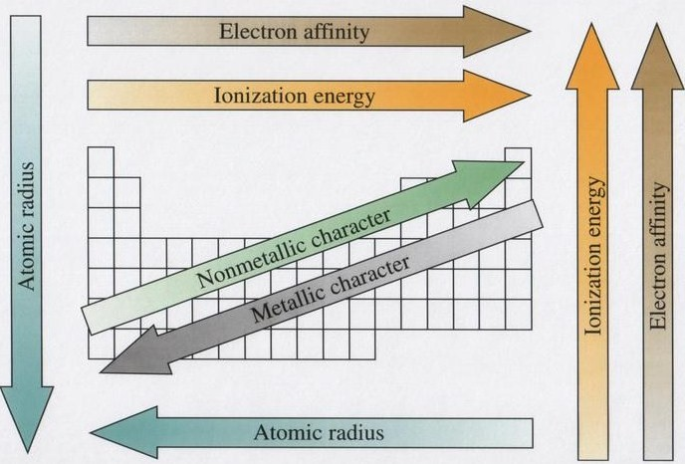
Periodic Trends Pictured

Slide 12
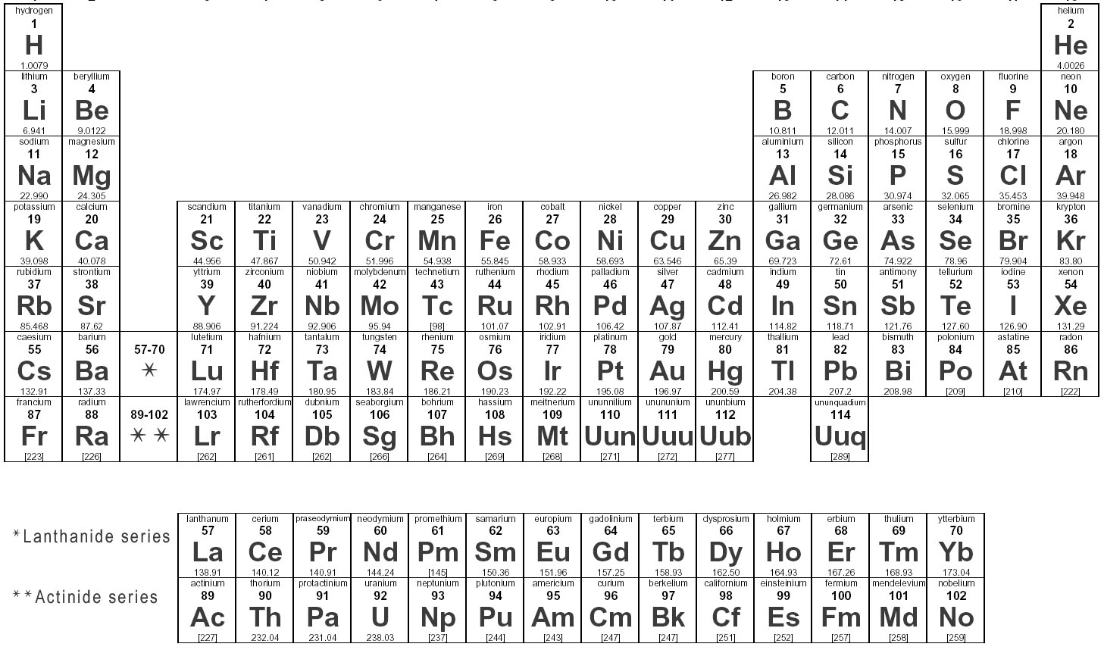
OR…BEARs Because UCLA > USC
E – Electronegativity
ionization Energy
B – Basicity
R – atomic Radius
A – Acidity

Slide 13
Quick Quiz #1
Compare the ionic radii of neutrally charged oxygen, and oxygen with a negative 2 charge. Which radius is larger, and why?
Fluorine has a high ionization energy AND electronegativity. Why do the noble gasses have a high ionization energy, but virtually no electronegativity?
Why do the atoms in the bottom LEFT corner have a larger atomic radius than elements in the bottom RIGHT corner?

