Slide 1
Warm Up #1
Draw the electron configuration (rings) for sodium.
1. What charge would sodium have, and why?
Draw the electron configuration for chlorine.
2. What charge would chlorine have, and why?
3. Why do you think sodium and chlorine have the tendency to bond with each other to make NaCl (table salt)?
4. What is the name of NaCl?

Slide 2
Warm Up #2
Draw the electron configuration (rings) for magnesium and fluorine.
How many valence electrons does each element have, and what will their eventual charges be to satisfy the octet rule?
In order to neutralize the charges of magnesium and fluorine, you will need to add more of one of the elements. Which element would you add more of, and why?

Slide 3
Ionic Bonding (w/naming)
Chapters 7.1 and 9.1

Slide 4
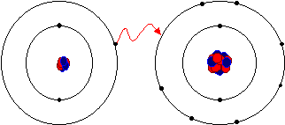
Metal and Non-Metal Bonding
Metals = Left side of table
Non-Metals = Right side
Metal mates with Non-Metal → IONIC BOND
Ionic Bond – metal donates electron to nonmetal
Lithium donating it’s valence electron with Fluorine…aww cute!

Slide 5
Ionic Bond Intro
Ionic Bond – between METAL and NON-METAL
Metal DONATES valence electrons to NON-METAL
Metal = Positive charge (Cation)
Non-Metal = Negative charge (Anion)

Slide 6
Example: Sodium and Chlorine
Na + Cl → Na⁺ + Cl⁻ → NaCl

Slide 7
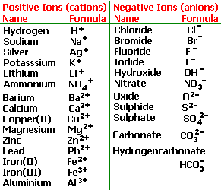
Naming Ionic Compounds
When naming:
Metal+ Non-metal”ide”*
NaCl (Na = cation, Cl = anion)
SODIUM CHLORIDE
*True when anion is BY ITSELF

Slide 8
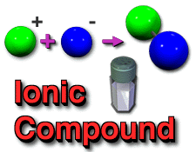
Other Examples
KBr
Metal = K (Potassium)
Non-Metal = Br (Bromine)
Name: Potassium Bromide
MgO
Metal = Mg (Magnesium)
Non-Metal = O (Oxygen)
Name: Magnesium Oxide

Slide 9
Chemical Equations: Ca + O → CaO
Ionic Bond = Metal (Ca) and Non-Metal (O)
Name = Metal Non-Metal “-ide”
Calcium Oxide
So Far:
Metals and Non-Metals = BALANCE
Ca = +2 O = -2
What happens when they don’t equal?

Slide 10
Example: Al + O → AlO (NOT!)
Name: Aluminum Oxide
Aluminum = +3 charge
Oxygen= -2 charge
Aluminum does NOT balance out Oxygen
What to do????

Slide 11
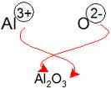
Subscripts
Subscript – a number in the bottom right hand corner of element symbol.
Equation: Al³⁺ + O²⁻ → Al₂O₃
_{Name} STAYS THE SAME

Slide 12
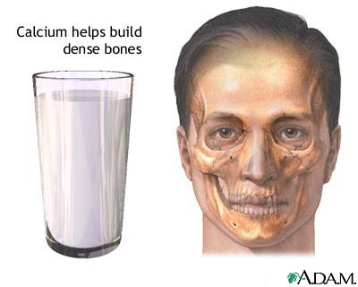
Example: Ca + Cl → ???
Ca = +2 charge (Cation)
Cl = -1 charge (Anion)
Equation:
Ca⁺² + Cl⁻¹ → Ca₁Cl₂ (OR CaCl₂)
Name: Calcium Chloride

Slide 13
Quick Quiz #1
Write the chemical equations for the following (DON’T FORGET SUBSCRIPTS IF NECESSARY)
Magnesium and Fluorine.
Name of compound?
Potassium and Oxygen
Name of compound?
Boron and Phosphorus
Name of compound?

