Slide 1
Warm Up #3
Write the chemical equation to form the following (include ion charges):
Strontium Oxide
Potassium Nitride
Magnesium Phosphide
Where are the transition metals found on the Periodic Table?

Slide 2
Chapter 7.2 and 9.2
Transition Metals and Polyatomic Ions

Slide 3
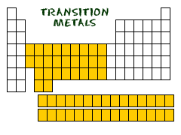
Transition Metals
Found in center of Periodic Table
Giant rectangle
Ex. Zinc, Copper, Iron
Ions of Transition Metals = + charge
MULTIPLE IONS of same metal exist

Slide 4
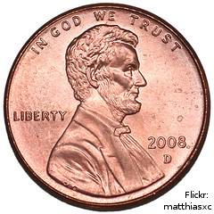
Transition Metal Ion Charges
Example: Iron (Fe)
Forms:
Fe⁺² (Ferrous Ion)
Fe⁺³ (Ferric Ion)
Example: Copper (Cu)
Forms:
Cu⁺¹ (Cuprous Ion)
Cu⁺² (Cupric Ion)

Slide 5
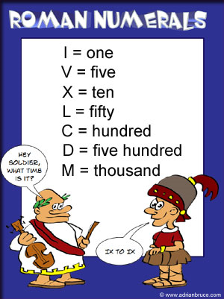
When Naming…
USE ROMAN NUMERALS
I = one
II = two
III = three
IV = four
Charge of metal = roman numeral used
Ex. Fe⁺² = Iron (II)

Slide 6
Example of Compounds
Ex. Fe⁺² + O⁻² → FeO
Metal = Iron (+2 charge)
Non-Metal = Oxygen (by itself)
“-IDE” ending
Name: Iron (II) Oxide
Ex. Fe⁺³ + O⁻² → Fe₂O₃
Metal = Iron(+3 charge)
Non-Metal = Oxygen (by itself)
“-IDE ending”
Name: Iron (III) Oxide

Slide 7
Polyatomic Ions
“Poly-” = Many
“-atomic” = consists of atoms
“Ion” = has a charge
Polyatomic Ion – an ion consisting of multiple elements (a COMPOUND)
Usually a negative charge (Exception: ammonium: NH₄⁺¹)
For all polyatomic ions, think as 1 non-metal!

Slide 8
Commonly Seen Polyatomic Ions
MEMORIZE!
OH⁻¹ = Hydroxide
PO₄⁻³ = Phosphate
SO₄⁻² = Sulfate
CO₃⁻² = Carbonate
NO₃⁻¹ = Nitrate

Slide 9
Naming Polyatomics
Ionic Bonds = “-ide” if anion is BY ITSELF
With Polyatomics:
Anion ending = “-ATE”
Ex: NaNO₃
Name: Sodium Nitrate

Slide 10
Polyatomics with Subscripts
With NaNO₃…
Na = +1
NO₃ = -1
NO SUBSCRIPTS NEEDED
BUT with Mg and PO₄…
Mg = +2
PO₄ = -3
SUBSCRIPTS NEEDED
Mg⁺² + PO₄³⁻ → Mg₃(PO₄)₂

Slide 11
Review:
Example: SrO
Sr = Metal
O = Non-Metal (by itself)
Name: Metal Non-Metal-IDE (Strontium Oxide)
Example: NaNO₃
Na = Metal
NO₃ = Non-Metal (polyatomic ion)
Name: Metal Non-Metal-ATE (Sodium Nitrate)

Slide 12
Quick Quiz #2
In the following chemical reactions, give the appropriate product, and its name:
[if the charge isn’t there, you should know it]
Ag⁺¹ + O → _________ (Name: _________)
Ca + PO₄ → ___________ (Name: _________)
Iron (III) Nitrate → _____ + ________
(Compound: _______)

