Slide 1
Warm Up # 8
Draw the following, label the number of sigma bonds and pi bonds for each:
H₃0⁺¹
HCN
SCN⁻¹
Look at SCN⁻¹. There are actually two correct ways you could draw it. Try to figure out both ways.

Slide 2
Octet Exceptions and Partial Positive/Negatives

Slide 3
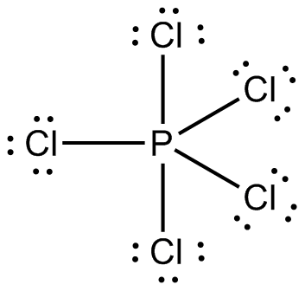
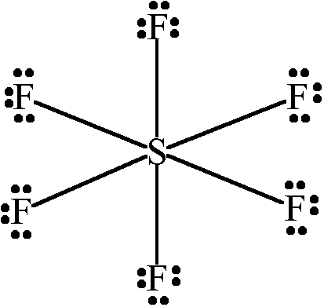
Octet Exceptions: Phosphorus and Sulfur
Phosphorus = 5 valence
CAN HAVE 5 bonds
Ex. PCl₅ or PO₄⁻³
Sulfur = 6 valence
CAN HAVE 6 bonds
Ex. SF₆ or SO₄⁻²
NOT TRUE FOR NITROGEN
OR OXYGEN

Slide 4
Resonance Structures
Resonance Structures – same compound, different bond combinations
Ex. SCN⁻¹, CO₃⁻², etc.
Show the combos. With two-sided arrow

Slide 5
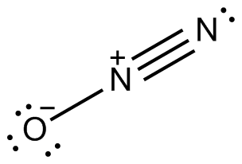
Partial Positives/Negatives
Ex. N₂O
To bond:
Nitrogen loses e- (+1)
Oxygen gains e- (-1)
Collectively: NEUTRAL
Ex. NO₃⁻¹, SO₃⁻²,

Slide 6
Steps when Bonding
1. Connect dots with single bonds first
2. Double/Triple bonds if necessary
3. Add electrons to outside atoms if necessary (- charge)
4. Take electrons away from central atom first (+ charge), THEN add e- to outside atoms

