Slide 1
Warm Up #12
Draw the following structures, labeling them with NAMES, SIGMA/PI BONDS and CHARGE (if necessary).
SCl₆
PO₄⁻³
CO₃⁻²
N₂O
The last three have at least 1 resonance structure. Show it next to your finished drawing with a

Slide 2
Bonding Structures
Chapter 8.4

Slide 3
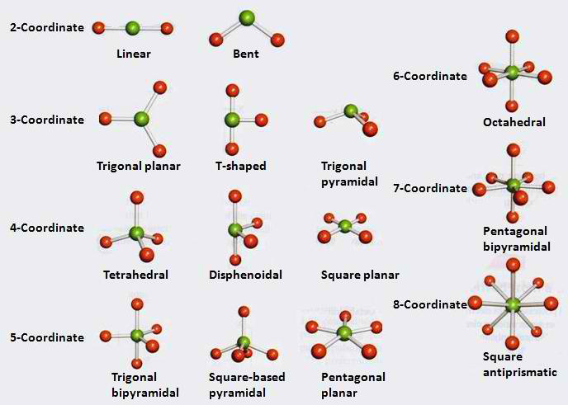
VSEPR Theory (“Vesper”)
VSEPR Theory – lone pairs and bonds stay as FAR APART AS POSSIBLE
Laws of attraction
Goals: Symmetry and separation

Slide 4
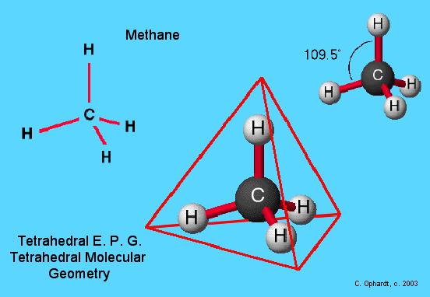
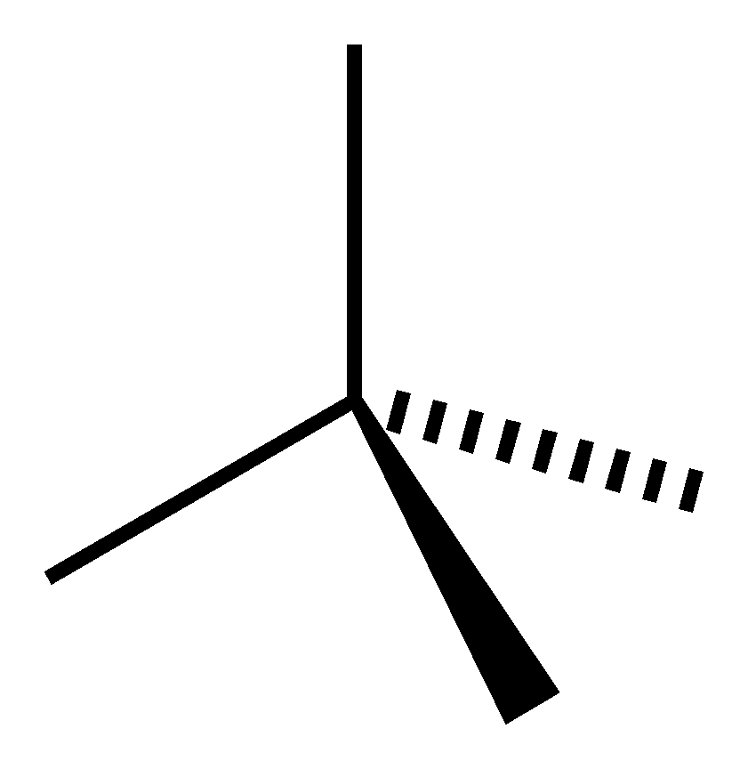
One Central, Four Outer
Tetrahedral – No lone pairs = symmetry
109.5º angles
Ex. CH₄
How to Draw:
Bond BEHIND
Bond OUTWARD

Slide 5
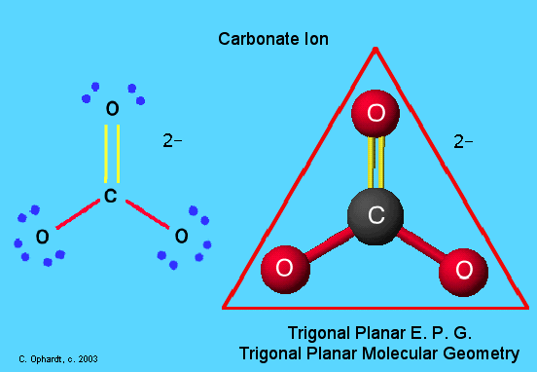
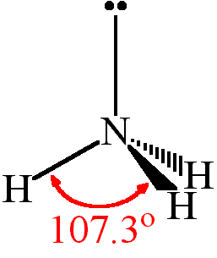
One Central, Three Outer
Trigonal Planar - No lone pairs = even symmetry
120º angles
BF₃, CO₃⁻²
Trigonal Pyramidal –Lone pair = repulsion DOWN
107º angles
NH₃

Slide 6
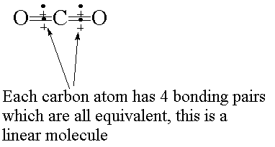
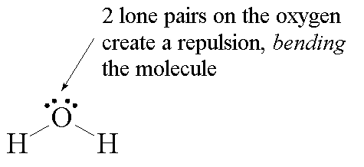
One Central, Two Outer
Linear – no lone pairs = even symmetry
180º angles
CO₂
Bent – two lone pairs = repulsion
105º angles
H₂O

Slide 7
Quick Quiz #6
Draw and name the correct structures for the following:
SO₂⁻²
PO₄⁻³
PCl₃

