Slide 1
Warm Up # 13
Draw and name the structures of the following:
Oxygen difluoride
Carbon tetraiodide
Carbonate ion
For each, include the:
Sigma and pi bonds
Resonance structures

Slide 2
Polar Bonds and Attractive Forces
Chapter 8.5

Slide 3
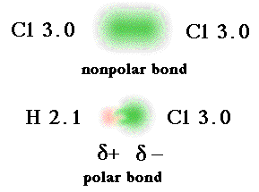
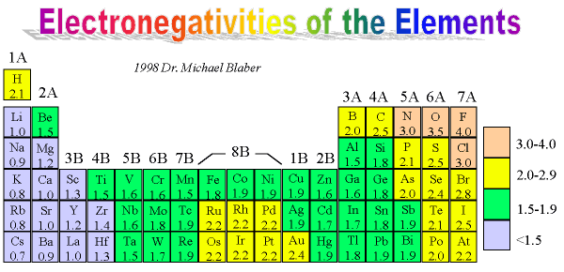
Covalent Bonding – e- sharing
Sharing = UNEQUAL (sometimes)
Nonpolar Bonds – equal sharing of e-
Polar Bonds – a covalent bond with unequal sharing
Polarity determined
by ELECTRONEGATIVITY

Slide 4
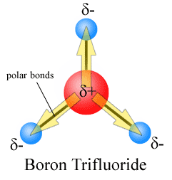
Electronegativity Revisited
Electronegativity – attraction to outside e-
If the two bonded atoms have an E.N.:
< 0.5 – non polar
0.5-2.0 – polar
>2.0 – ionic
If polar:

Slide 5
Three Major Bond Forces
Dispersion Forces – ALL bonds
Weakest bonds
Dipole Interactions – any polar bonds
Hydrogen Bonds – any polar bonds WITH HYDROGEN
Strongest bonds

Slide 6
Three Bond Forces
Are there bonds present?
YES…DISPERSION FORCES
Are your bonds polar?
YES…DIPOLE
NO…NOTHING ELSE
Do your polar bonds involve hydrogen?
YES…HYDROGEN BONDS
NO…NOTHING ELSE

Slide 7
Quick Quiz #
NH₃
CF₄
BeF₂
For the following
include the:
Structure
Name of structure
Bond angles
Number of sigma and pi bonds
Ionic, Polar or non-polar (show your work)
What forces are at work

