Slide 1
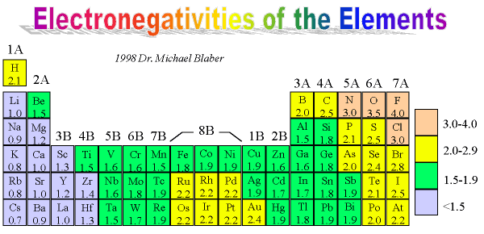
Warm Up #14
H₂S
PCl₃
HCN
For the following
include the:
Structure
Sigma/Pi
Ionic, Polar or non-polar (show your work)

Slide 2
Chapter 8 Review Slides

Slide 3
Ionic Bonding
Metal and Non-metal
Metal → donates valence e- (+ charge)
Left side of metalloid staircase
Non-Metal → receives valence e- (- charge)
In a chemical reaction…remember to FLIP THE CHARGES for subscripts

Slide 4
Ionic Bonding Naming
Metal – name stays same
TRANSITION metal – roman numeral (charge of metal)
Non-metal – name changes
By itself → ‘-ide’ ending
Polyatomic ion → ‘-ate’ ending

Slide 5
Covalent Bonding
Non-metal and Non-metal
SHARE electrons to satisfy octet rule
Single (1σ), Double (1σ, 1π), Triple (1σ, 2π) bonds
Diatomics – Never Have Fear Of Ice Cold Beer
Two of the same atom (N₂)

Slide 6
Covalent Bonding Naming
PREFIXES (mono-, di-, tri-, tetra-, penta-…)
If first non-metal has no subscript…NO PREFIX
Second non-metal…PREFIX ALWAYS

Slide 7
Steps when Bonding
1. Connect dots with single bonds first
2. Double/Triple bonds if necessary
3. Add electrons to outside atoms if necessary (- charge)
4. Take electrons away from central atom first (+ charge), THEN add e- to outside atoms

Slide 8
Other Covalent Stuff
Resonance Structures – same compound, different structure
ONLY if double/triple bonds are present
3-D Structures
Tetrahedral (4 outer atoms)
Trigonal Planar (3 outer atoms, 0 lone pairs)
Trigonal Pyramidal (3 outer atoms, 1 lone pair)
Linear (2 outer atoms, 0 lone pairs)
Bent (2 outer atoms, 2 lone pairs)

Slide 9
Three Bond Forces
Are there bonds present?
YES…DISPERSION FORCES
Are your bonds polar?
YES…DIPOLE
NO…NOTHING ELSE
Do your polar bonds involve hydrogen?
YES…HYDROGEN BONDS
NO…NOTHING ELSE

