Slide 1
Warm Up #7
Describe how tectonic plates are able to move, using the different layers of earth in your answer. Additionally explain the THREE ways they are able to move.
Using the information gathered yesterday, why can we say that while the Atlantic Ocean is expanding, the Pacific Ocean is shrinking?
Why would Southern California not break away from the rest of the continental US? Also, explain why volcanic eruptions would probably never happen in SoCal.

Slide 2
Earthquake Epicenters: An Investigation

Slide 3
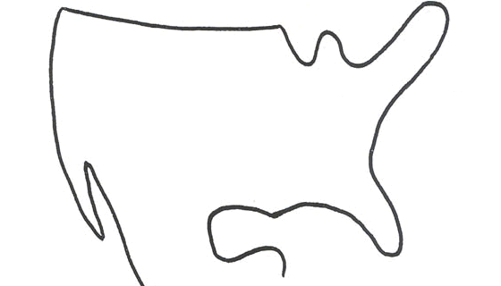
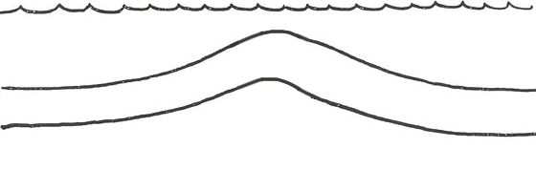
Tectonic Plate Review
Convergent Plate
Transform Plate
Divergent Plate

Slide 4
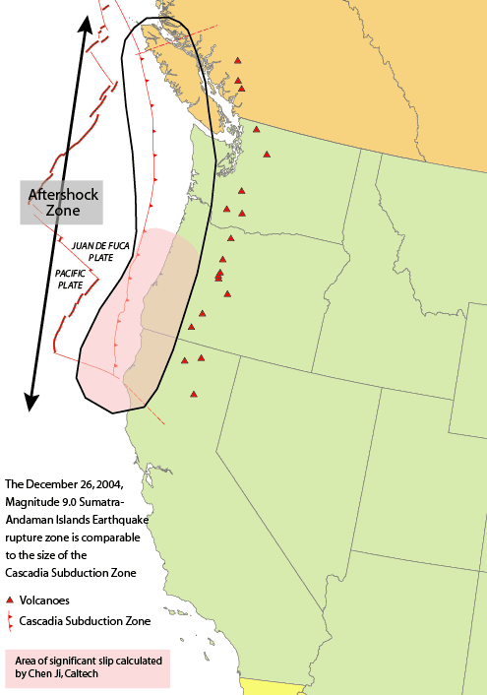
Hidden Tectonic Plates?
Farallon Plate – convergent plate COMPLETELY subducted under North American Plate
Explains Cascade and Rocky Mountain Ranges
Now deep below surface in Mantle

Slide 5
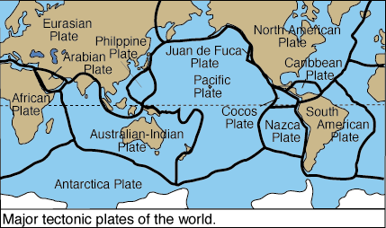
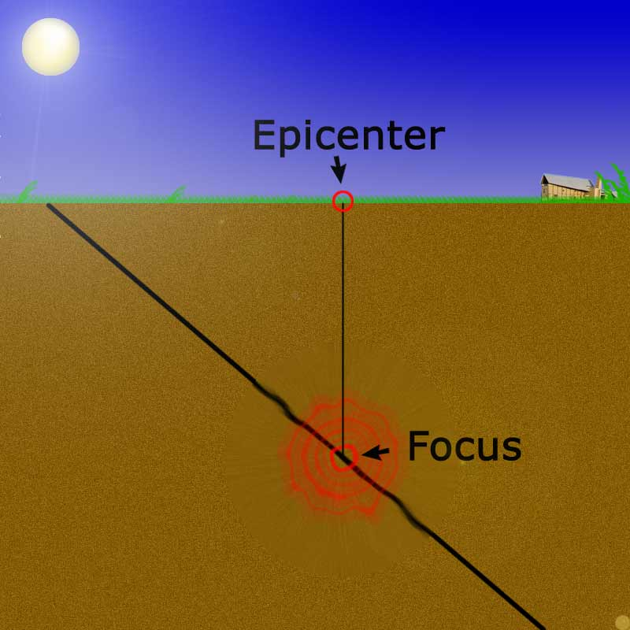
Earthquakes
Earthquake – abrupt movement of plates
release of energy (friction)
Focus = location of quake beneath surface
Epicenter = location ON Earth’s surface
Seismology – study of earthquakes

Slide 6
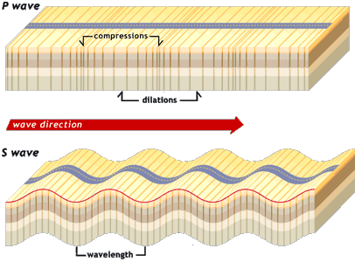
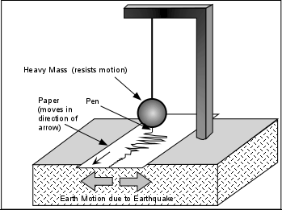
P and S Waves
P-Wave – primary wave, always felt first
S-Wave – secondary wave, always felt second
Wavy-looking
Difference in time between P and S wave = ∆T_{sp}

Slide 7
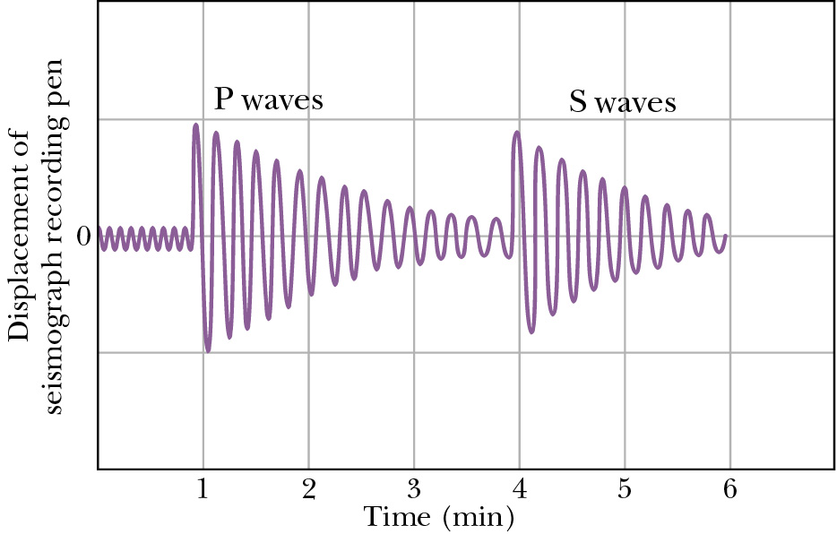
Seismogram Data
Seismogram – measures earthquake activity
1st waves = P
2nd waves = S
∆T_{sp} - time between P and S waves.
If ∆T_{sp} is small, CLOSER to the earthquake

Slide 8
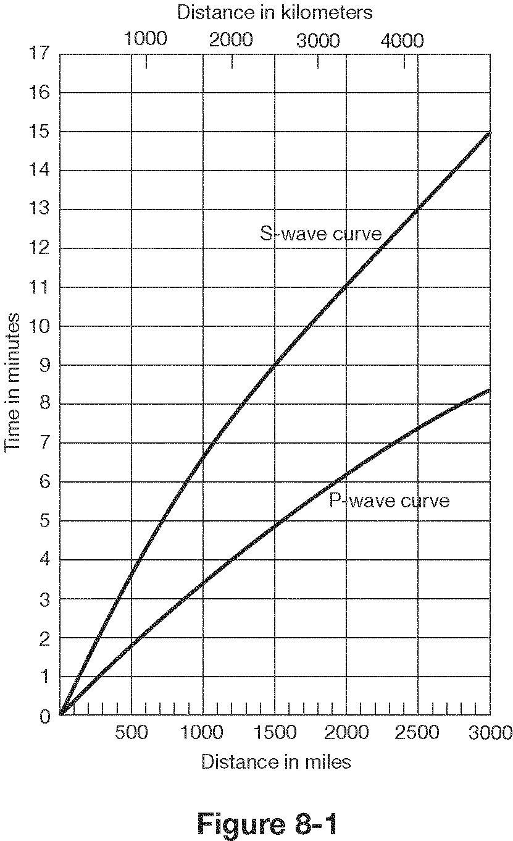
Epicenter Distance and ∆T_{sp}
∆T_{sp} – time between P and S waves.
Determines station’s distance FROM epicenter.
Line straight down to x-axis.
Distance = RADIUS of epicenter circles you will be drawing.
∆T_{sp}

Slide 9
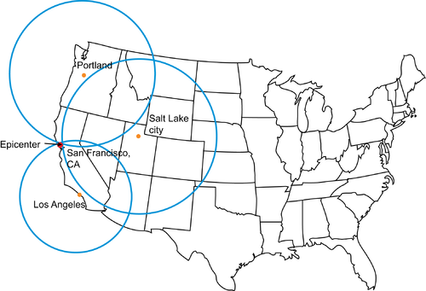
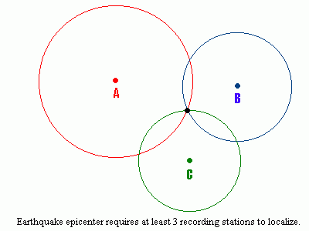
Drawing Epicenter Circles
∆T_{sp} distance = radius of circle from station
Use scale provided
Measured using ∆T_{sp} of at least 3 quake stations
Ensures accuracy of epicenter.
Epicenter – where all 3 circles touch (earthquake site)

Slide 10
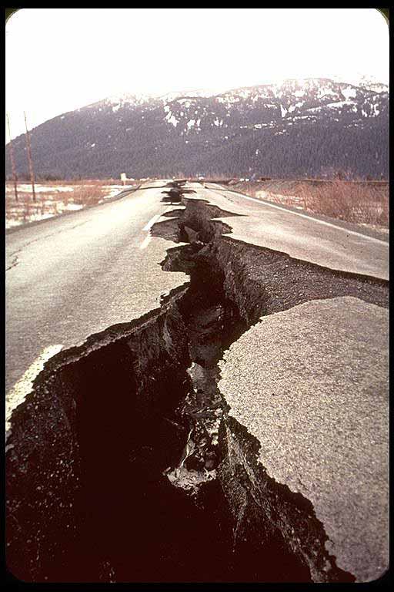
Why are Earthquakes Crazy
Amount of stored energy
Distance plate moves
How far below surface earthquake is (focus)
Makeup of rocks

Slide 11
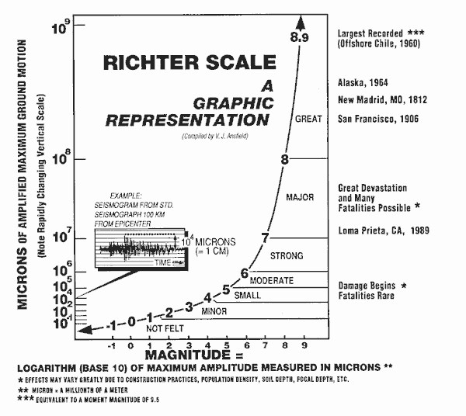
Measuring Earthquakes
Magnitude - amount of energy released from plate movement
Richter Scale – measurement of wave size (logarithmic – like pH)
1-10
Compare 5.0 and…
5.1 = 1.3x greater
5.5 = 5.5x greater
6.0 = 10x greater
7.0 = 100x greater
8.0 = 1000x greater

Slide 13
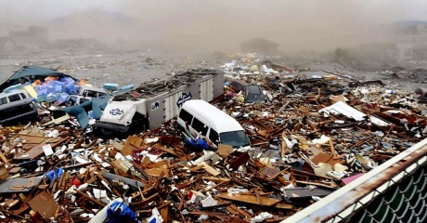
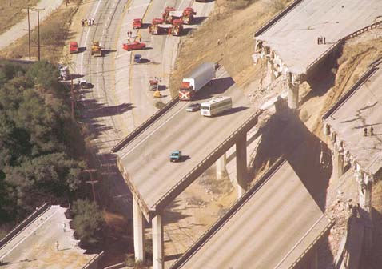
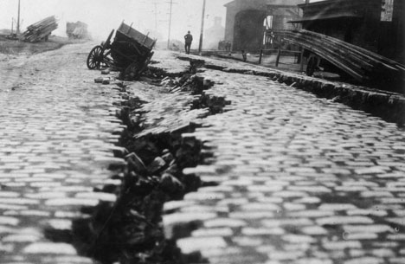
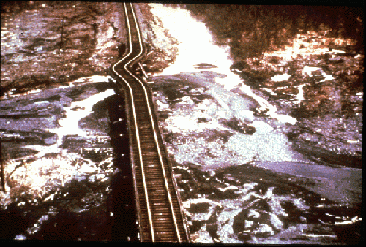
Richter Scale Examples
Japan – Magnitude 9.0 (2011)
Los Angeles – 6.7 Magnitude (1994)
San Francisco – Magnitude 7.9 (1906)
Alaska – Magnitude 8.5 (1964)

Slide 14
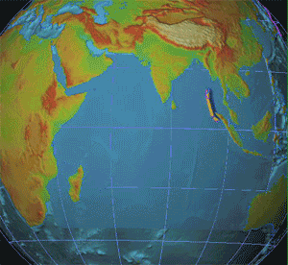
Sumatran Earthquake (Christmas, 2004)
Convergent, 9.2 Magnitude
Triggered MAJOR tsunamis in Pacific and Indian Oceans
100 foot waves
230,000 people killed
Entire PLANET vibrated
Pacific Ocean aftershocks

Slide 15
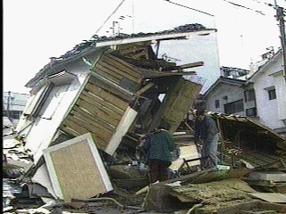
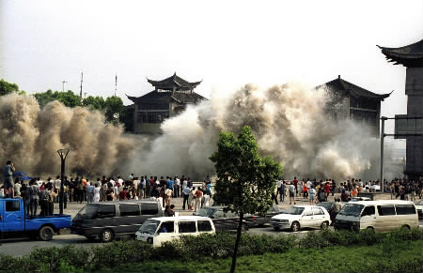
Effects of Earthquakes
Intensity – effect of earthquake on humans/environment
Primary Effects – building damage, loss of life
Secondary Effects – rock slides, flooding, tsunamis
Reducing damage – emergency response, mapping fault lines, strong buildings

Slide 16
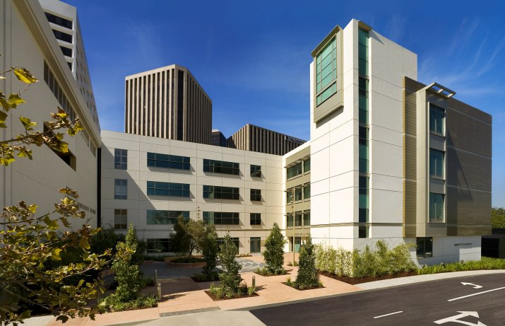
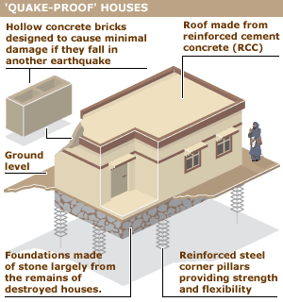
Beverly Hills Science Building

Slide 17
Quick Quiz #3
Looking at a seismogram, how could you determine how far away you are from an Earthquake’s epicenter?
Why, in determining an earthquake’s epicenter, do you need the information from at least THREE different earthquake stations?
What kinds of things influence an Earthquake’s magnitude?

Slide 18
Warm Up #6
What is the difference between an earthquake’s epicenter and its focus?
How does a seismogram’s ∆T_{sp} relate to your distance from the quake?
How does an Earthquake with a magnitude of 5.0 differ in strength from a 6.0 quake?

Slide 19
Post-Activity Questions [answer on Data Table page]
What city was the closest to the Earthquake’s epicenter?
How do you know this location is closest to the epicenter?
Looking at the locations of the last three cities (Bogota, Jamestown and State College), which city was closest to the quake? What allows you to figure out the distance between the city and the quake?
Why do the resulting distances of the three cities make sense in respect to the Earthquake’s location?

Slide 20
Warm Up # 7
Why do you use three circles in order to find an earthquake’s epicenter?
What city ended up being closest to the earthquake’s epicenter in your activity?
How do we access the minerals underneath Earth’s surface? Why can this be environmentally harmful?

