Slide 1
Warm Up #4
The atmosphere is one important carbon reservoir.
(i) Describe a biological process by which carbon is removed from the atmosphere and converted to organic molecules.
(ii) Describe a biological process by which carbon is converted from organic molecules to a gas and returned to the atmosphere.
Oceans and terrestrial systems are also important carbon reservoirs.
(i) Explain how atmospheric carbon is incorporated into two oceanic sinks.
(ii) Identify one terrestrial sink, other than fossil fuels, that stores carbon for thousands to millions of years.
Nitrogen is another element important to all organisms:
(i) Identify one reason why nitrogen is needed in all organisms.
(ii) Identify and describe TWO steps in the Nitrogen cycle.

Slide 2
Farming and GMOs

Slide 3
Green Revolution
Green Revolution – hybrid species of grains
Goal: more crop yields
Expensive – poor farmers can’t afford hybrid seeds
Hunger crisis solved?

Slide 4
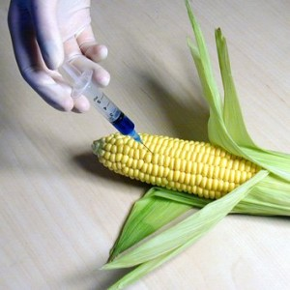
Mutant Fruit!
Genetically Modified Organisms (GMO’s) – food with changed DNA
Improves crop yields
Disease, drought, etc.
Pest-repellant
No pesticides needed
Enriched with vitamins & minerals
Nutritious
Oral vaccines
Developing countries

Slide 5
Creating the Mutants
Common Gene Mutations
Bt gene = insect killing gene
HT gene = herbicide (Roundup) tolerant gene

Slide 6
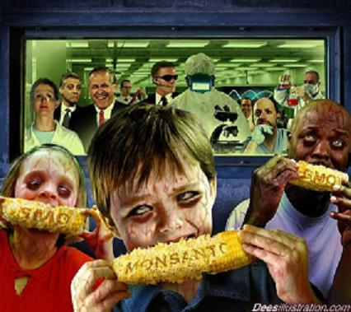
Safe? [Franken-foods]
New pests = possible
Expensive
Biodiversity Threatened
Bred vs. wild salmon
Possible health effects
Livestock deaths from eating GM foods.
Cancer?

Slide 7
Staple Carb. Crops
Rice
Wheat
Corn
Soybeans
Potatoes

Slide 8
High Fructose Corn Syrup (HFCS)
Corn-based sugar
natural
Found in:
Sodas and Juices
Candy and Fast Food
Same nutrition as sugar
Surplus of corn = HFCS
Obesity & diabetes connection
Obviously….

Slide 9
How Seafood is “Farmed”
Aquaculture – growing aquatic species in pens
Disrupts food chain, contaminates water (fish waste)
Herbivorous fish = good (China’s rice paddies)

Slide 10
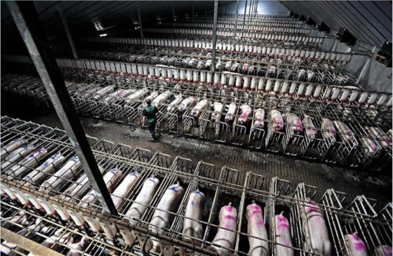
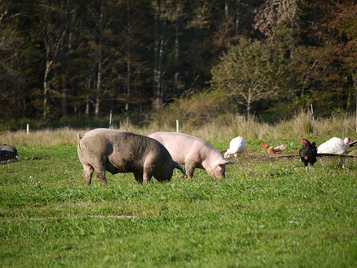
Meat…a symbol of Wealth
Meat = expensive to produce
Cows, chickens, pigs need a lot of GRAINS
CAFO (confined animal feeding operation) – animals housed/fed (soy and corn)
Antibiotics in food

Slide 11
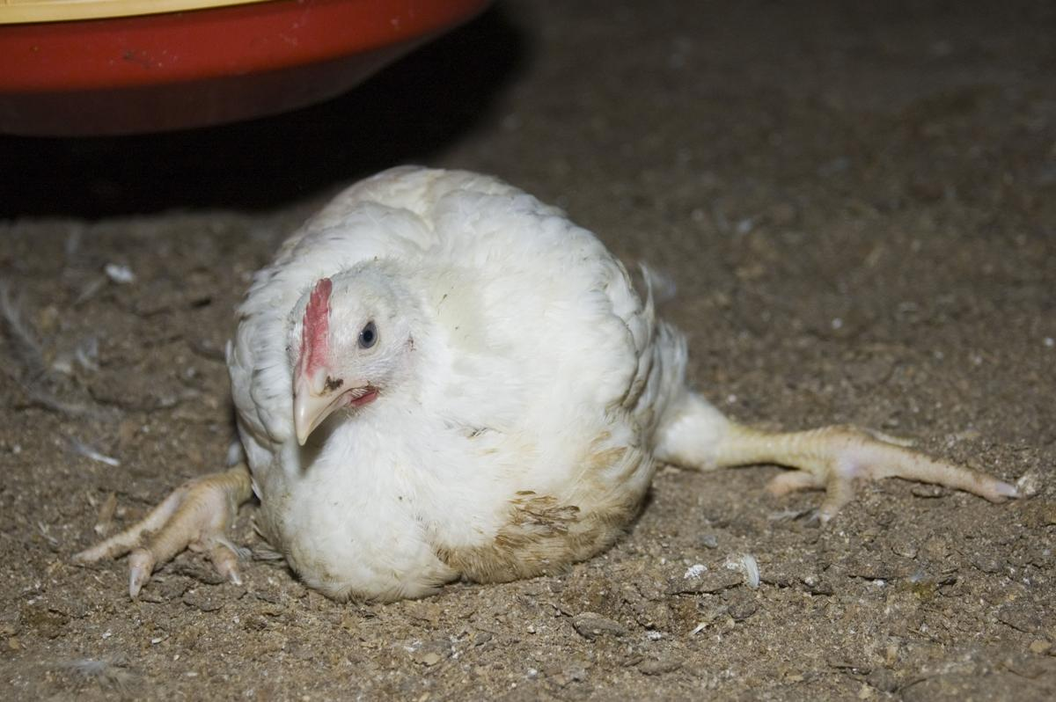
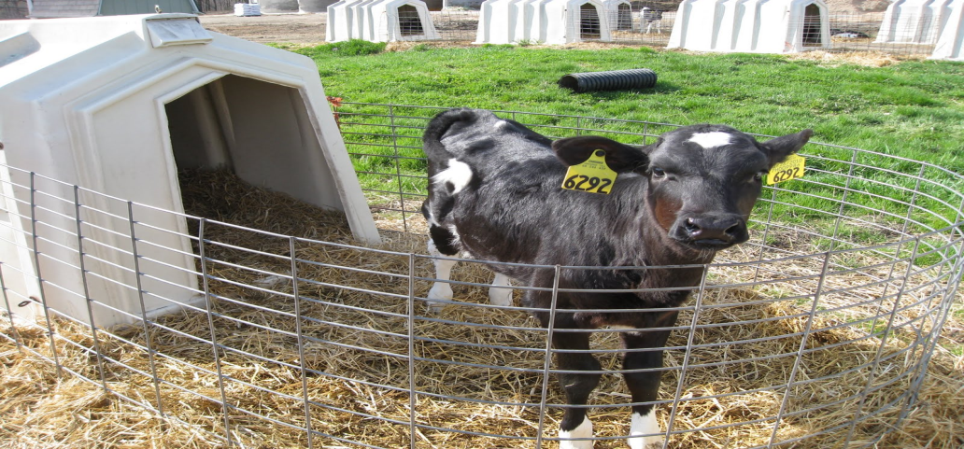
Where Things Get Real
Cut meat eating by 20% = MORE energy saved than EVERYONE driving Prius
Chicken “housing”
Too fat to move (KFC)
Foie Gras (Goose Liver)
A disease, not a delicacy
Cow calf housing = hutches
Less movement = more tender veal
Animal Cruelty? Uh, yeah…

Slide 12
Uplifting Videos:
Meat.org
Kentucky Fried Cruelty
http://www.youtube.com/watch?v=sARewW_Po64&feature=related
Foie Gras: A Disease not a Delicacy
http://www.youtube.com/watch?v=32815SIgq1A
Super Cows
http://www.youtube.com/watch?v=Nmkj5gq1cQU&feature=fvwp&NR=1

